Slide 1
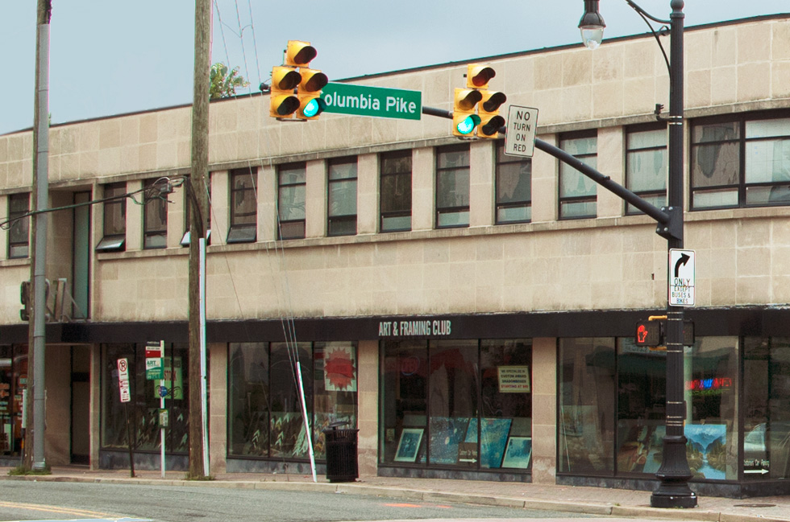
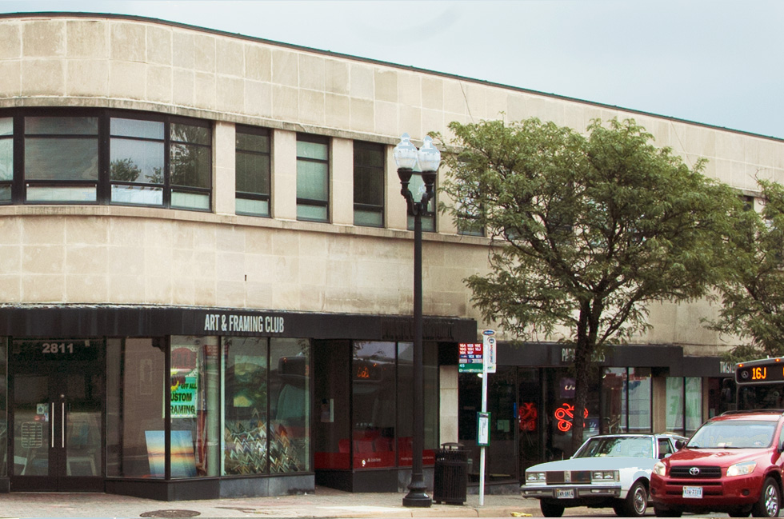
Elkins Building 2801 Columbia Pike
Historic Affairs and Landmark Review Board
Design Review Committee
December 7, 2022

Slide 2
Site Information
Northeast quadrant of the intersection of Columbia Pike and S Walter Reed Drive
Site Area: Approx. 19,049 square feet
Existing: 2-story office building
Columbia Pike Form Based Code
Town Center Node
Main Street Building Envelope Standards
Historic Resources Inventory – Phase I
Important (Top Third)
Façade Preservation

Slide 3
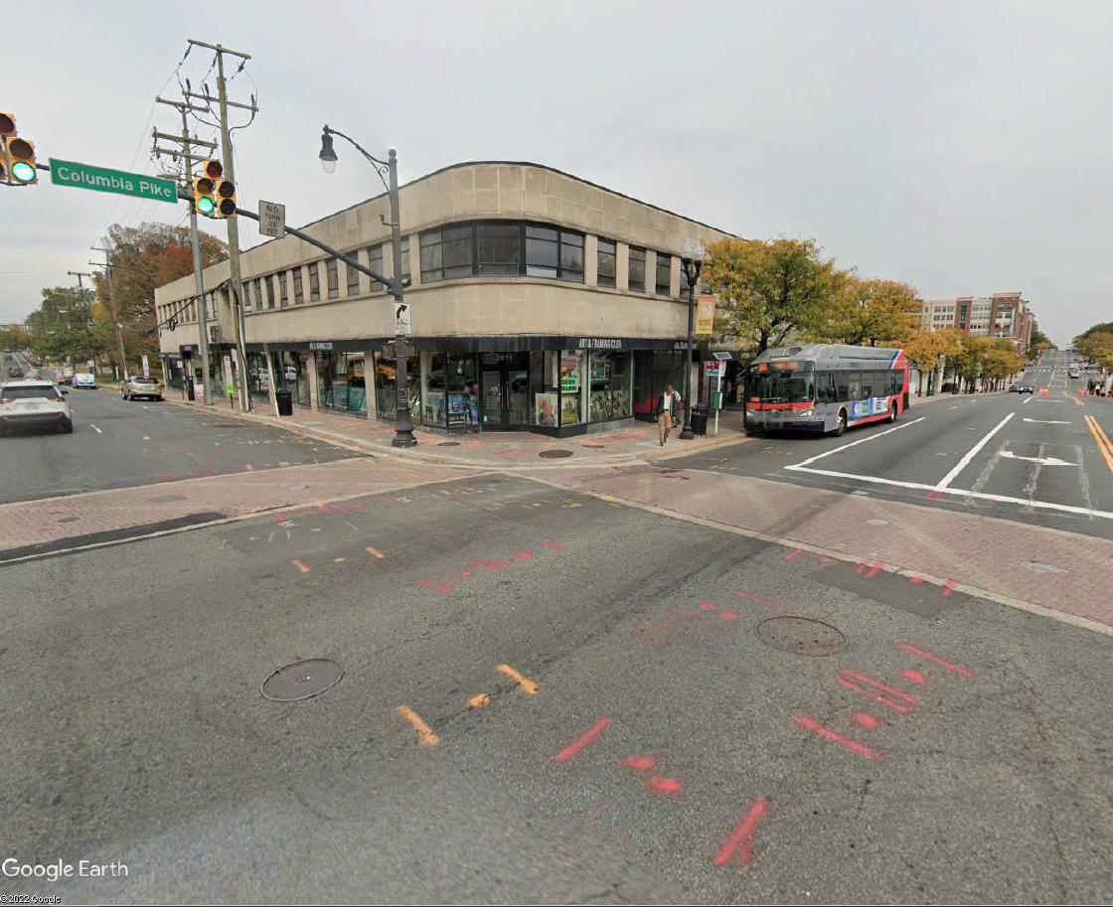

Slide 4
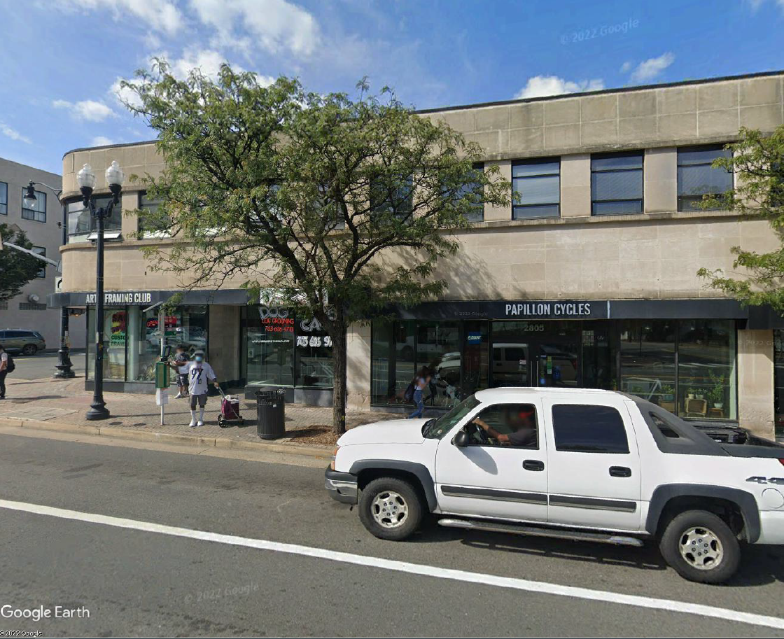

Slide 5
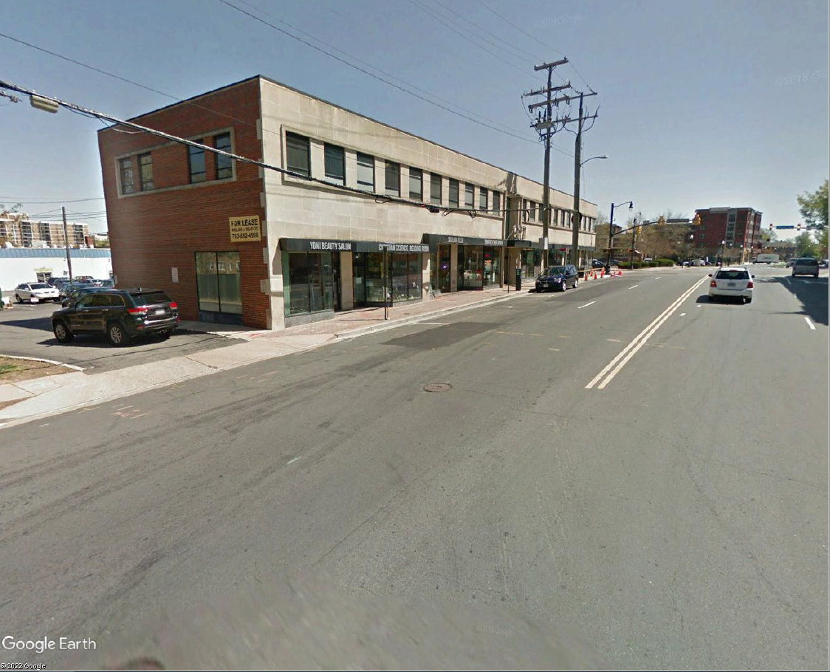

Slide 6
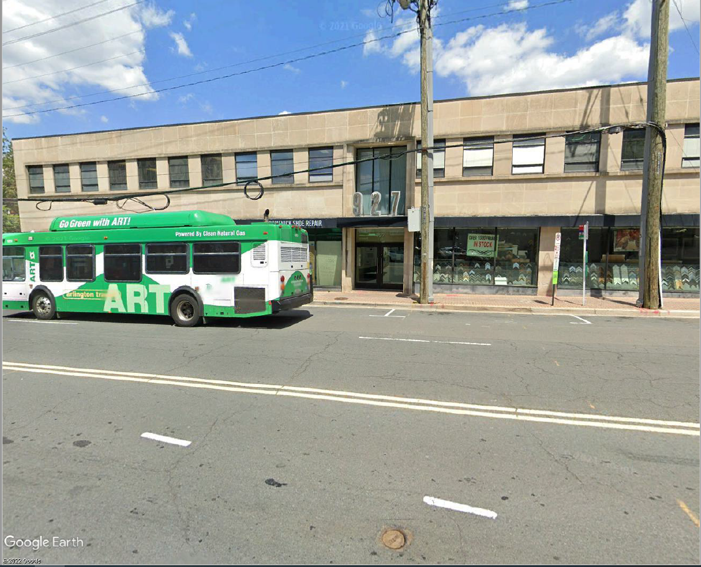

Slide 7
Design Considerations
Preserve historic façade
Accommodate transit improvements on Columbia Pike
Accommodate transit and street changes on S Walter Reed Drive
Address Form Based Code requirements

Slide 8
Proposed Design
Columbia Pike
Preserve building façade
Accommodate bus shelter and transit platform
Move façade 3 feet horizontally
Move façade 6 inches vertically
3-foot stepback of Floors 3-7
S Walter Reed Drive
Shorten and preserve building façade
Accommodate road changes and transit improvements
4-foot stepback of Floors 3-7

Slide 9
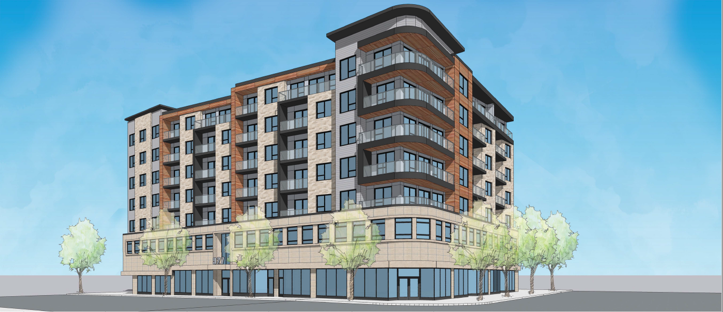
April DRC Meeting

Slide 10
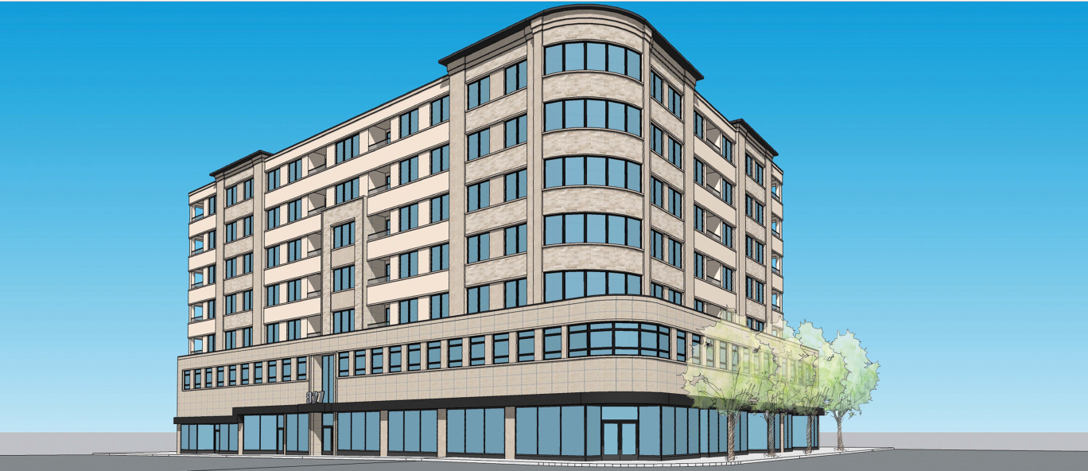
May DRC Meeting

Slide 11
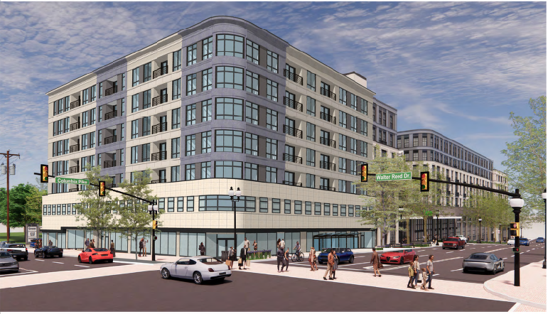
Updated Design

Slide 12
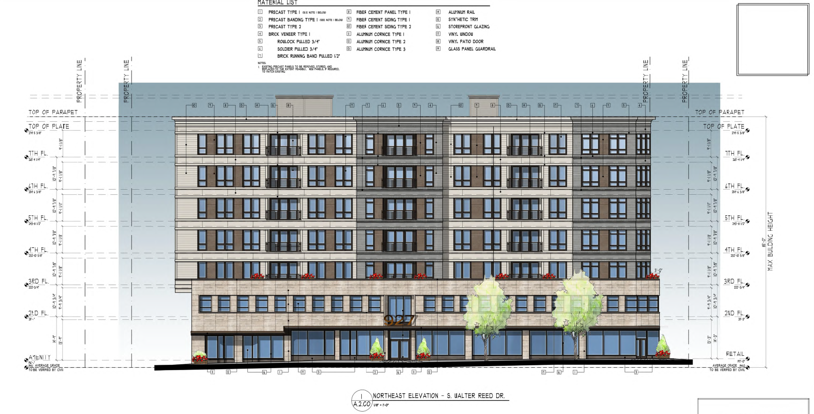

Slide 13
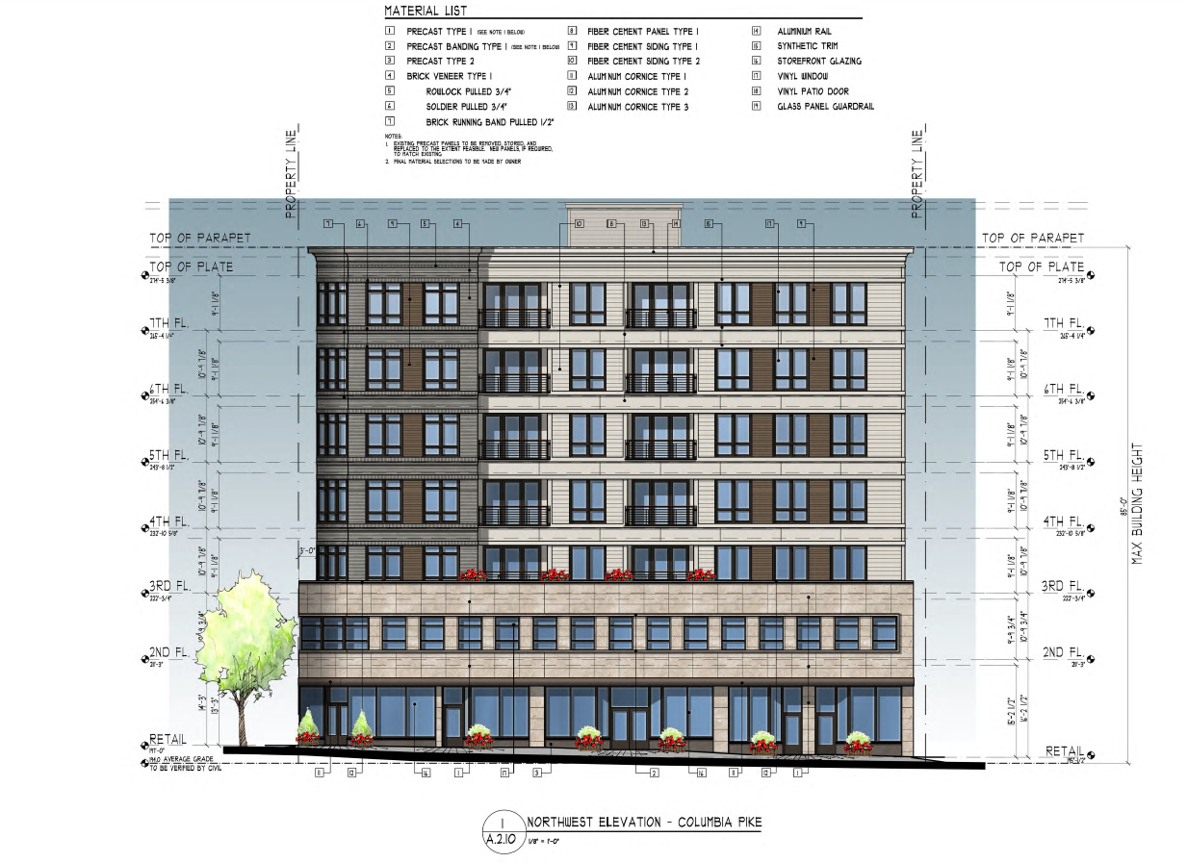

Slide 14
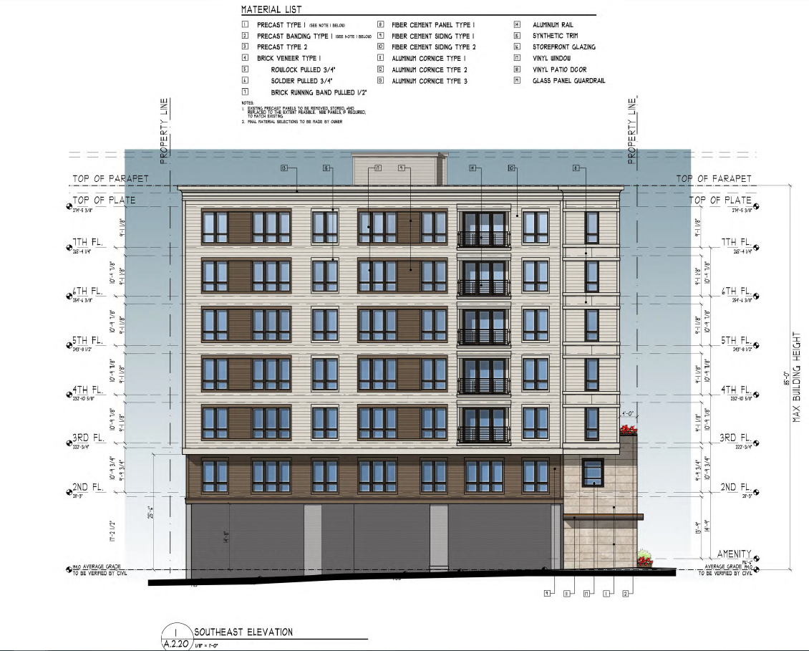

Slide 15
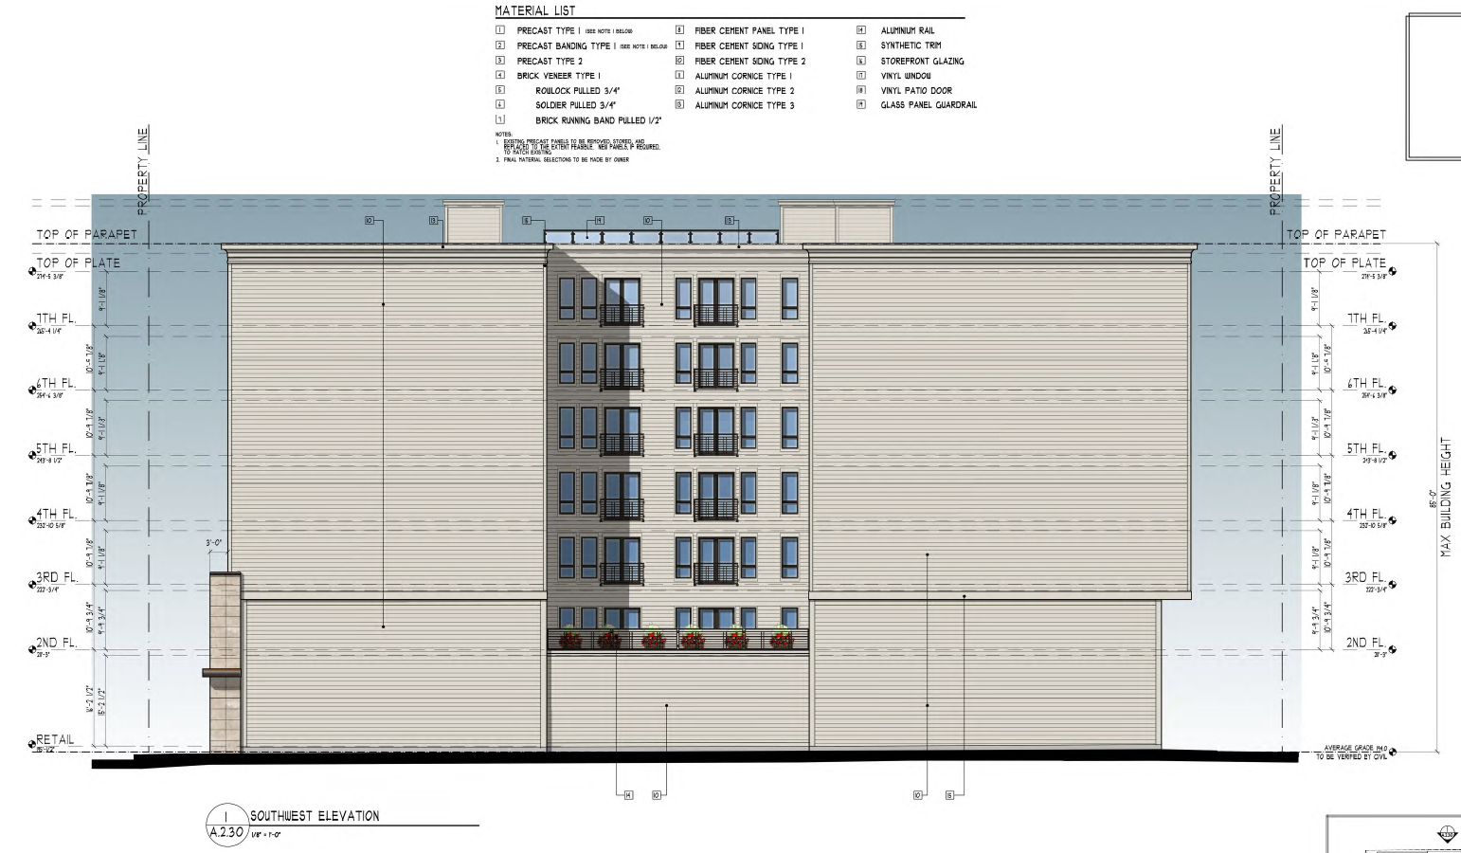

Slide 16
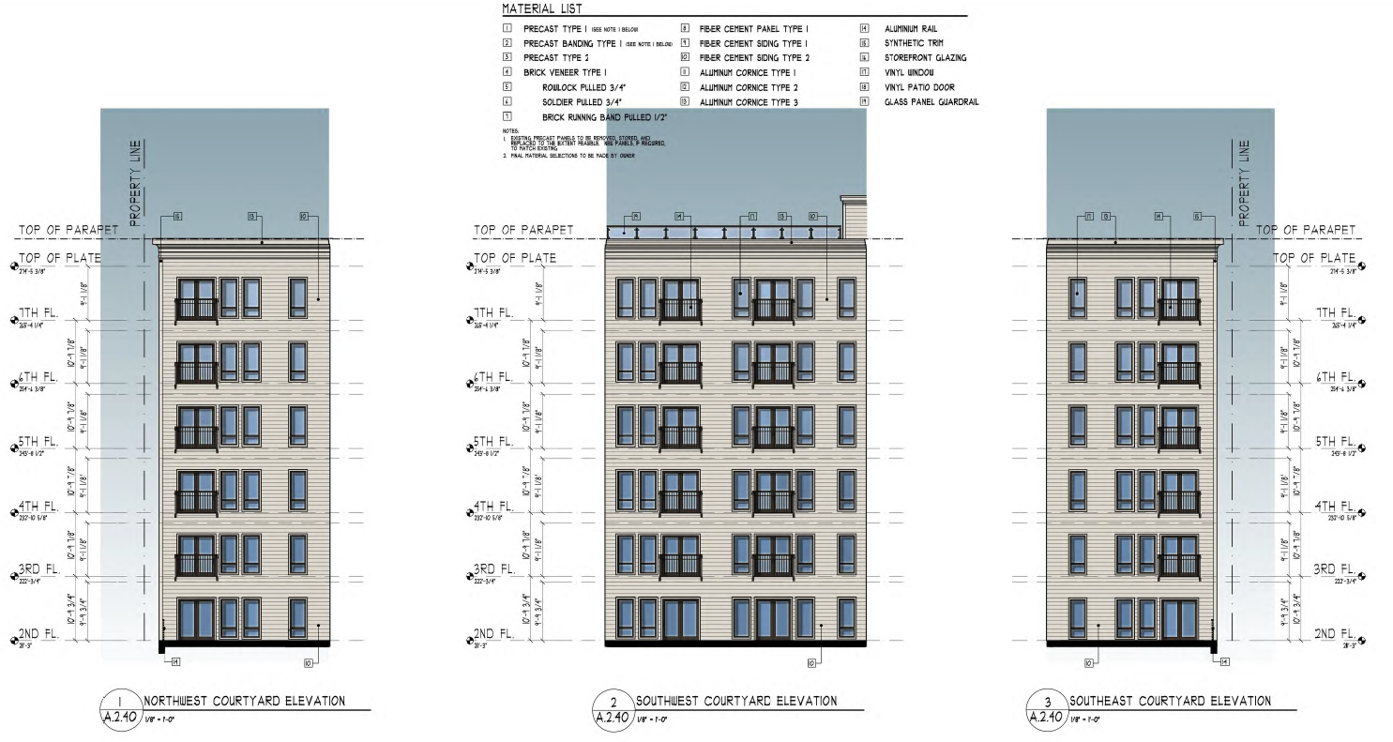

Slide 17
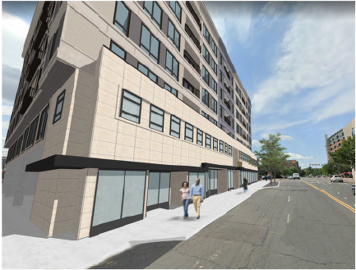
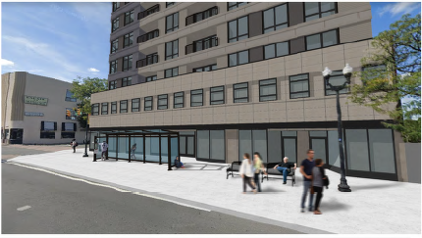
From South Walter Reed Drive Facing Columbia Pike
Columbia Pike Frontage

