Slide 1
HMIS Agency Admin
Training Guidebook
Arlington County Government
Revised June 2022

Slide 2
Table of Contents
Validation Report
HUD/State/Local Reports
Data Pull
Generate
Export
Custom Reports
Export
Manage Staff Account
Create New Staff Account
Disable Staff Account
Bed List
Create New Unit/Bed
Manage

Slide 3
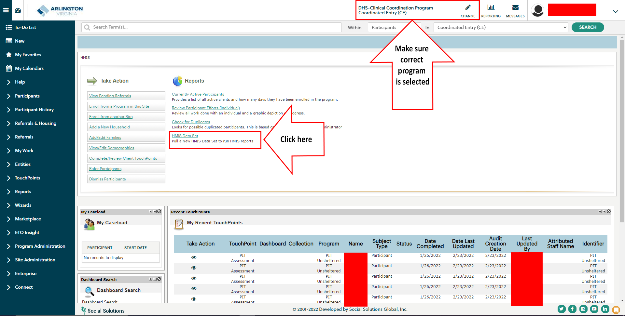
Validation Report

Slide 4
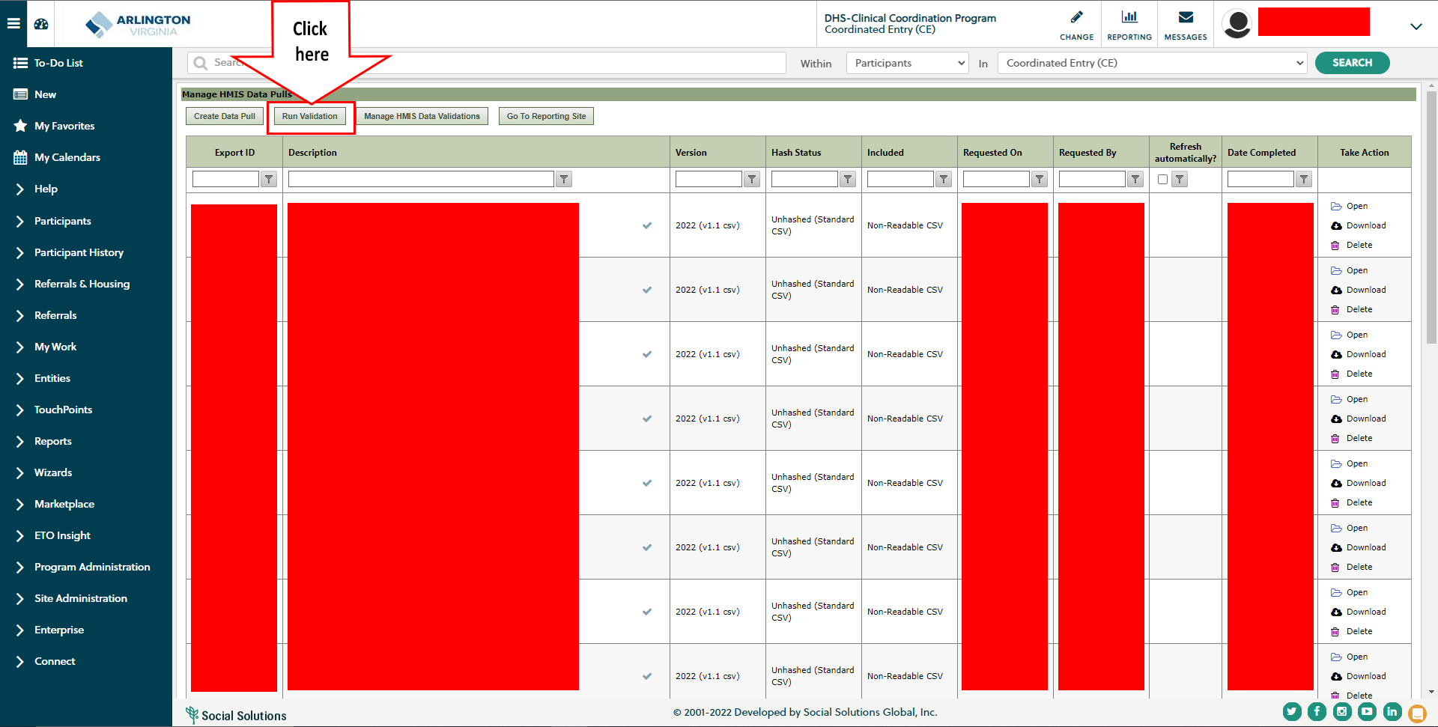
Validation Report

Slide 5
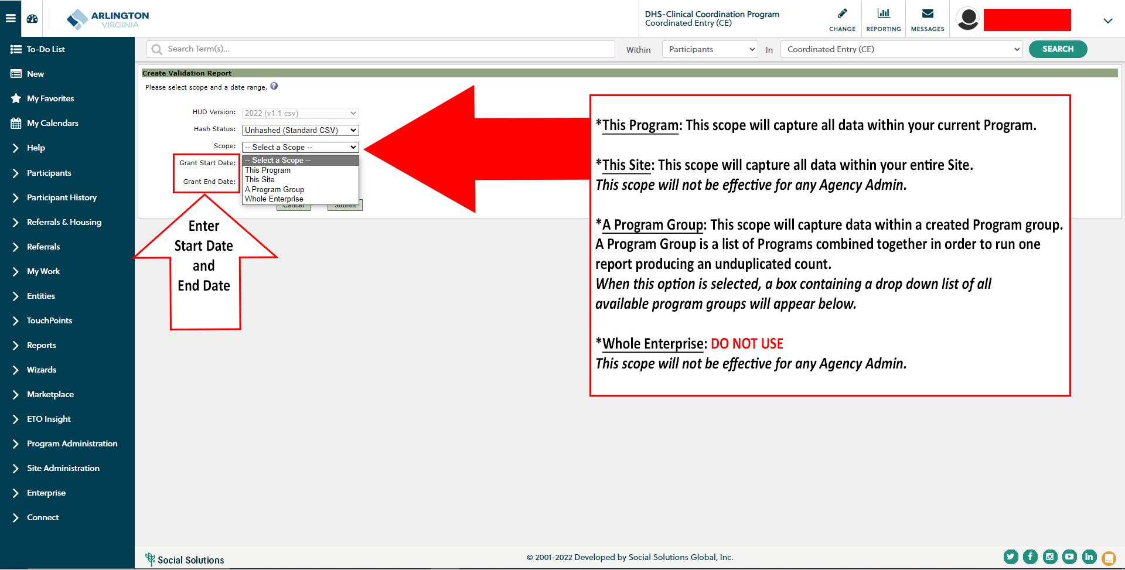
Validation Report

Slide 6
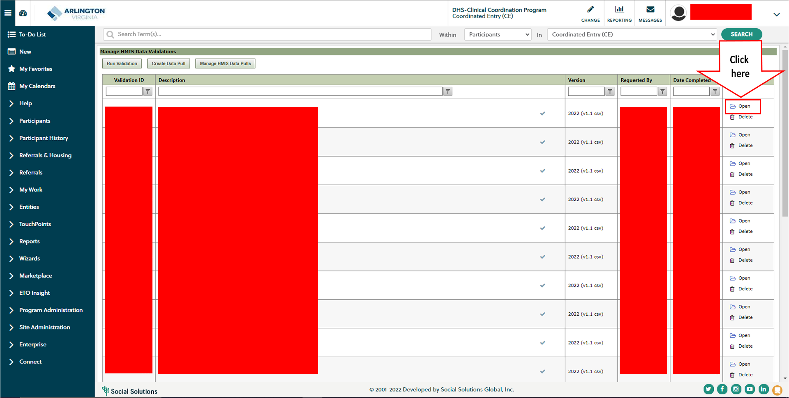
Validation Report

Slide 7
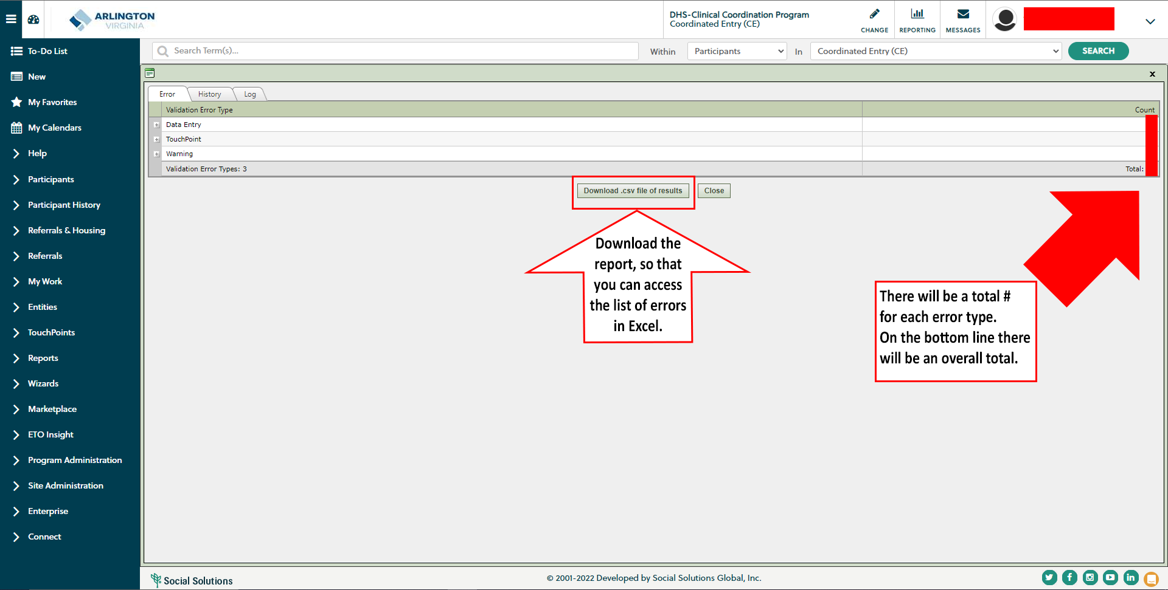
Validation Report

Slide 8
HUD/State/Local Reports: Data Pull

Slide 9
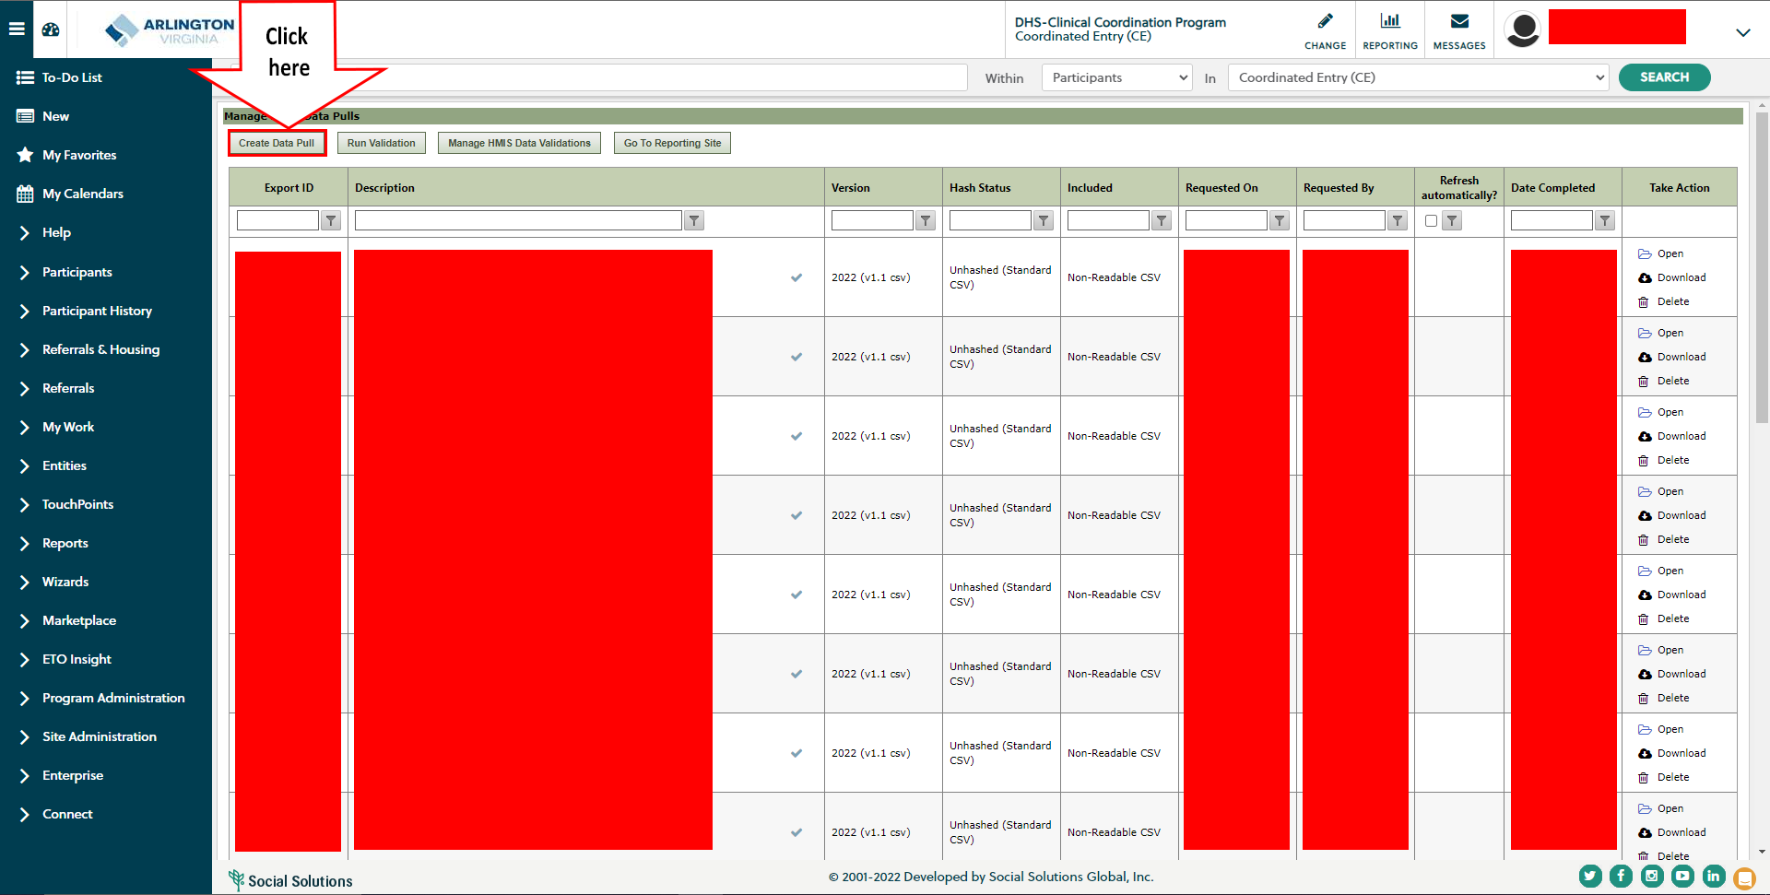
HUD/State/Local Reports: Data Pull

Slide 10
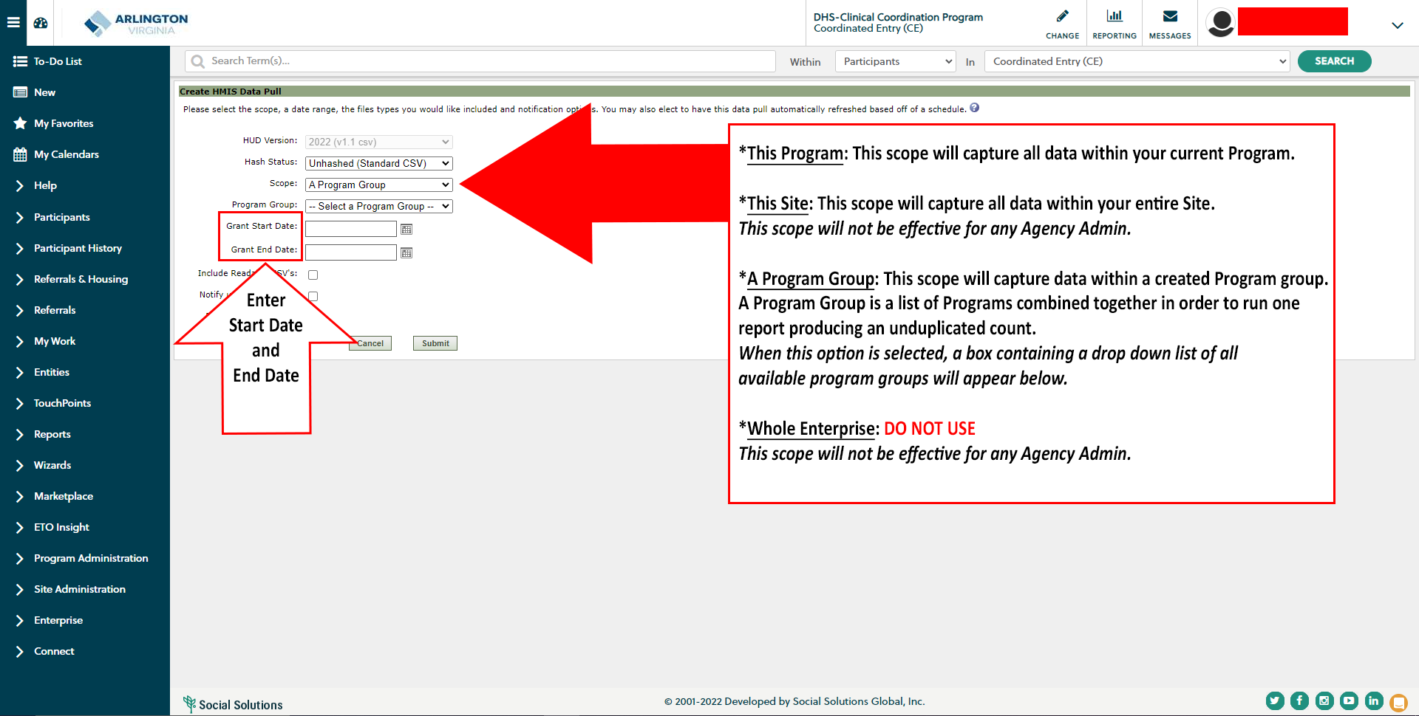
HUD/State/Local Reports: Data Pull

Slide 11
HUD/State/Local Reports: Generate

Slide 12
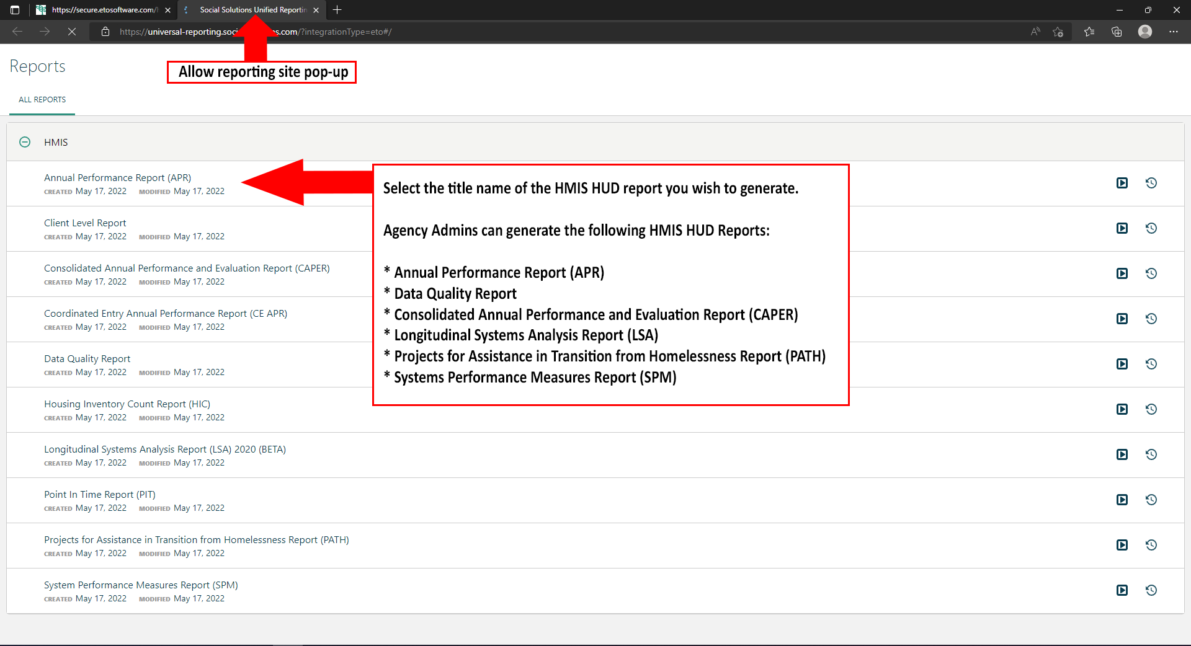
HUD/State/Local Reports: Generate

Slide 13
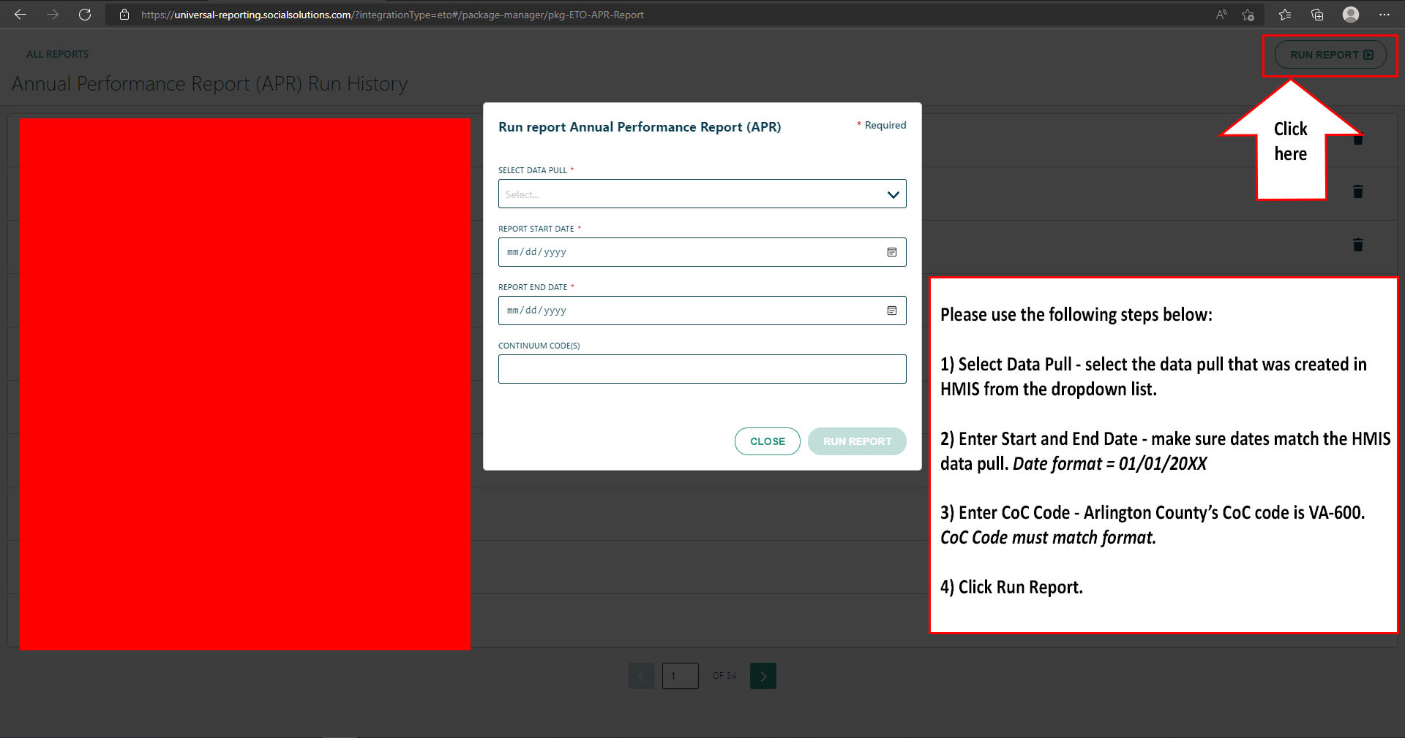
HUD/State/Local Reports: Generate

Slide 14
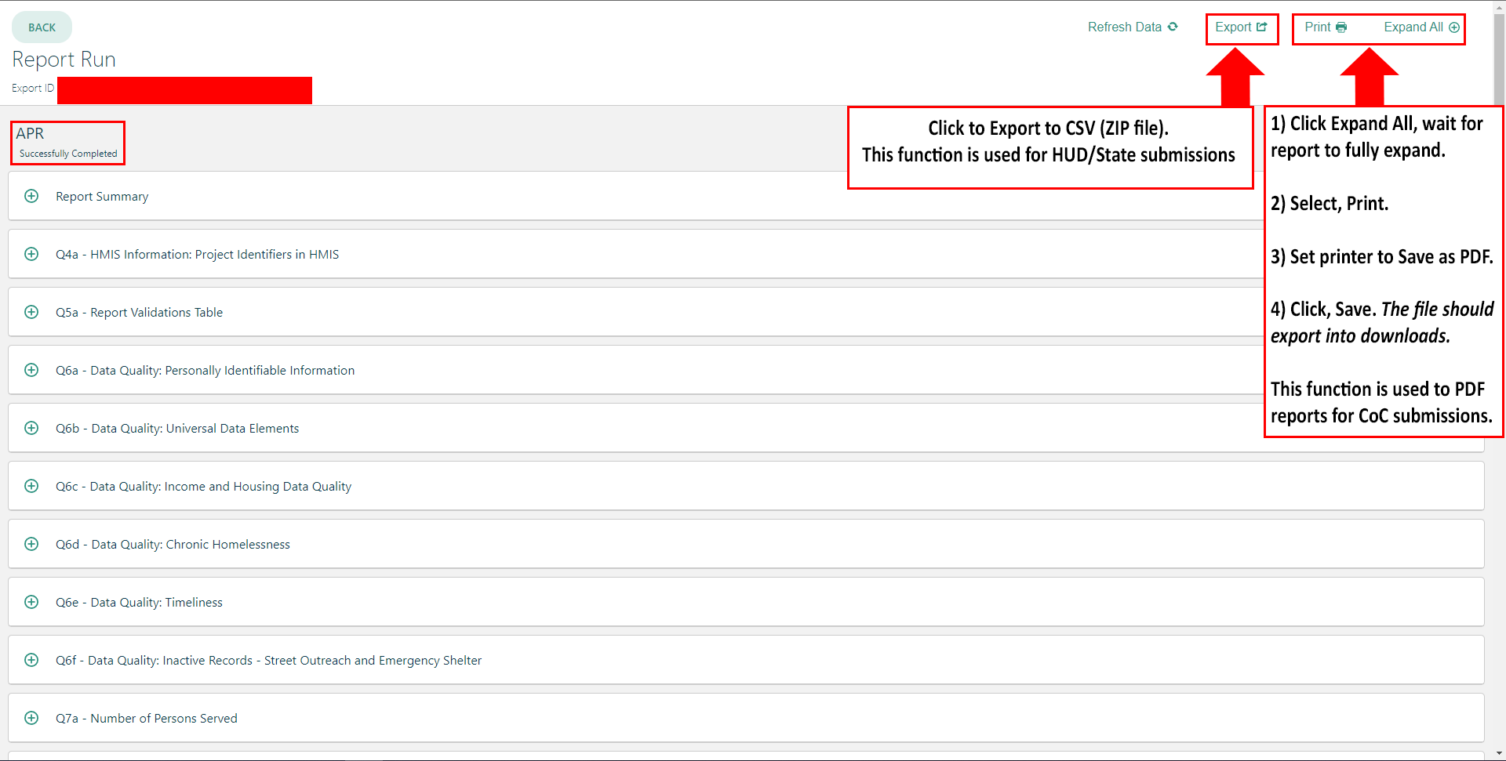
HUD/State/Local Reports: Export

Slide 15
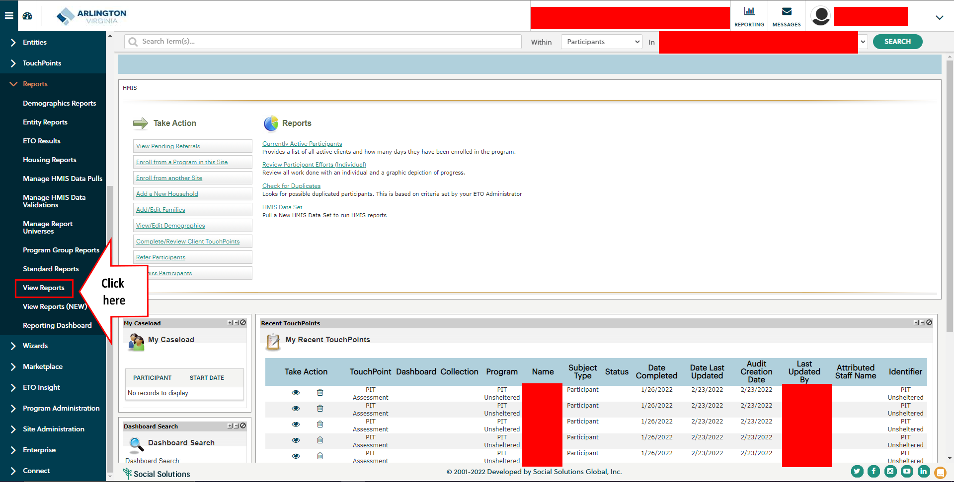
Custom Reports

Slide 16
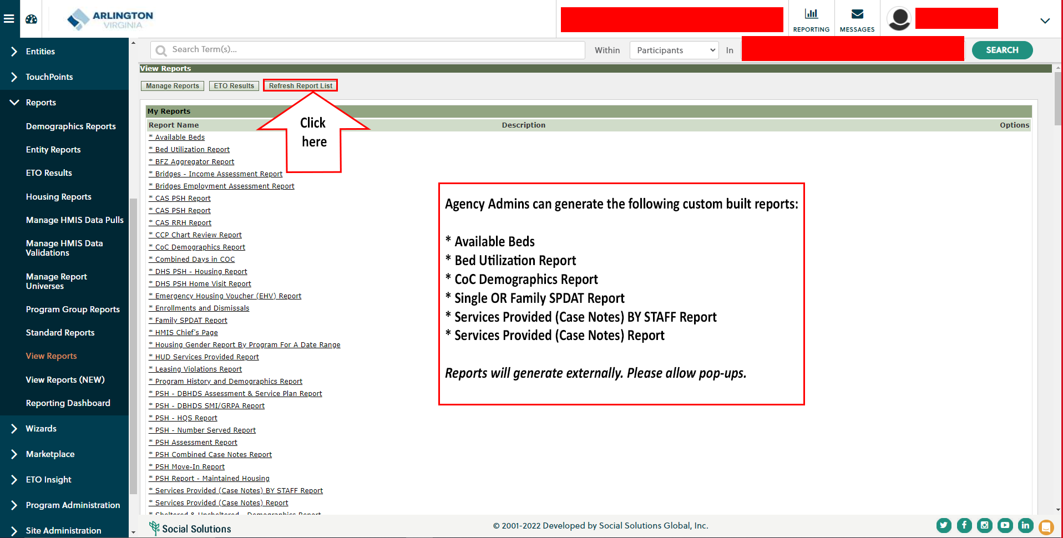
Custom Reports

Slide 17
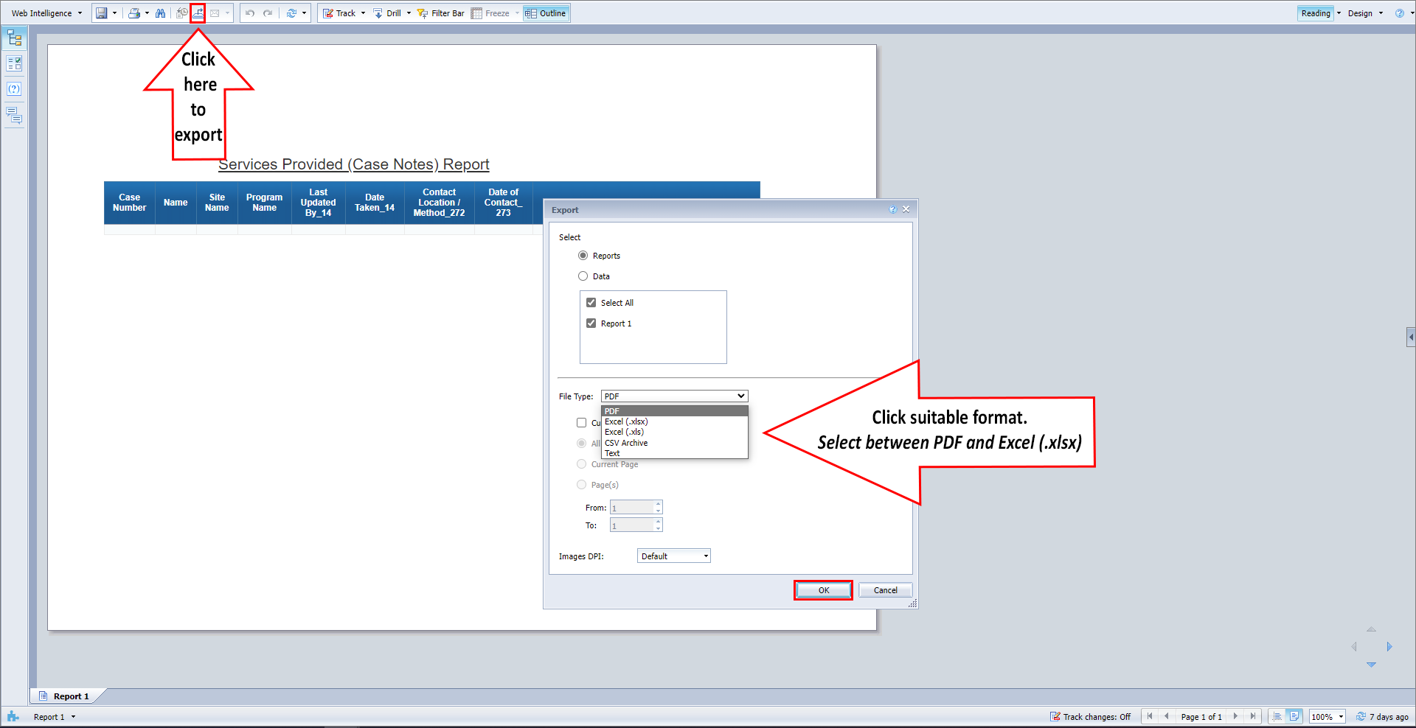
Custom Reports: Export

Slide 18
Manage Staff Accounts: Create New Staff Account

Slide 19
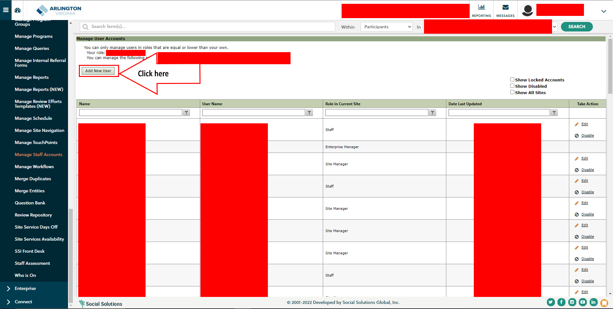
Manage Staff Accounts: Create New Staff Account

Slide 20
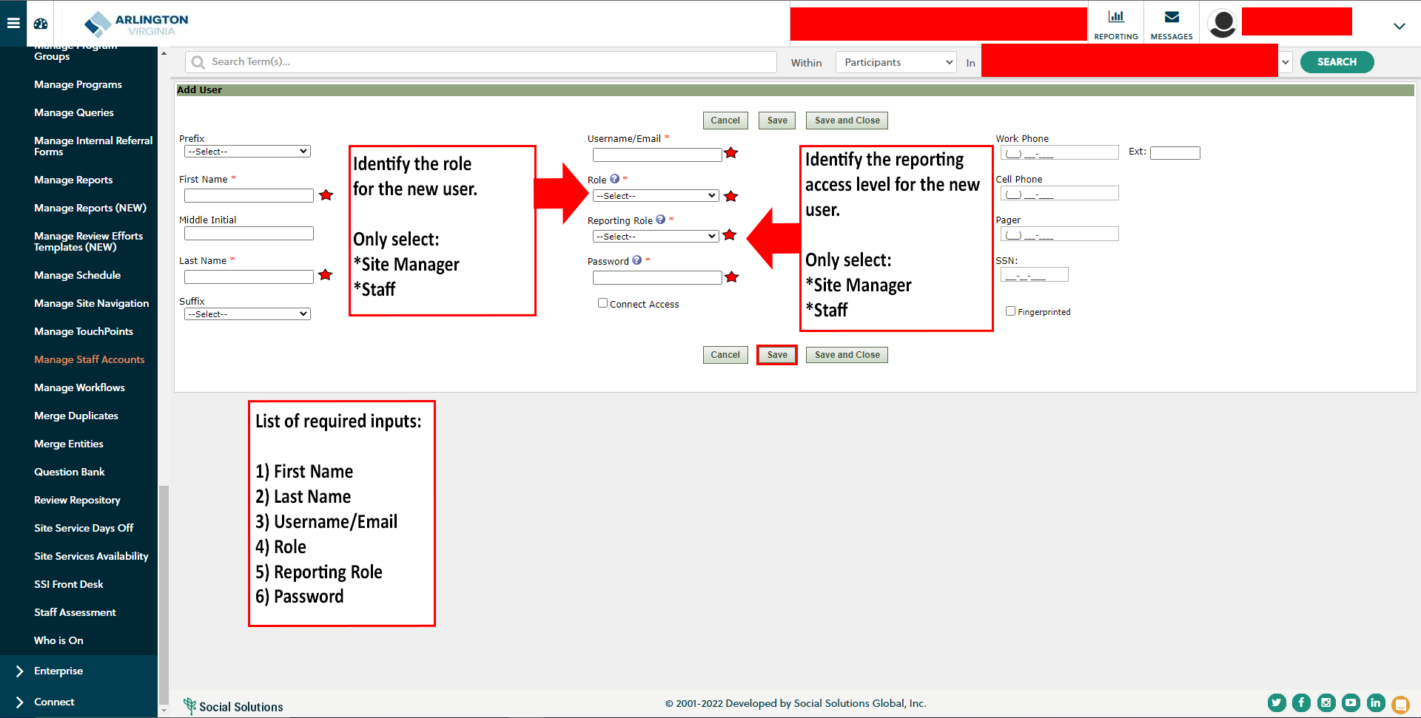
Manage Staff Accounts: Create New Staff Account

Slide 21
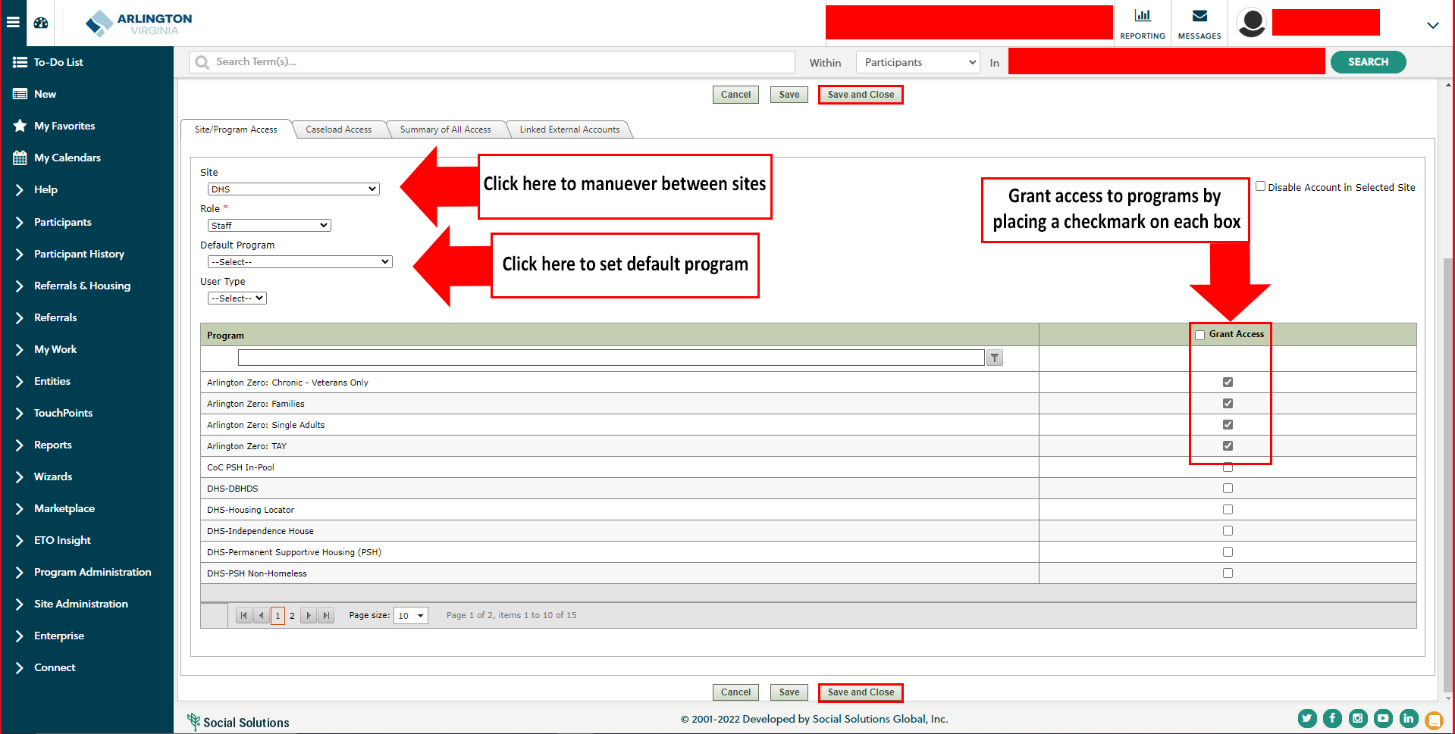
Manage Staff Accounts: Create New Staff Account

Slide 22
Manage Staff Accounts: Disable Staff Account

Slide 23
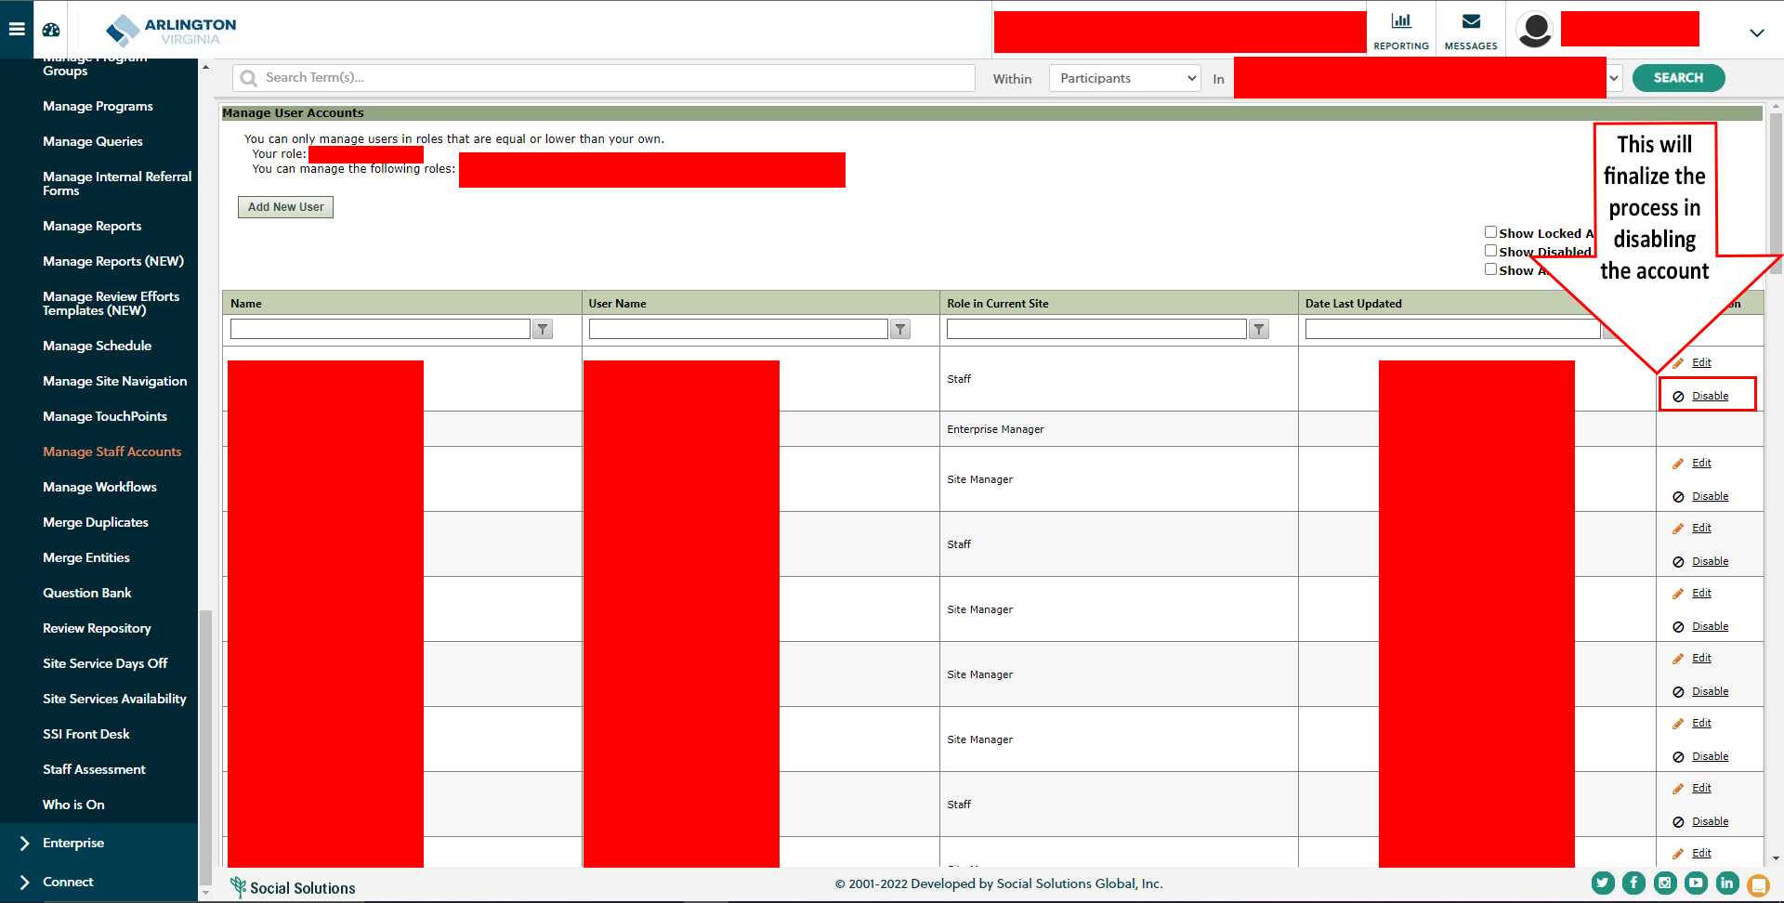
Manage Staff Accounts: Disable Staff Account

Slide 24
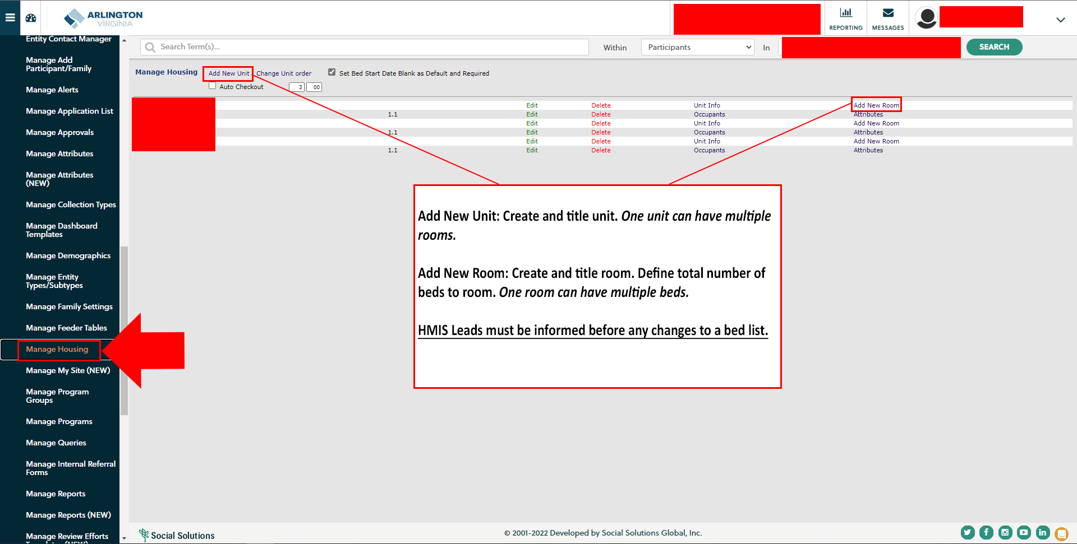
Bed List: Create New Unit/Room

Slide 25
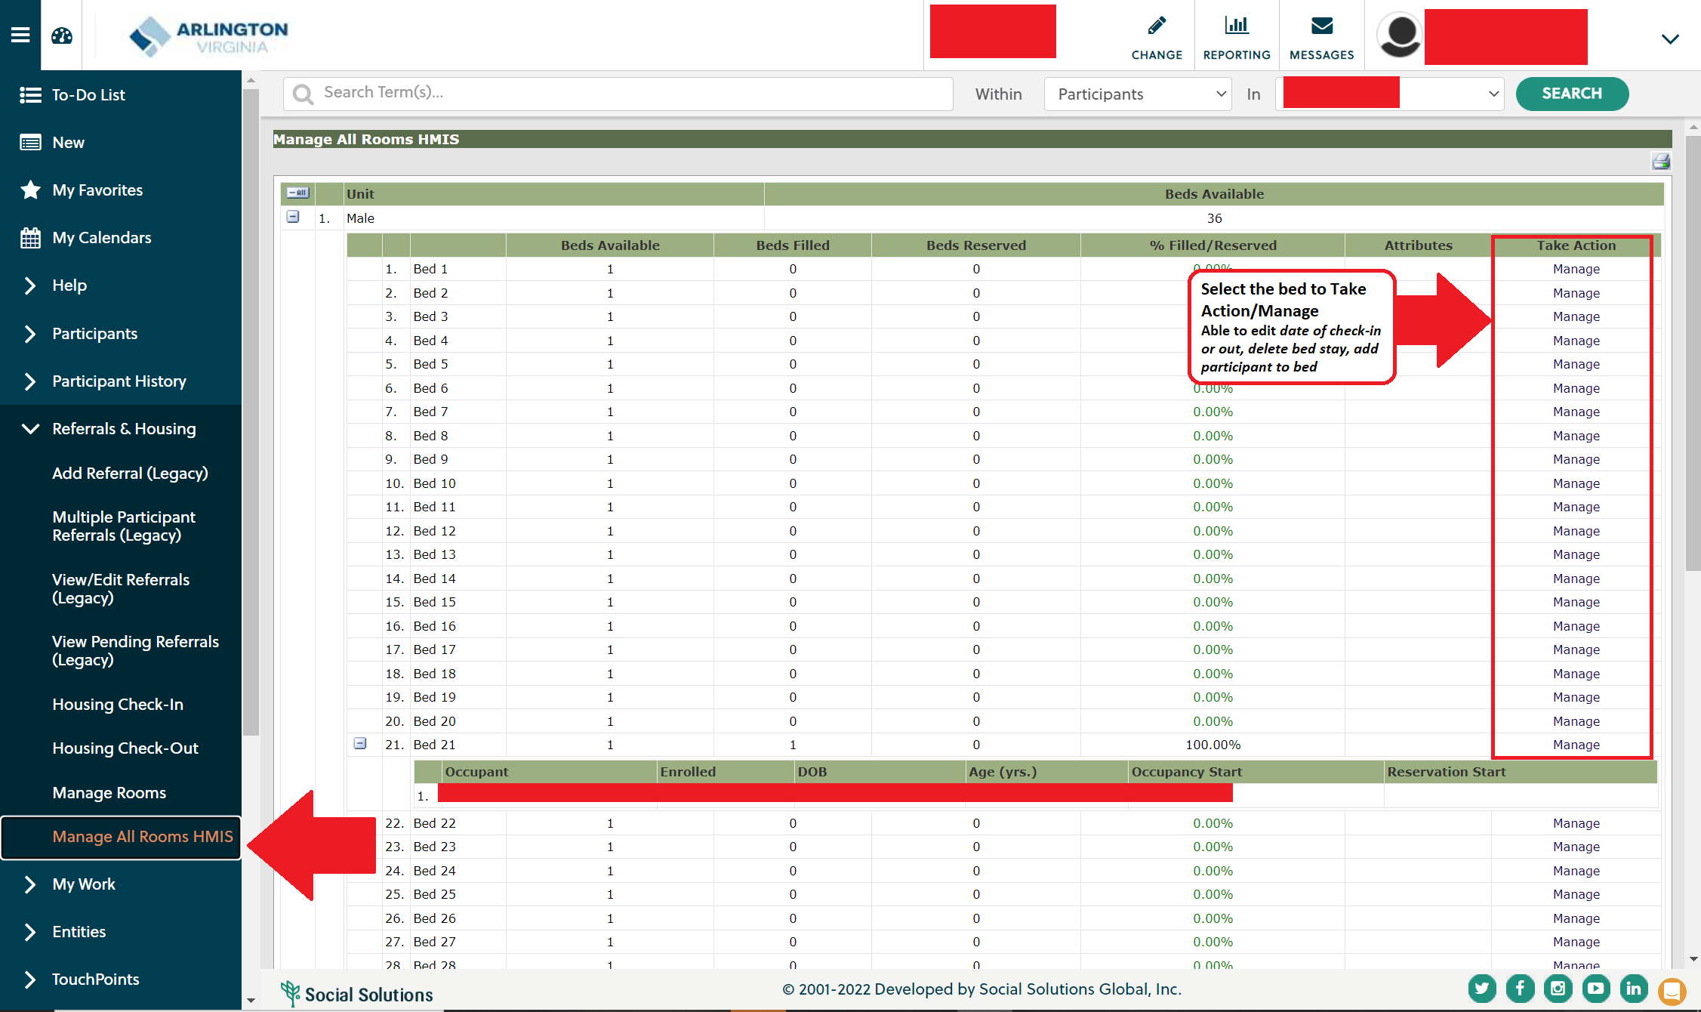
Bed List: Manage

Slide 26
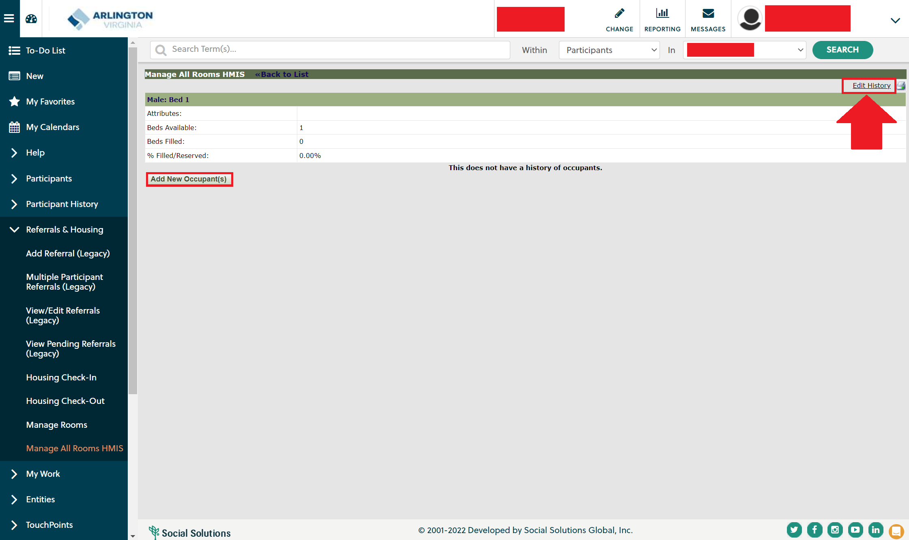
Bed List: Manage

Slide 27
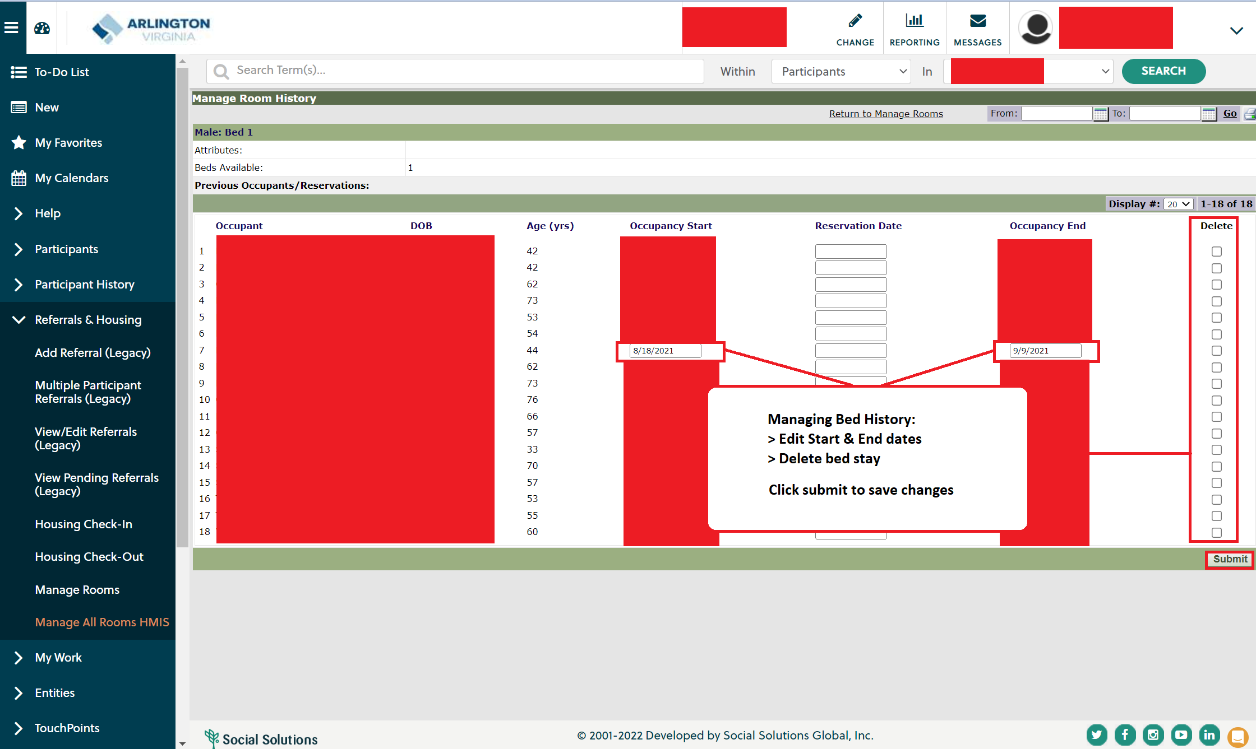
Bed List: Manage

