Slide 1
HMIS Agency Staff
Training Guidebook
Arlington County Government
Revised June 2022

Slide 2
Table of Contents
HMIS Referrals
Creating a Referral
Managing a Referral
Search Functions
Searching within a Program
Searching within a Site
Searching Outside of Current Site/Program
Enroll Existing Household
Create New Household
Demographics
HMIS Mandatory TouchPoints
HUD Assessment (Entry/Update/Annual/Exit)
Services Provided (Case Notes) & Forms of ID
Additional Assessments based on Project Types
HMIS Bed-list
Check-In
Check-Out
Manage
Dismissals/Project Exit
HUD Assessment at Exit
Reasons for Dismissal
Built for Zero (BFZ) – (CoC Requirement for Shelter & Street Outreach programs)
Enroll
Dismiss
Agency Staff

Slide 3
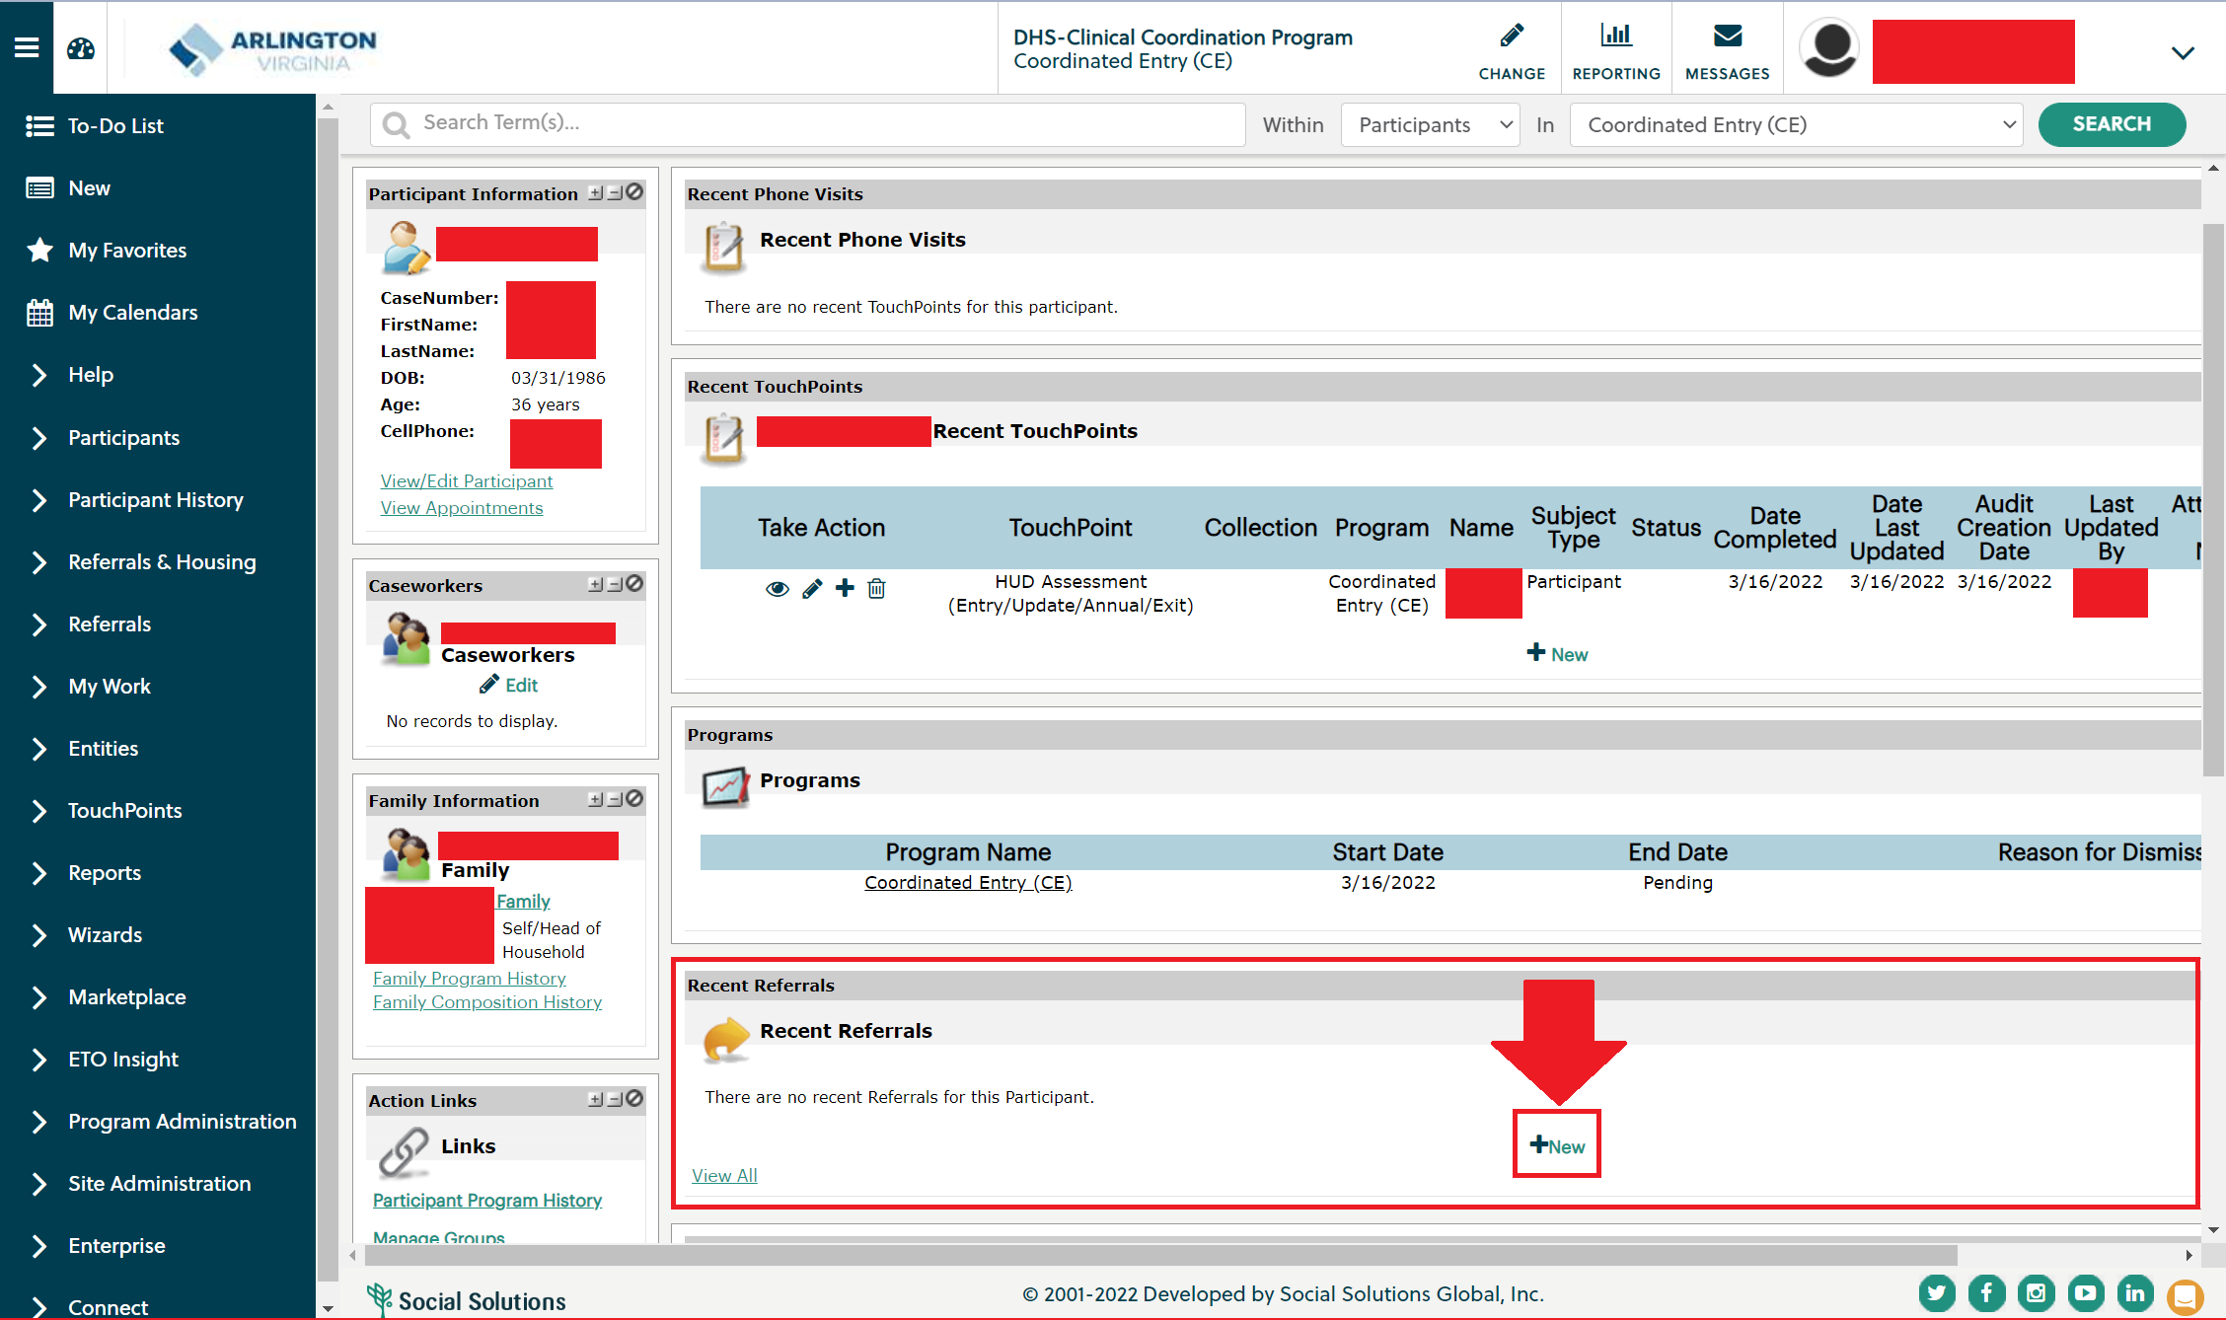
HMIS Referrals: Creating a Referral
Agency Staff

Slide 4
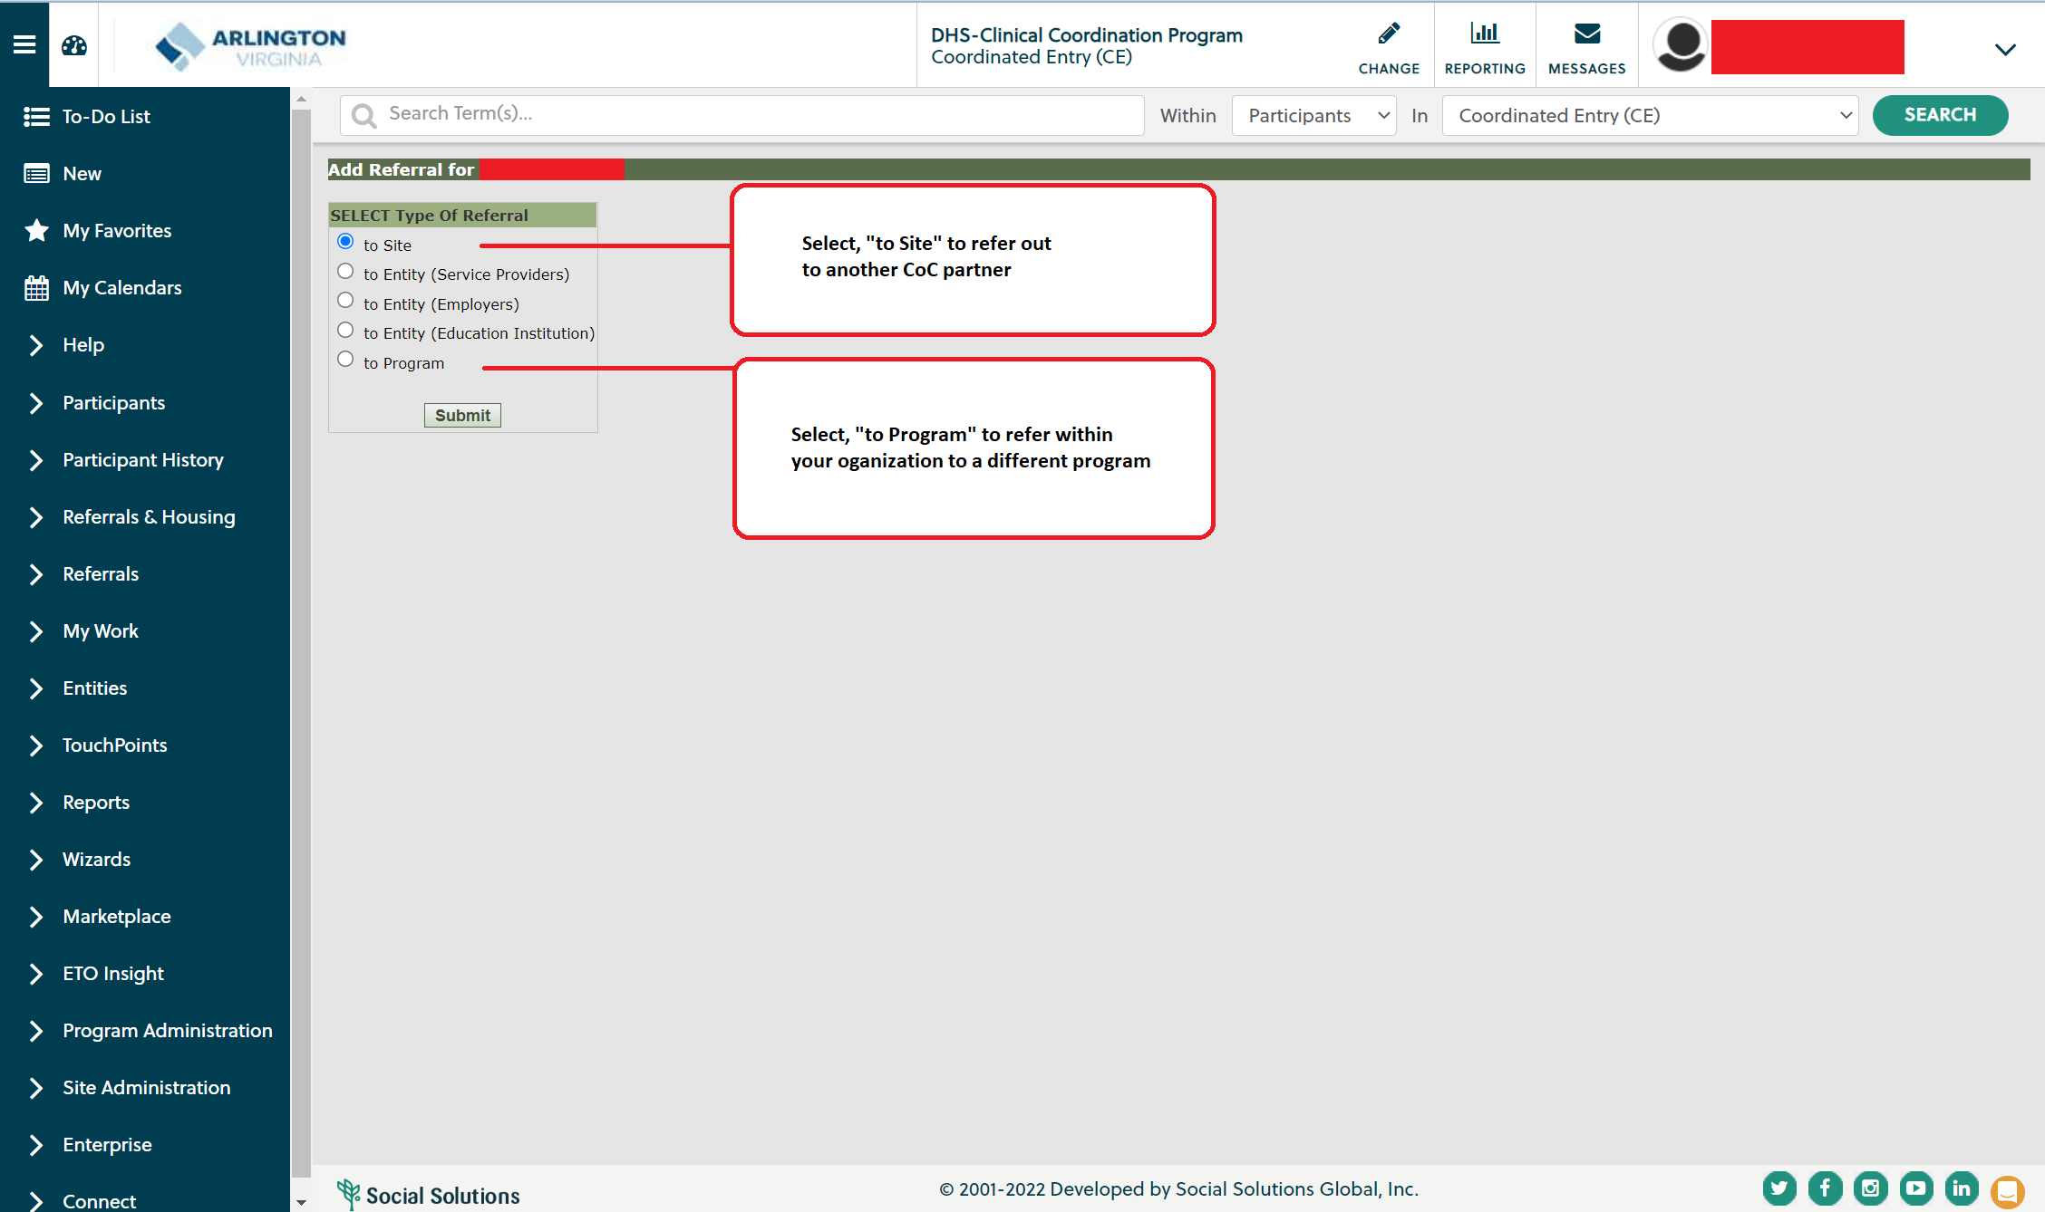
HMIS Referrals: Creating a Referral
Agency Staff

Slide 5
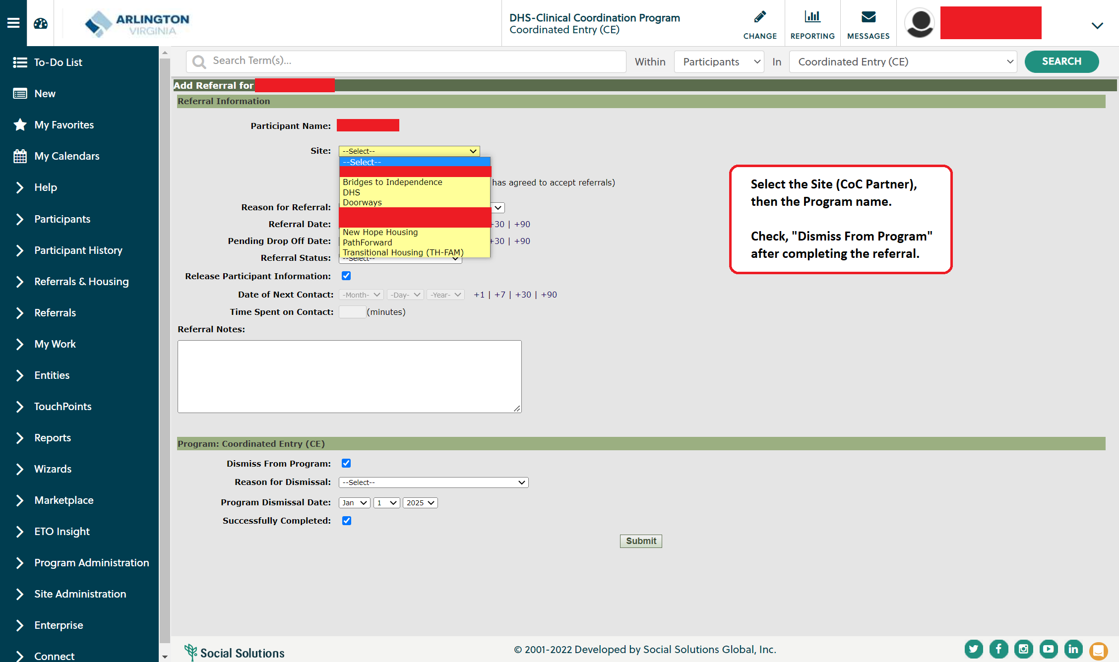
HMIS Referrals: Creating a Referral
Agency Staff

Slide 6
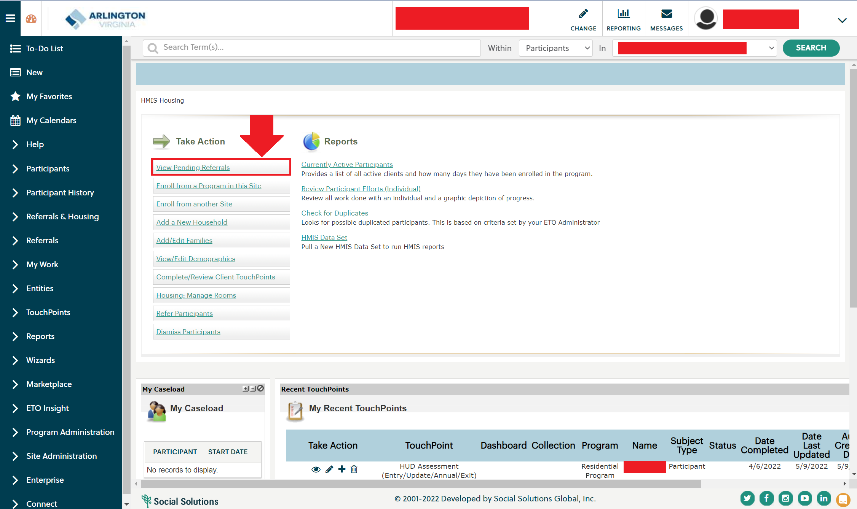
HMIS Referrals: Accepting a Referral
Agency Staff

Slide 7
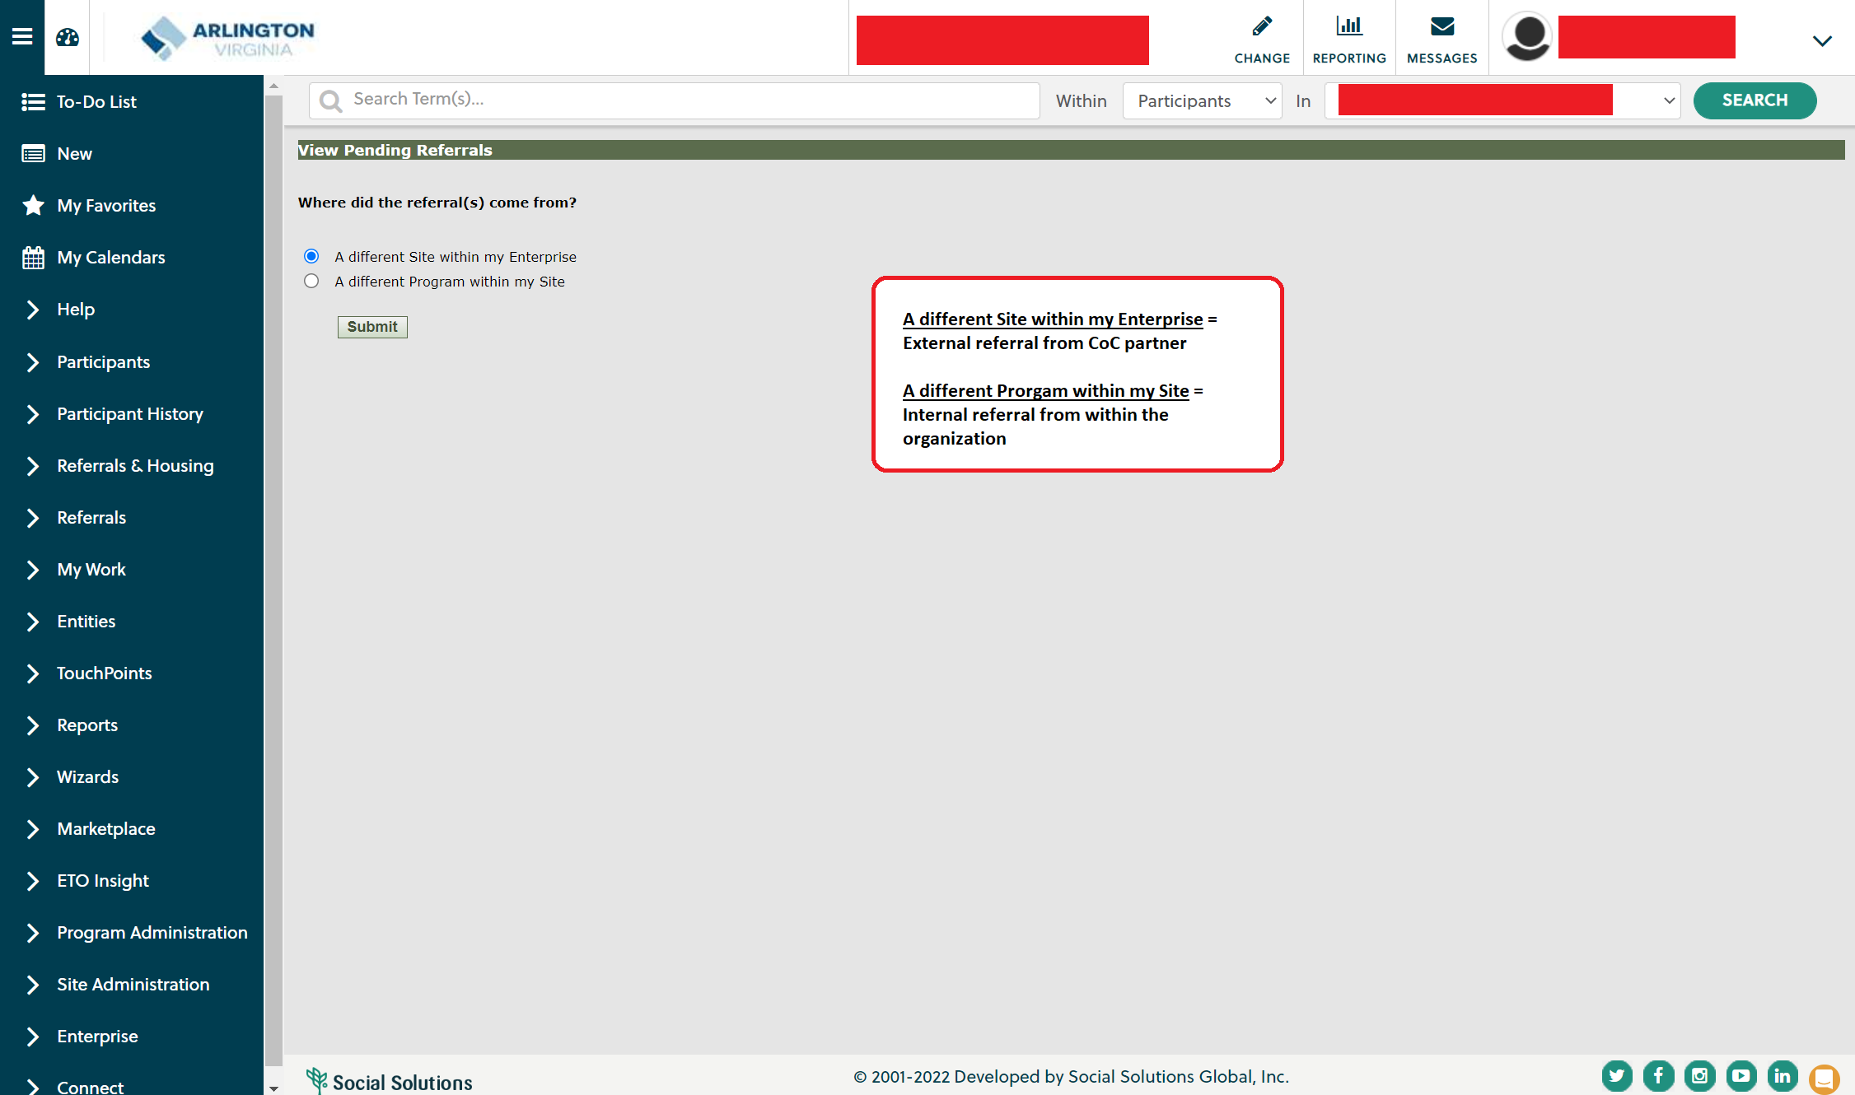
HMIS Referrals: Accepting a Referral
Agency Staff

Slide 8
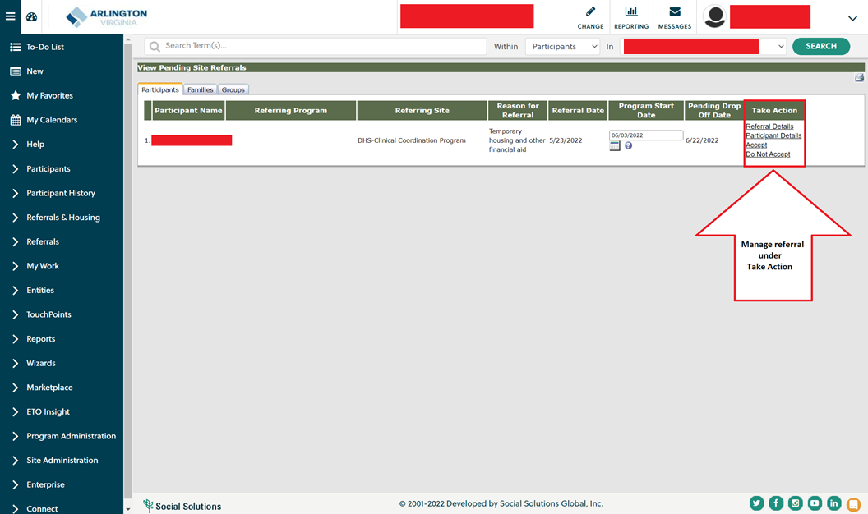
HMIS Referrals: Accepting a Referral
Agency Staff

Slide 9
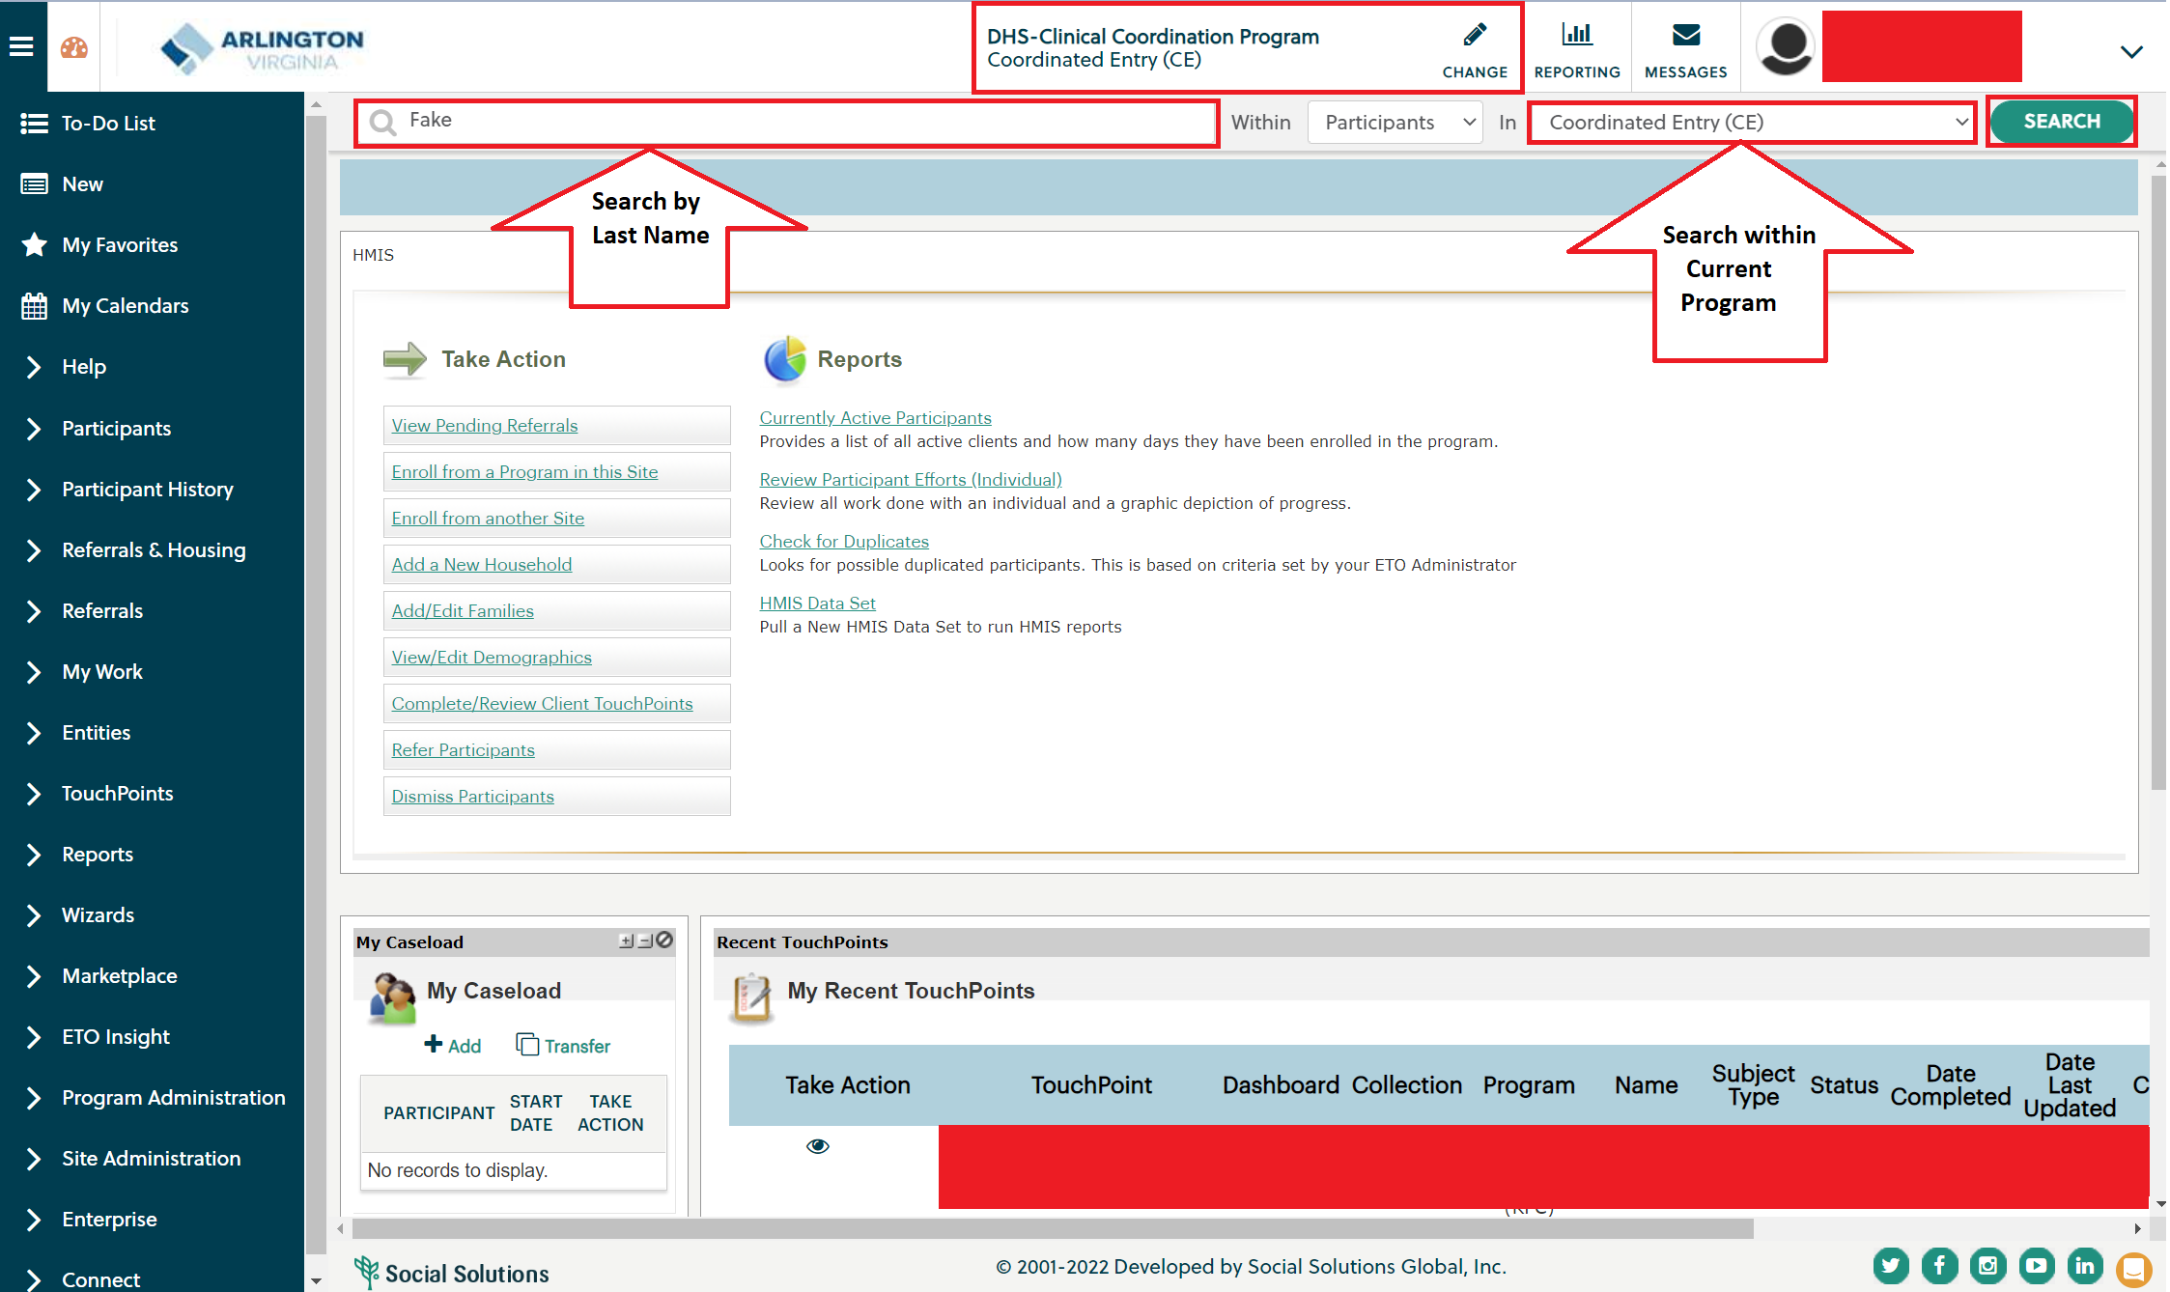
Search Functions: Searching Within a Program
Agency Staff

Slide 10
Search Functions: Searching Within a Program
Agency Staff

Slide 11
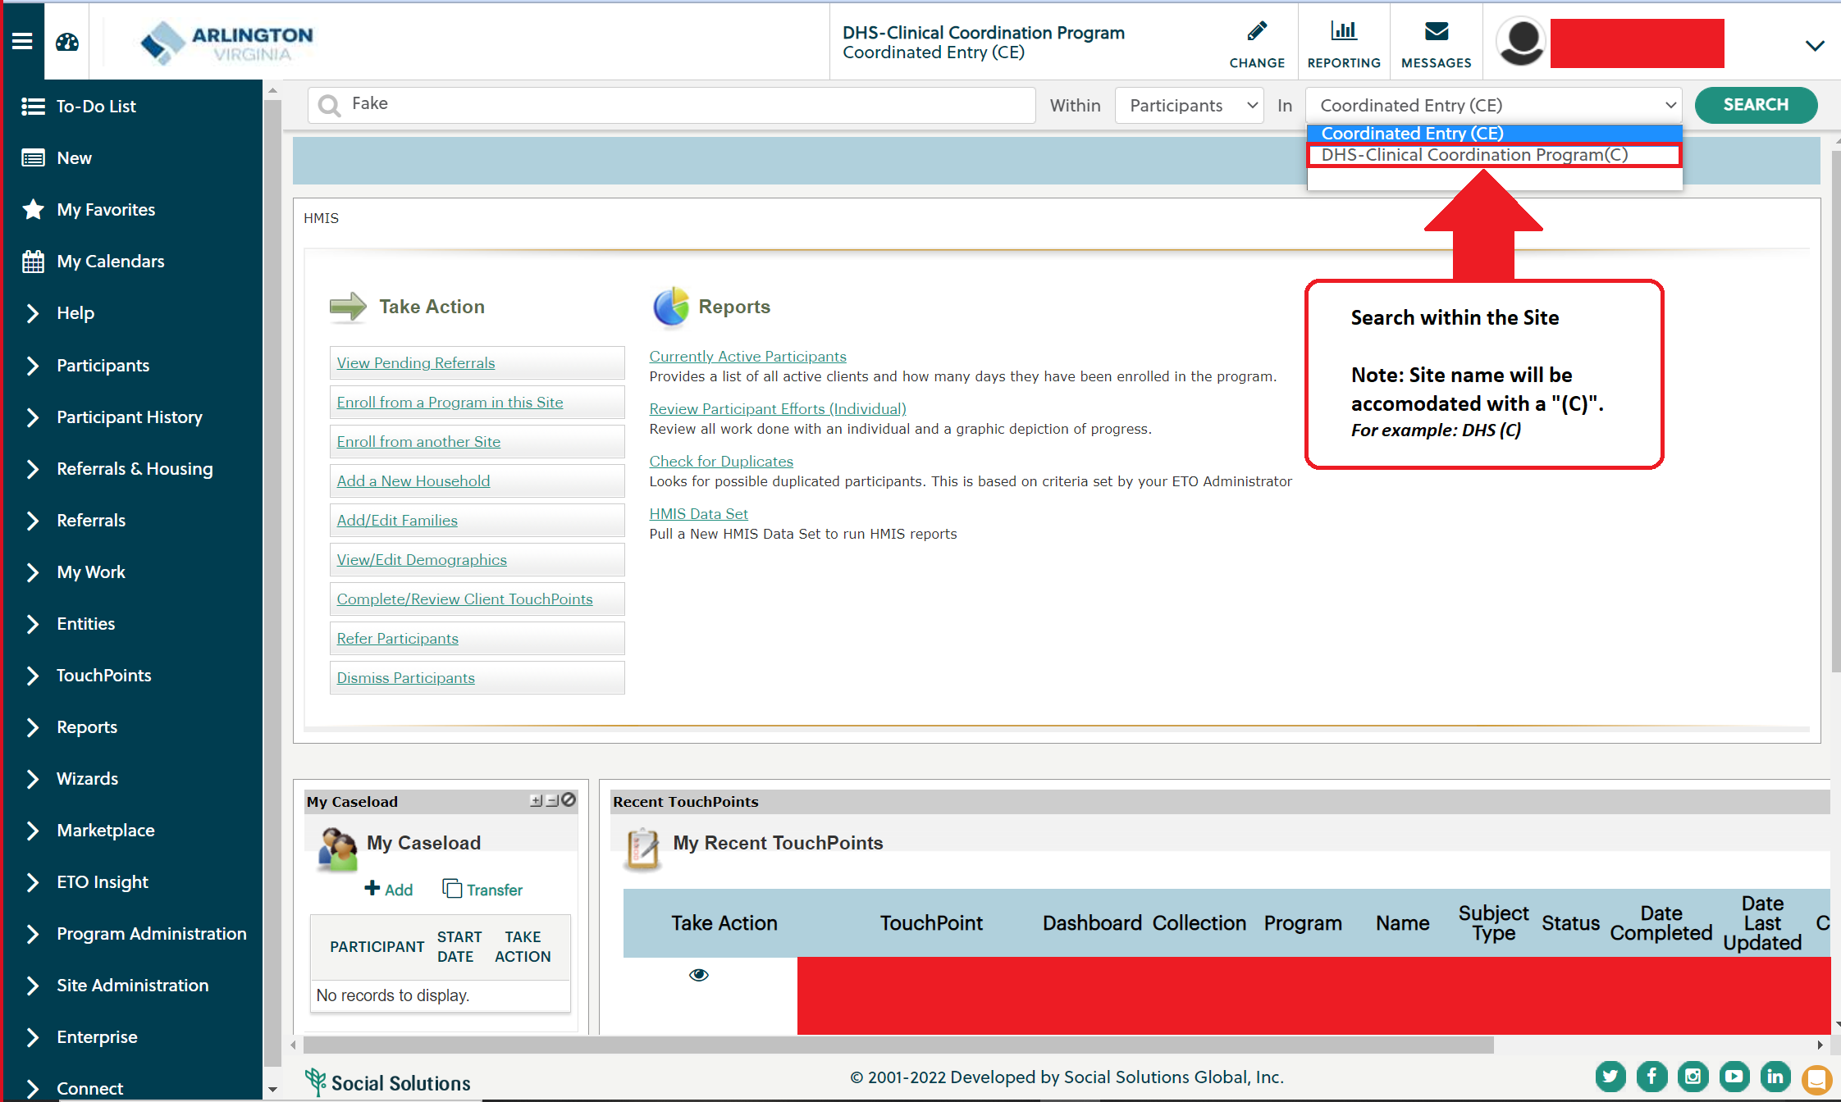
Search Functions: Searching Within a Site
Agency Staff

Slide 12
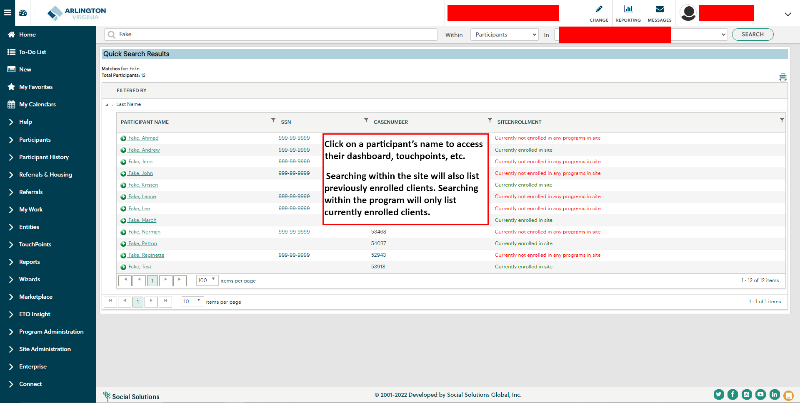
Search Functions: Searching Within a Site
Agency Staff

Slide 13
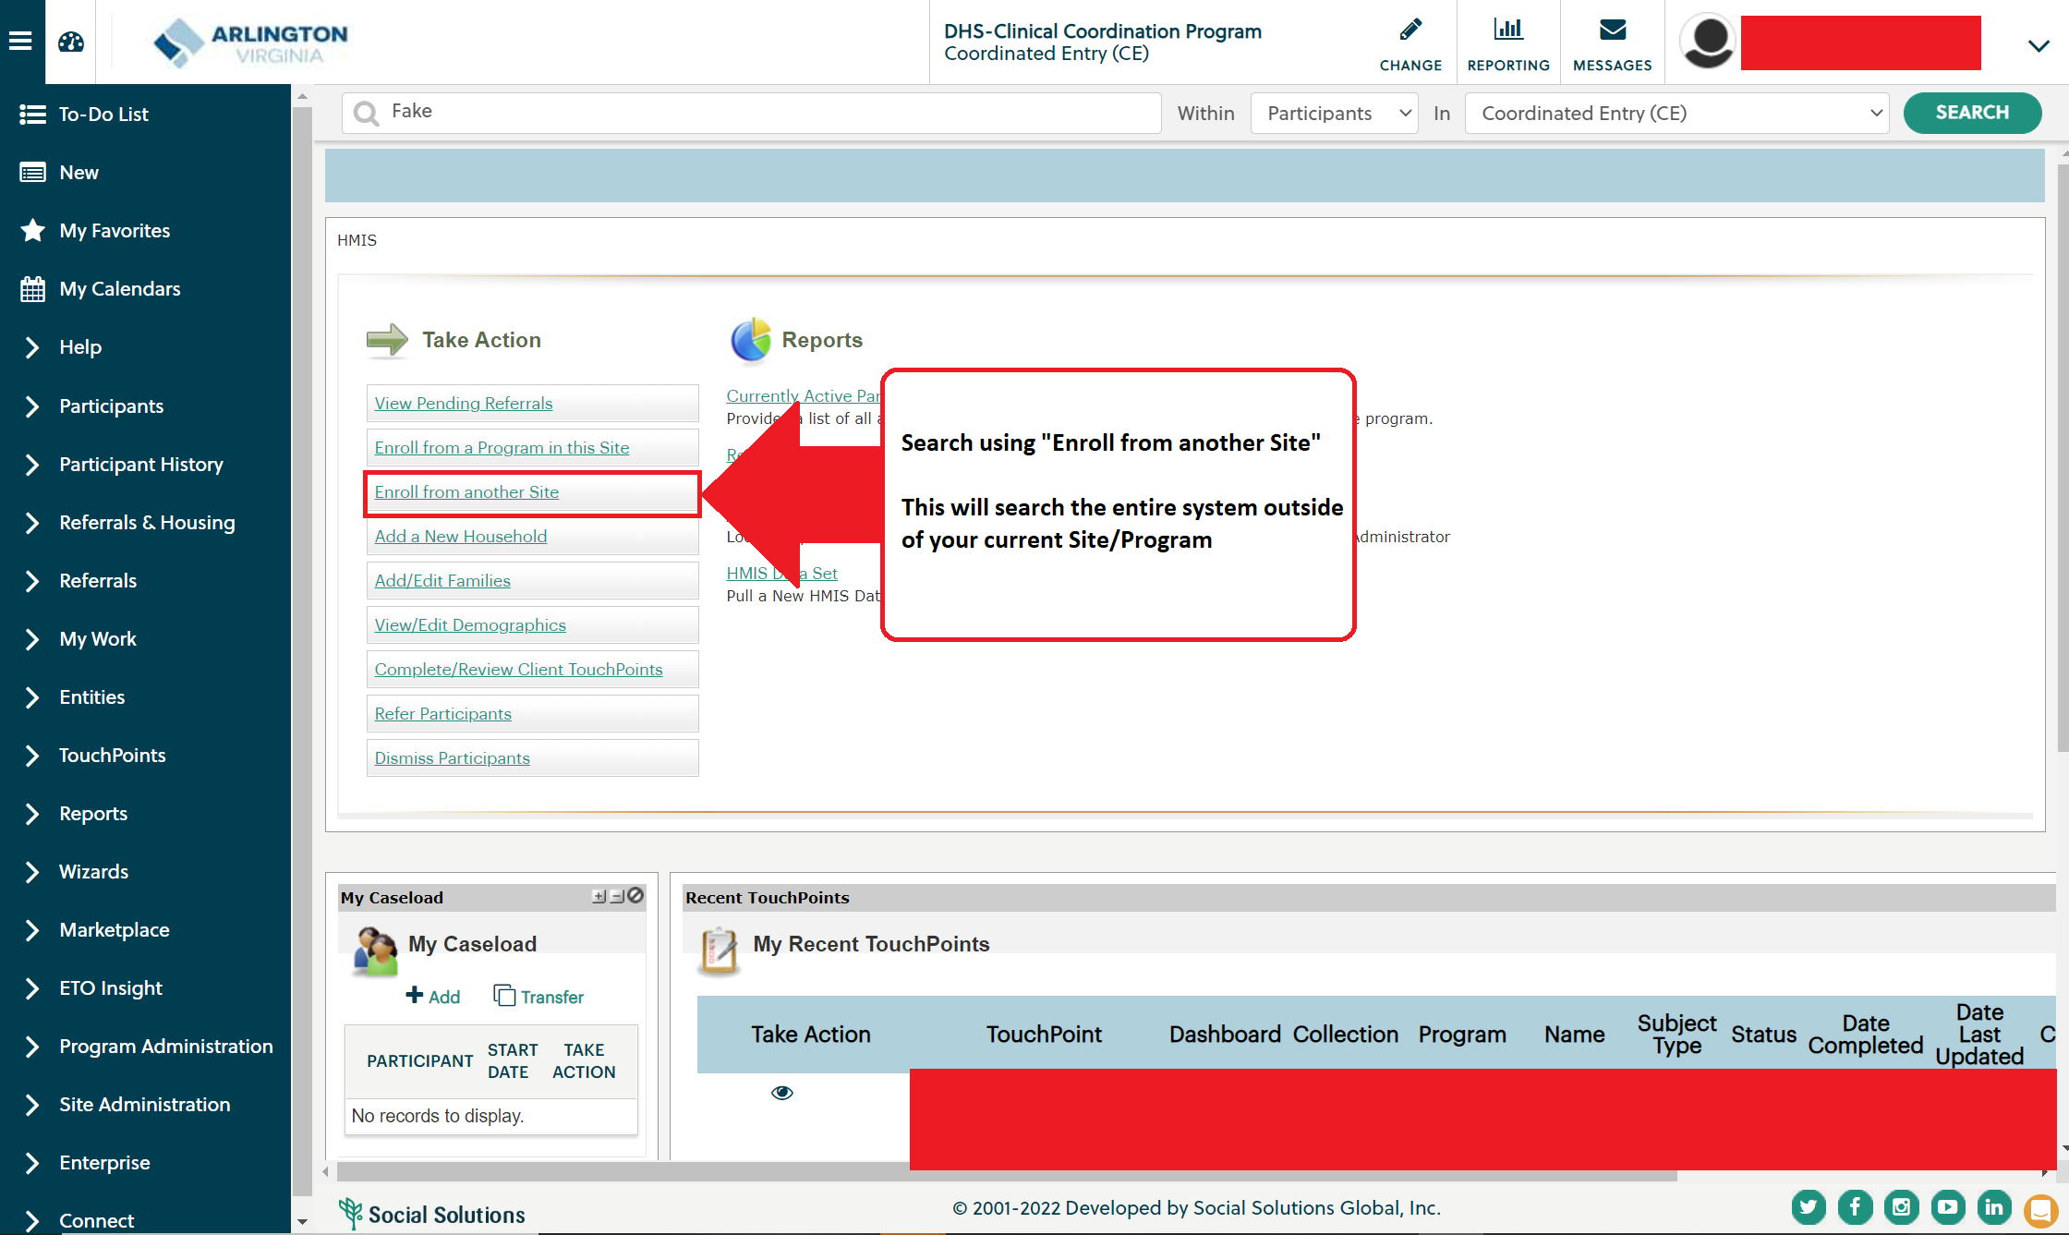
Search Functions: Searching Outside Current Site/Program
Agency Staff

Slide 14
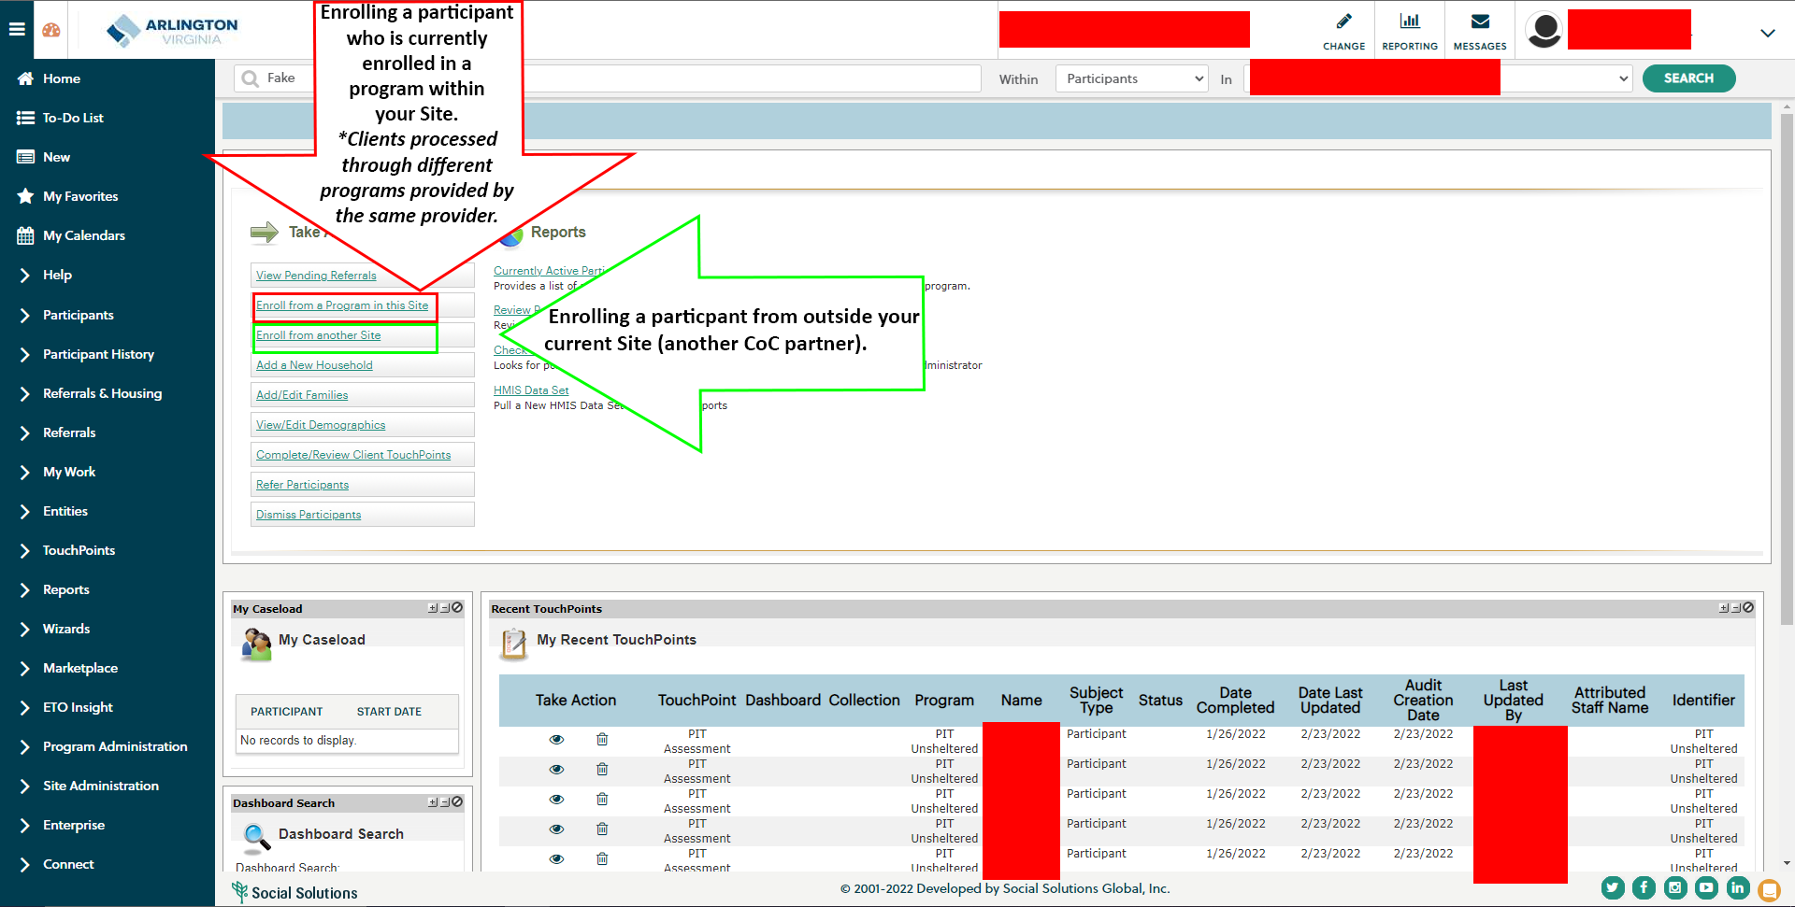
Enroll Existing Household
Agency Staff

Slide 15
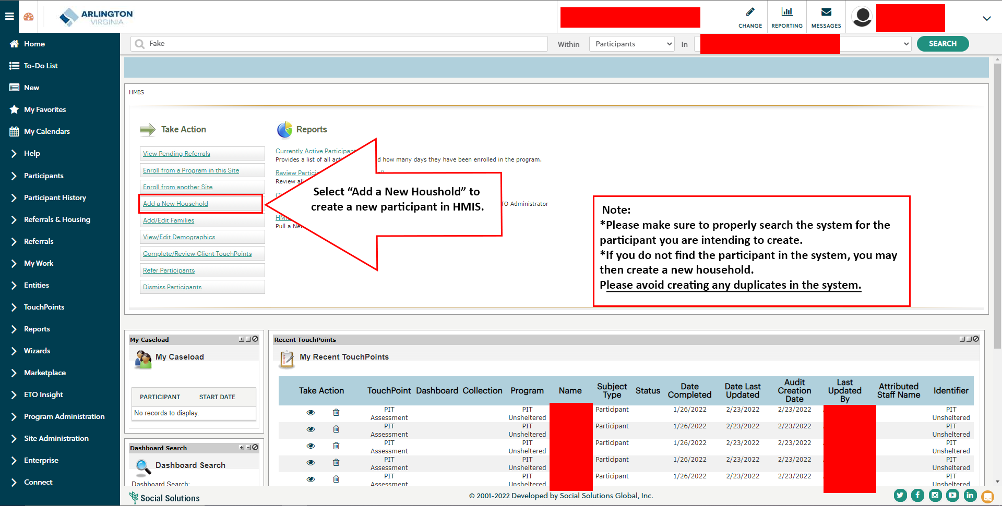
Create New Household
Agency Staff

Slide 16
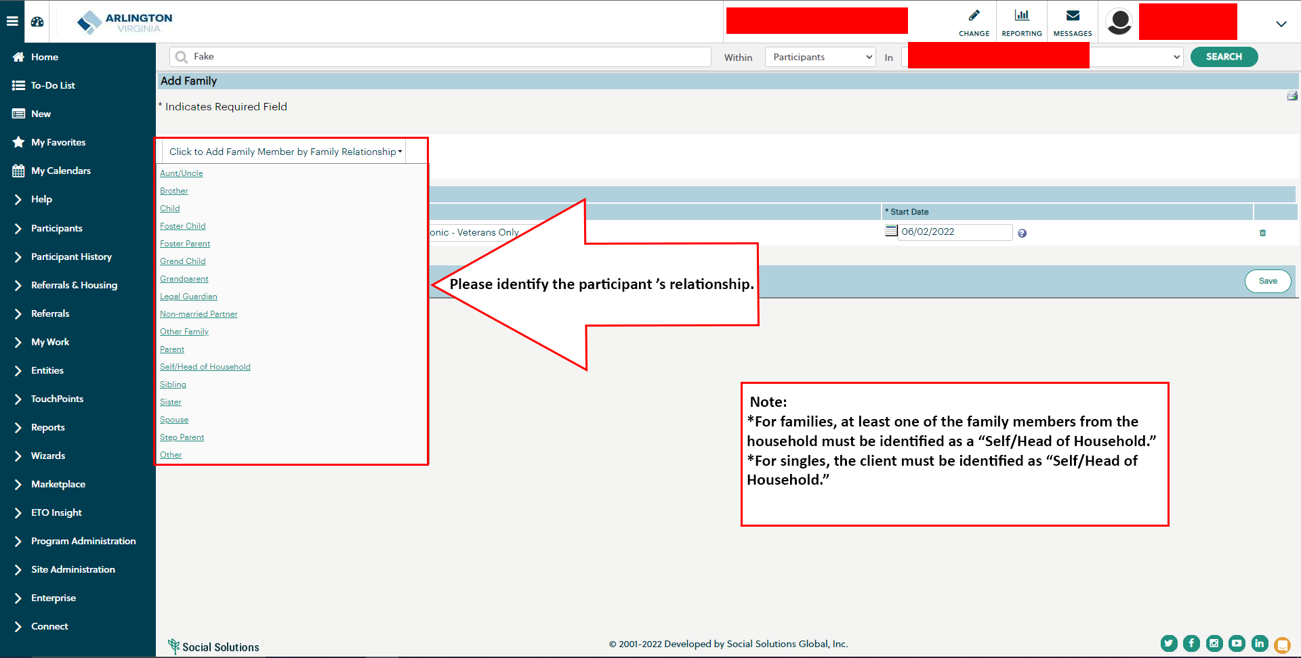
Create New Household: Demographics
Agency Staff

Slide 17
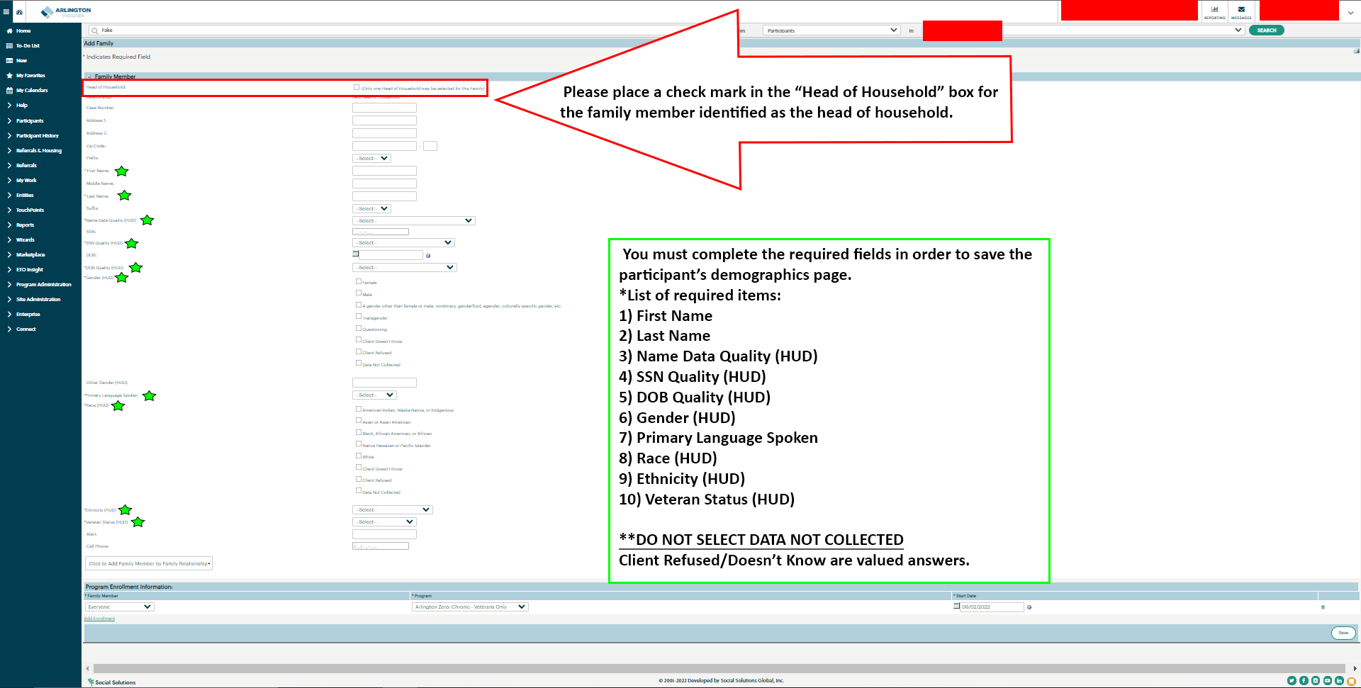
Create New Household: Demographics
Agency Staff

Slide 18
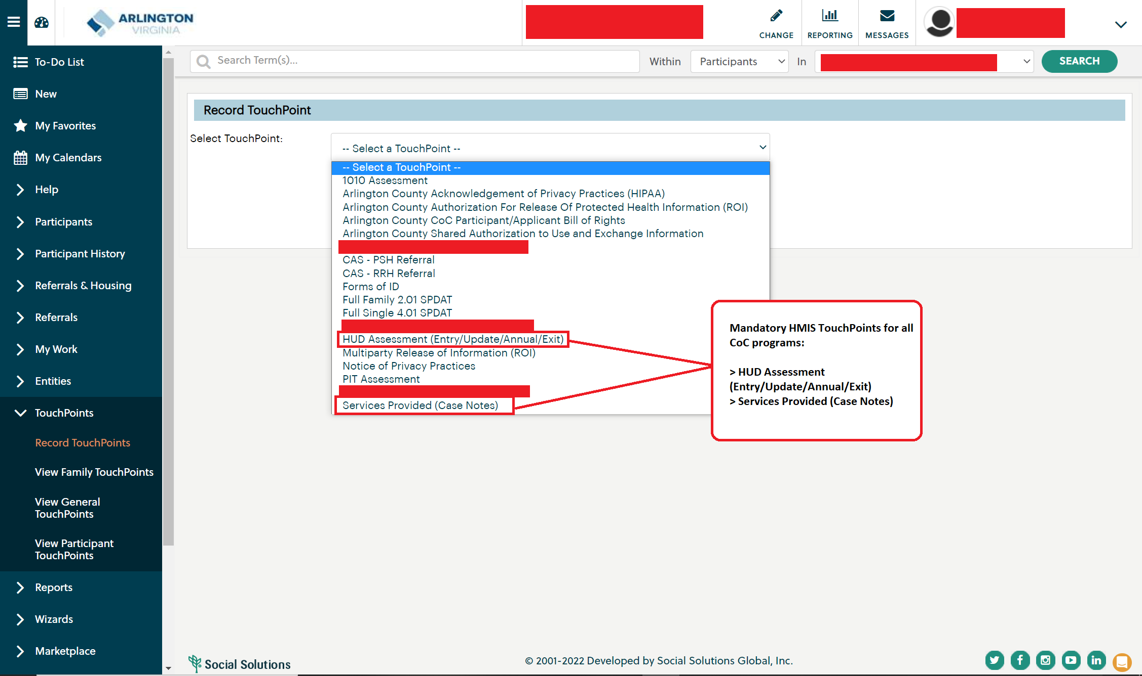
Mandatory HMIS TouchPoints
Agency Staff

Slide 19
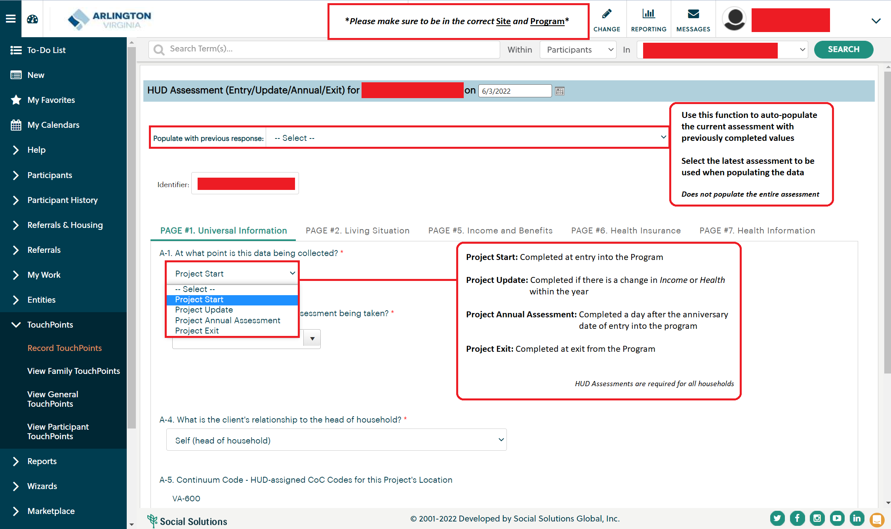
Mandatory HMIS TouchPoints: HUD Assessments (Entry/Update/Annual/Exit)
Agency Staff

Slide 20
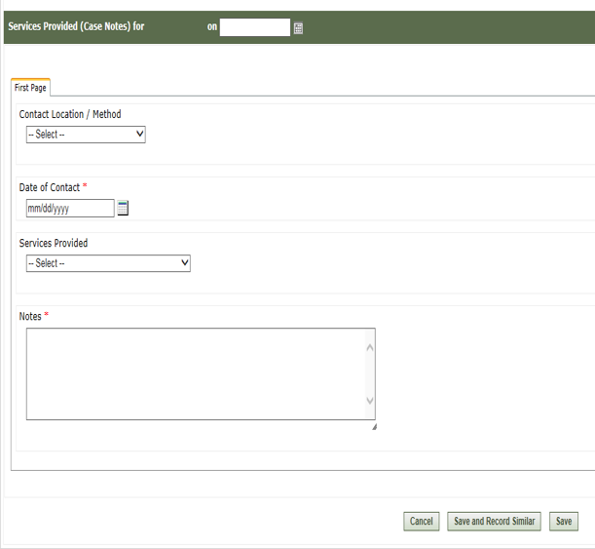
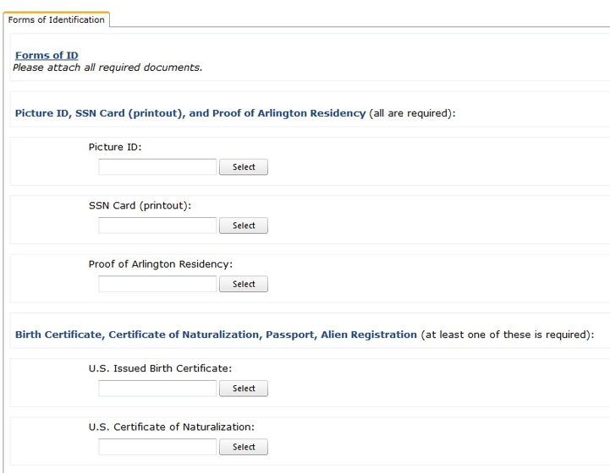
Mandatory HMIS TouchPoints: Services Provided (Case Notes) & Forms of ID
Services Provided (Case Notes) Forms of ID
Agency Staff

Slide 21
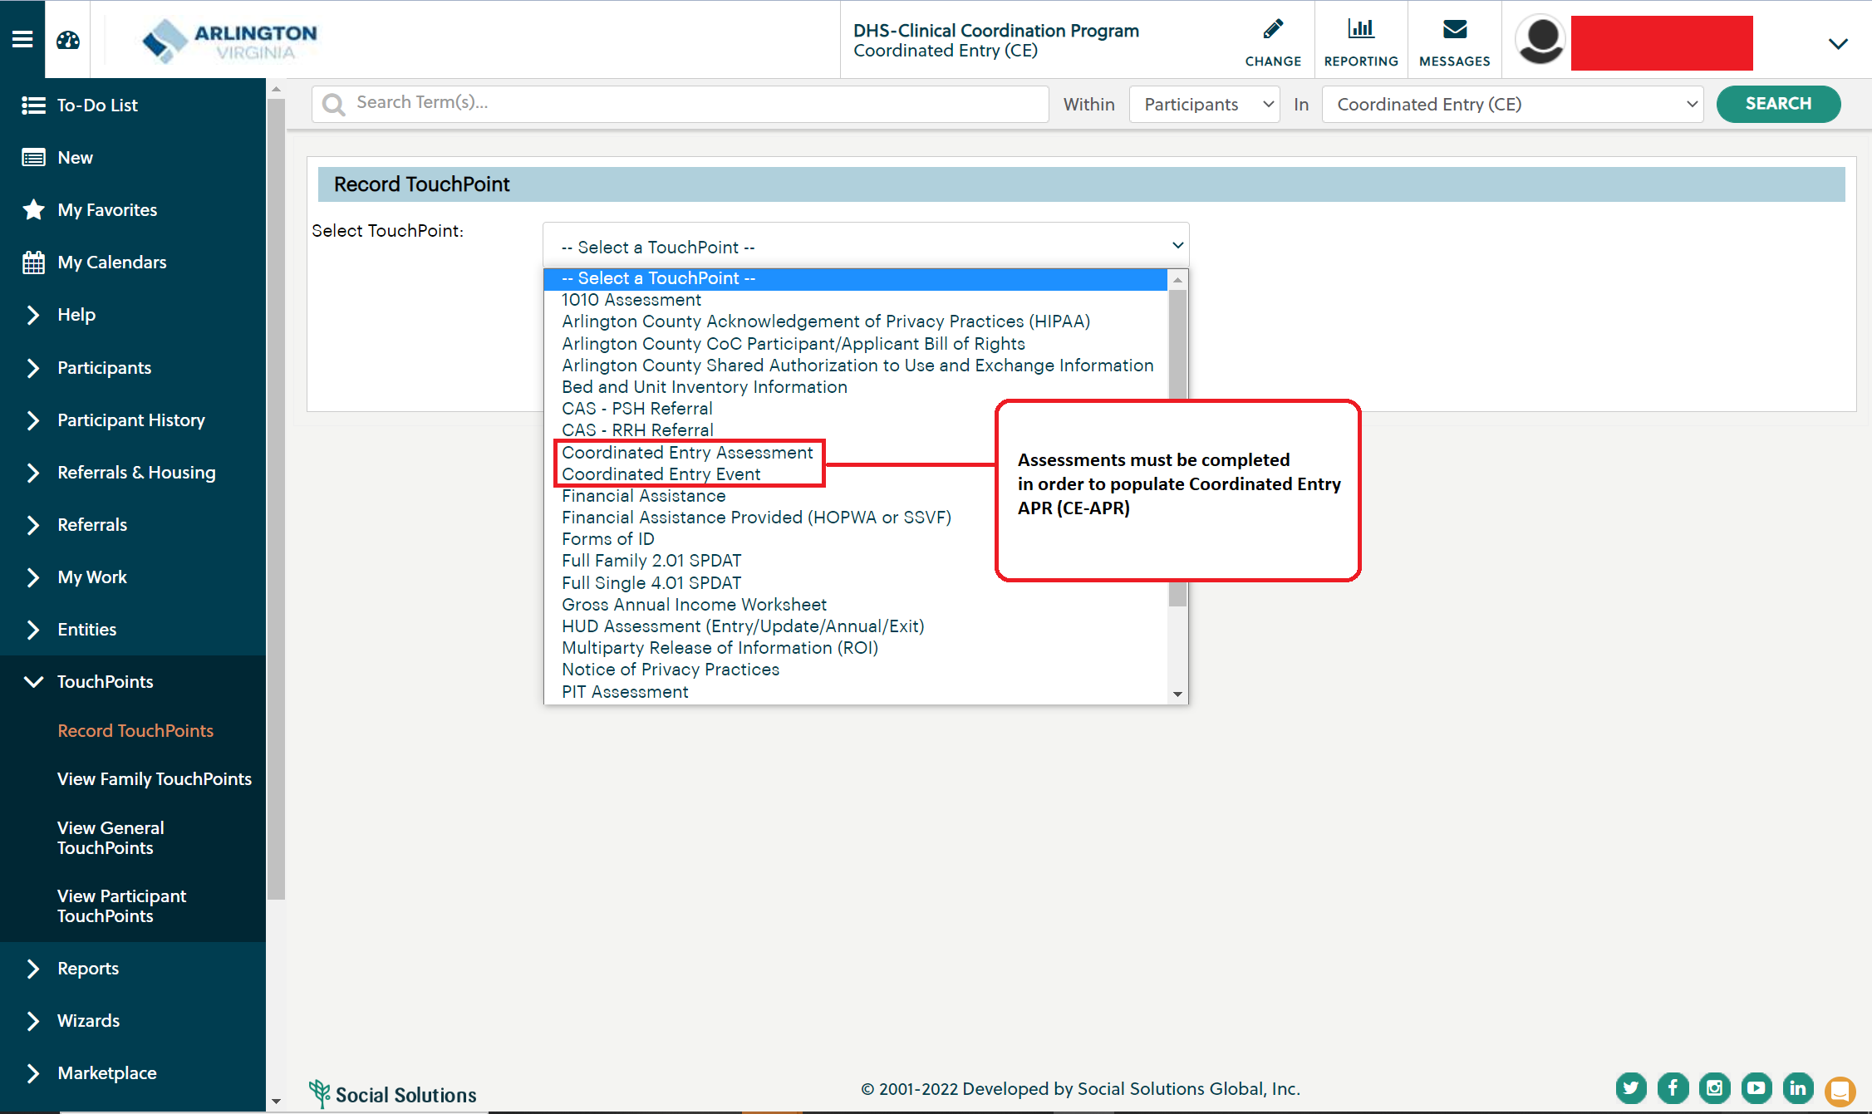
Mandatory HMIS TouchPoints: Additional Assessments based on Project Types
Coordinated Entry (CE)
Agency Staff

Slide 22
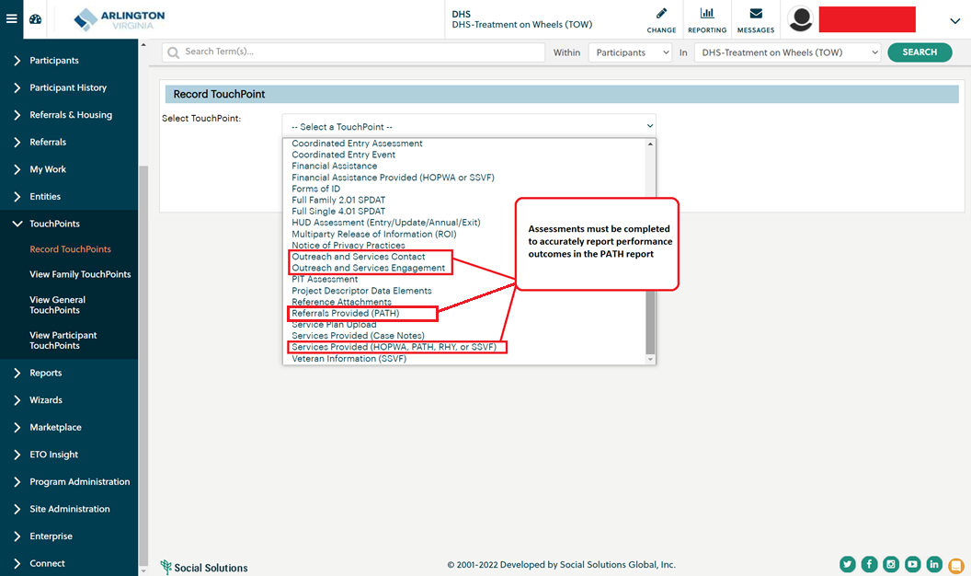
Mandatory HMIS TouchPoints: Additional Assessments based on Project Types
Treatment on Wheels (TOW) – PATH
Agency Staff

Slide 23
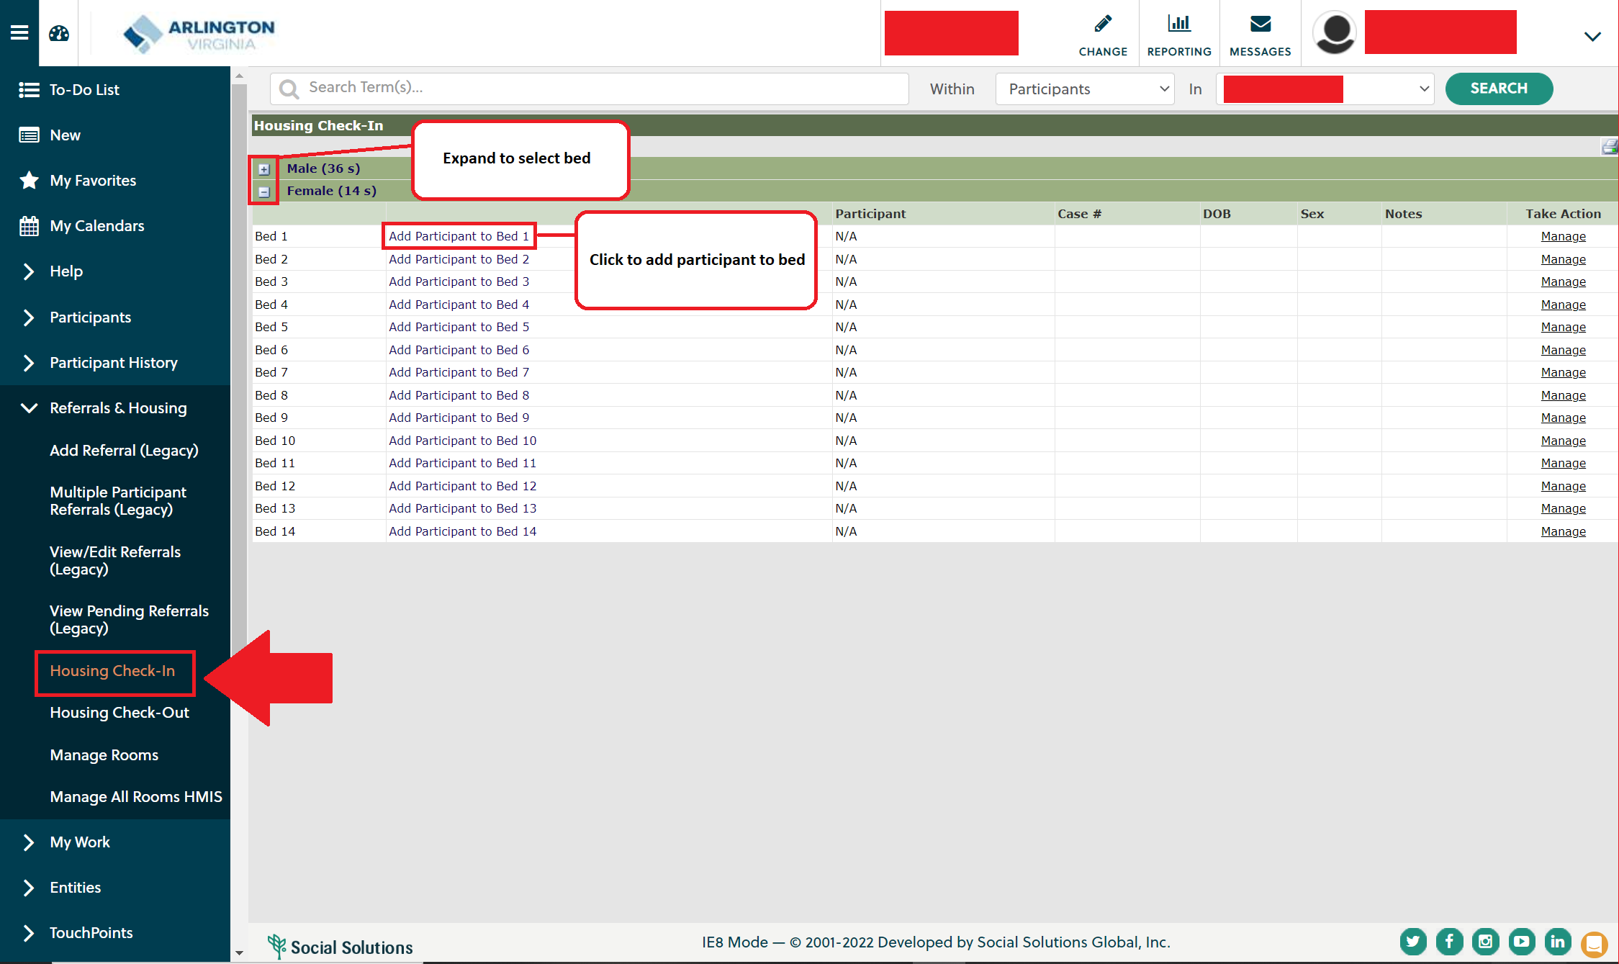
HMIS Bed List: Check In
Agency Staff

Slide 24
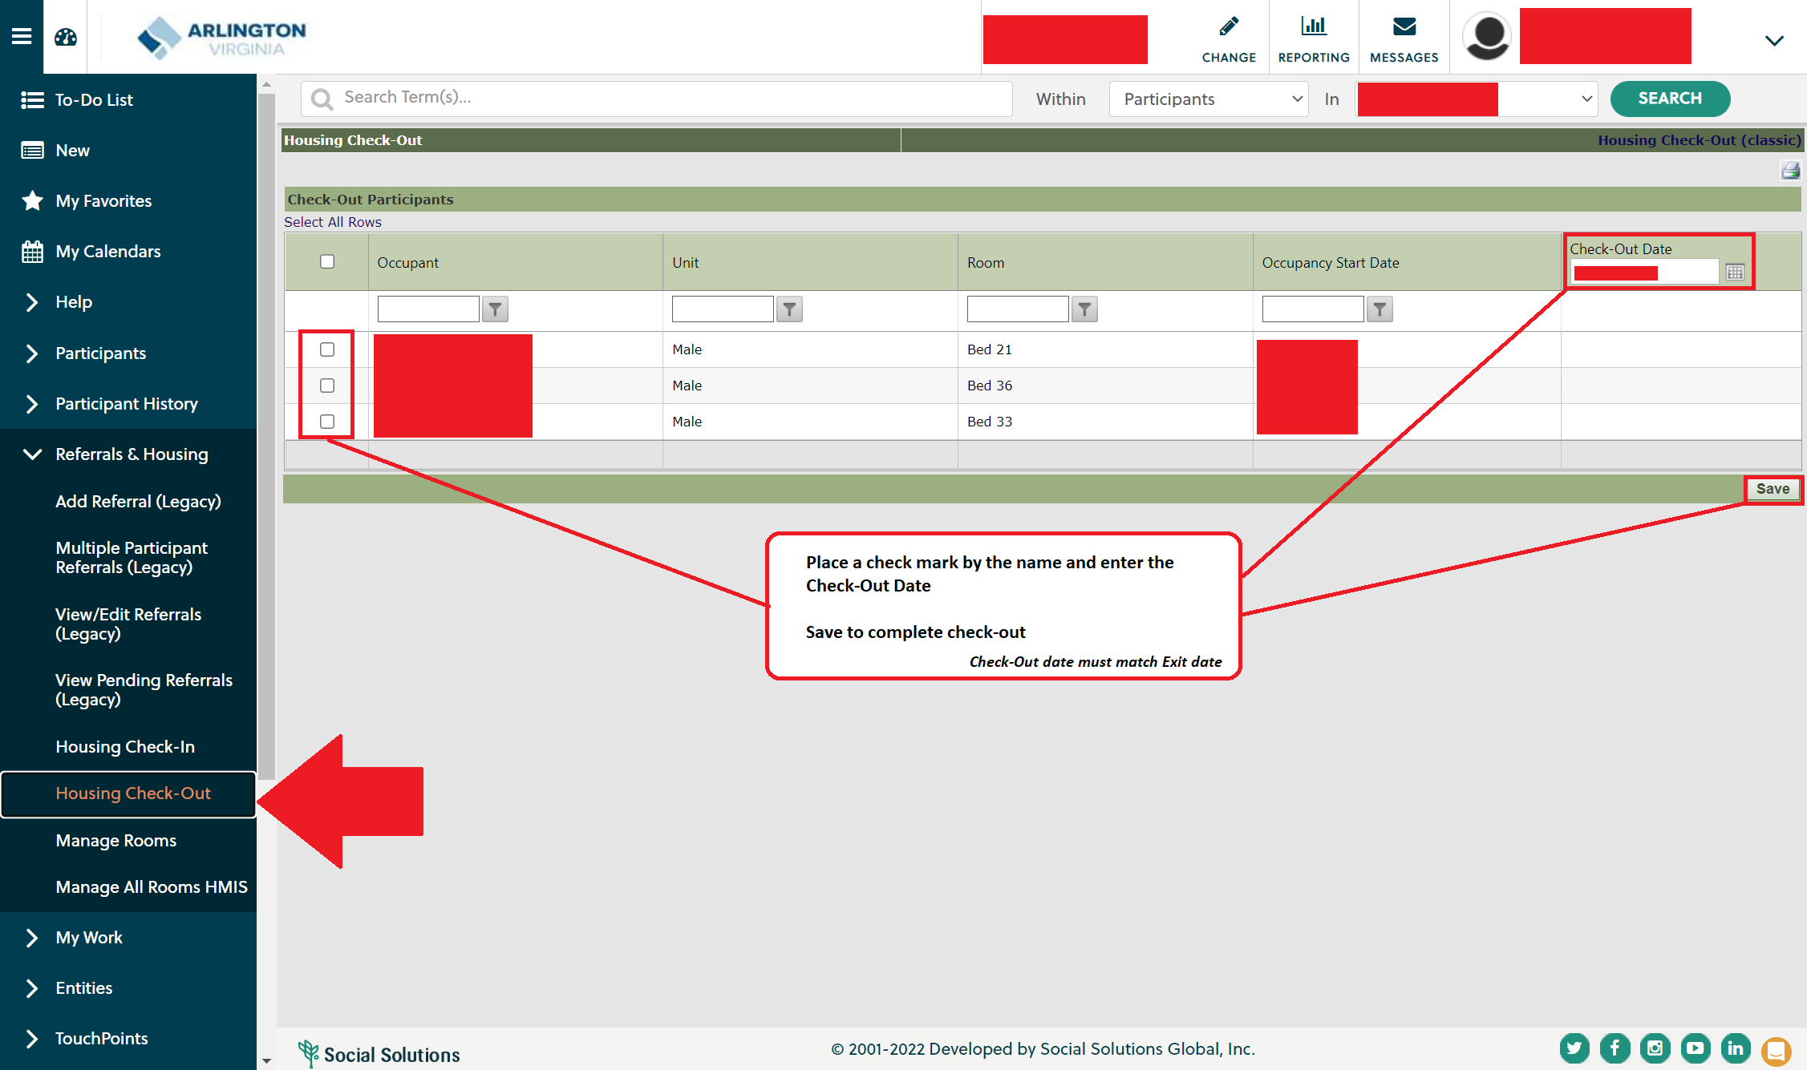
HMIS Bed List: Check Out
Agency Staff

Slide 25
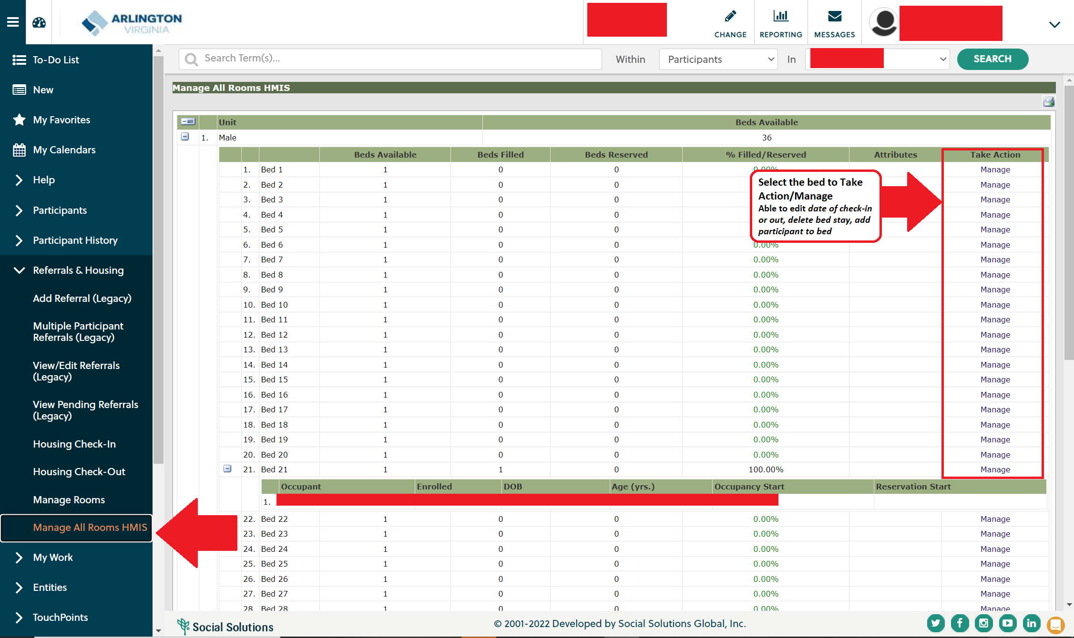
HMIS Bed List: Manage

Slide 26
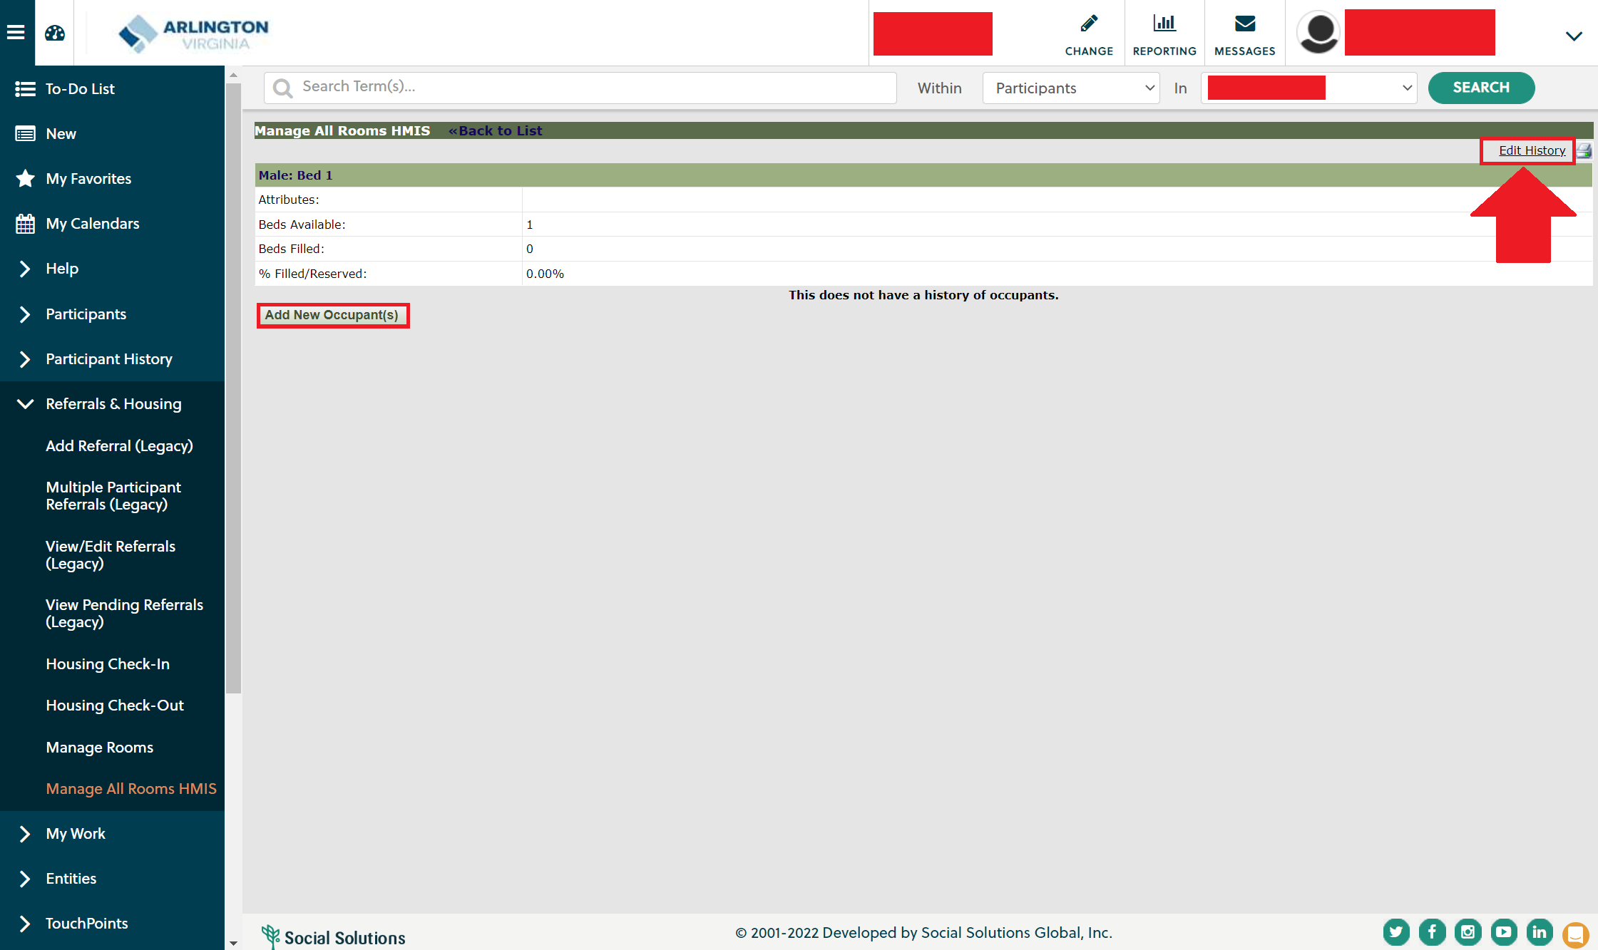
HMIS Bed List: Manage
Agency Staff

Slide 27
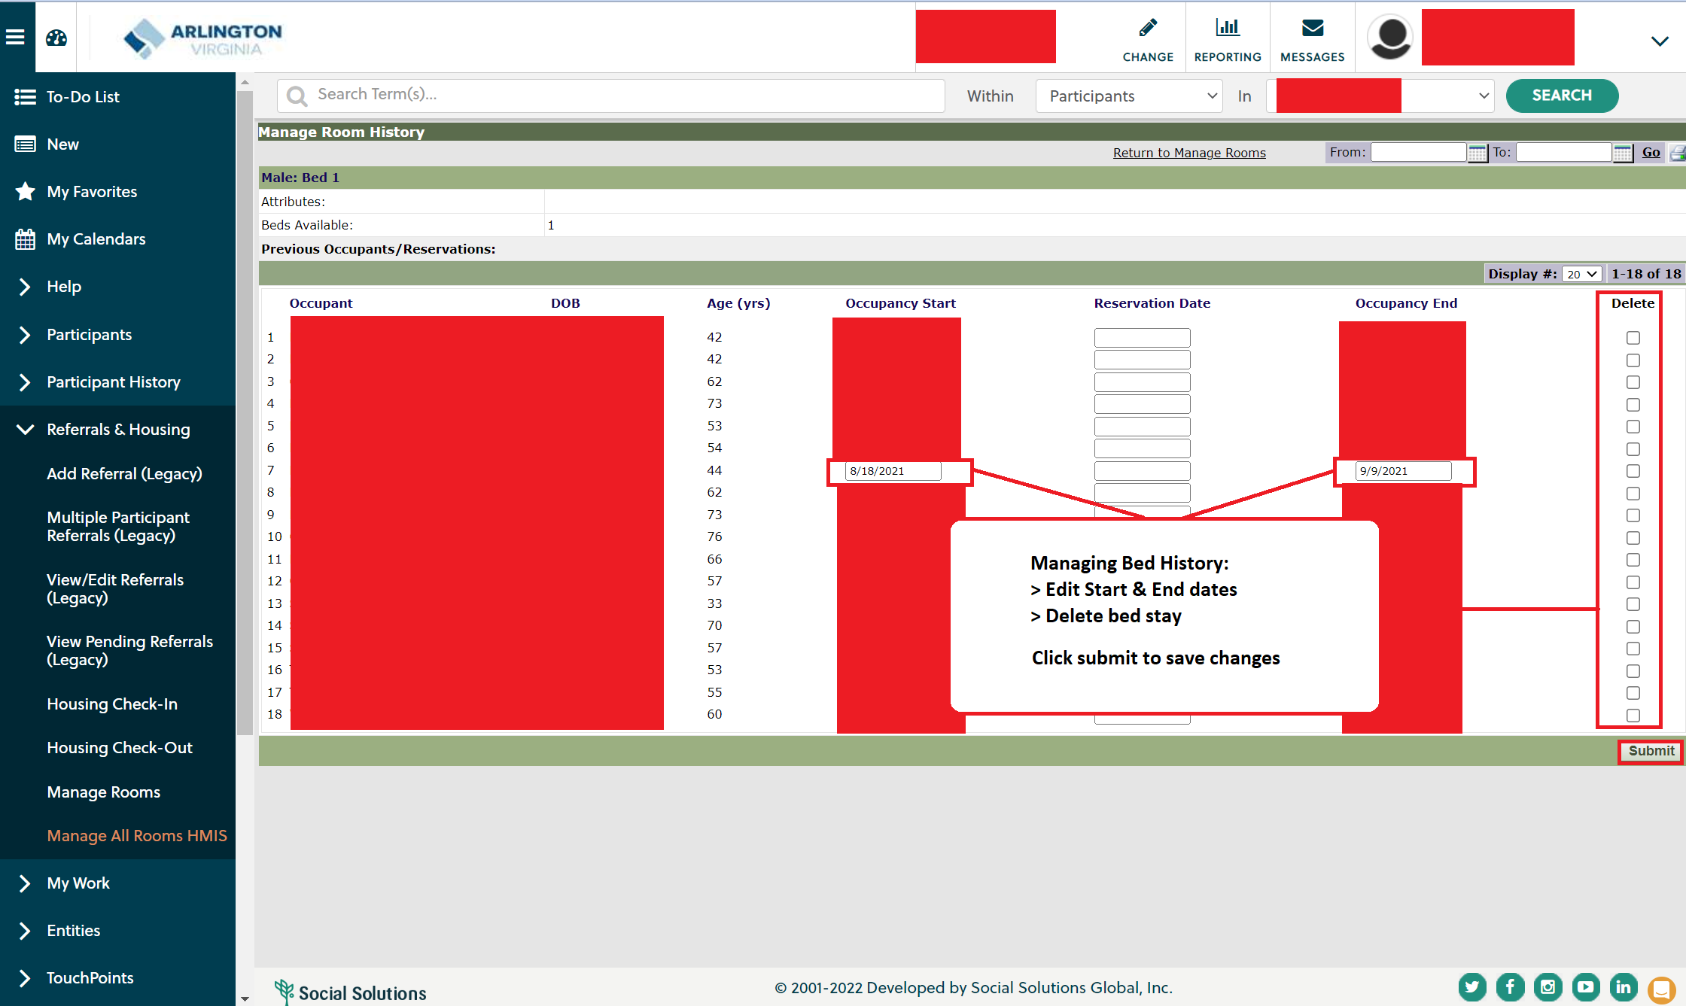
HMIS Bed List: Manage
Agency Staff

Slide 28
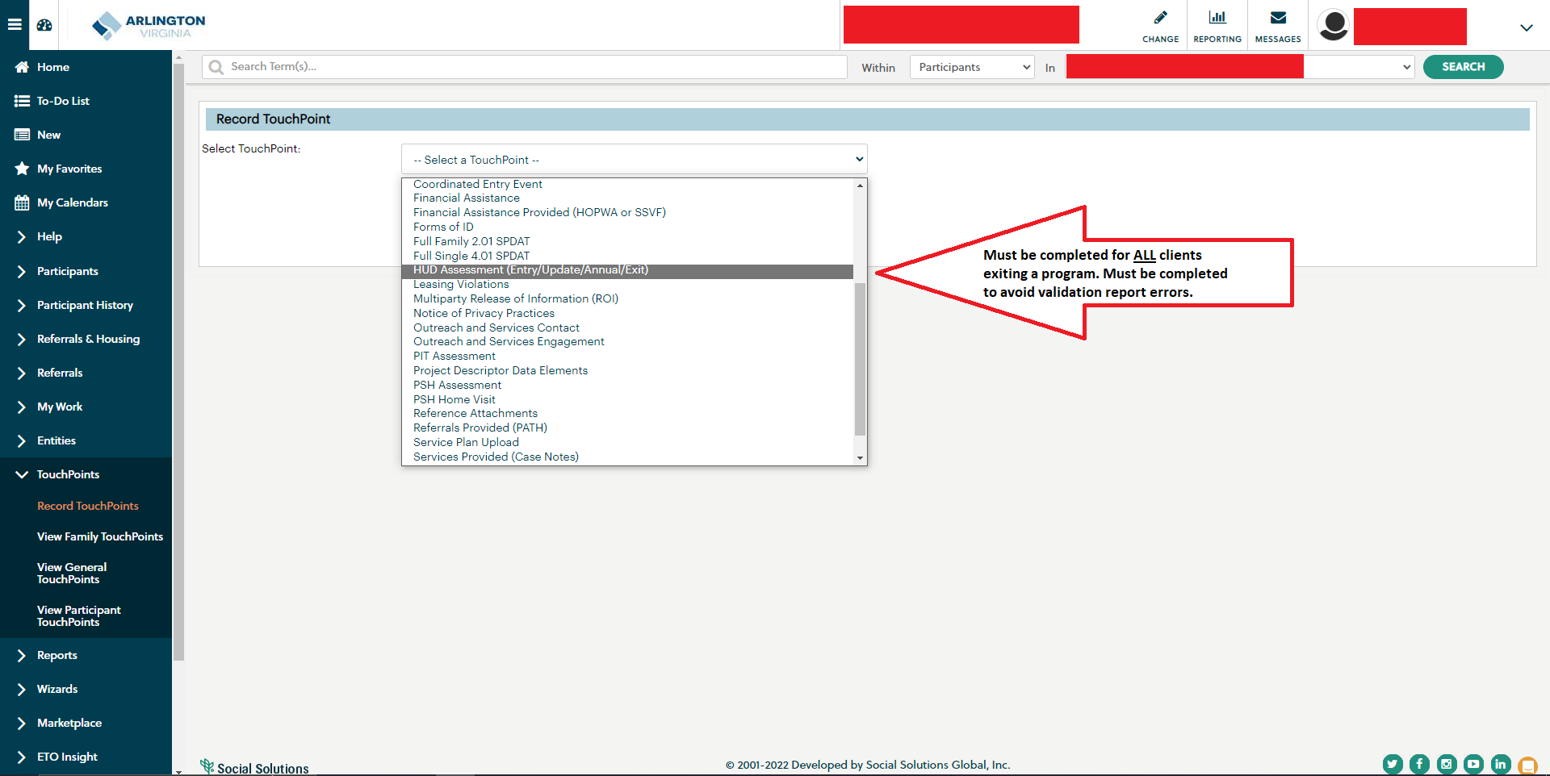
Dismissals/Project Exit: HUD Assessment at Exit
Agency Staff

Slide 29
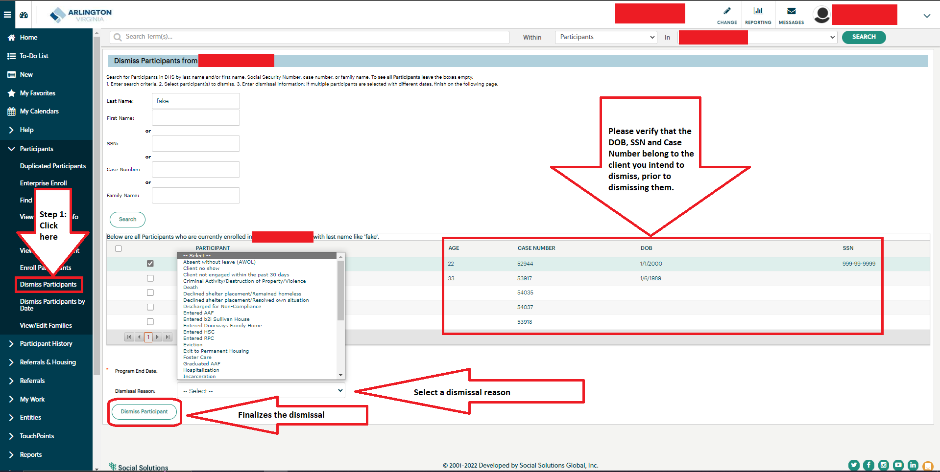
Dismissals/Project Exit: Reasons for Dismissal
Agency Staff

Slide 30
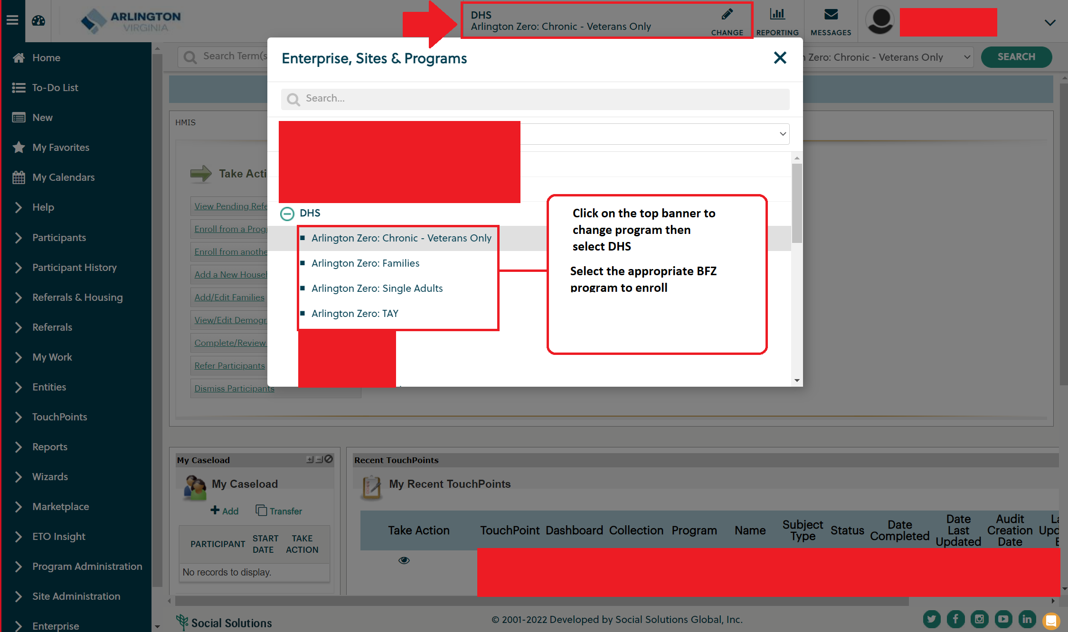
Built for Zero (BFZ): Enroll
Agency Staff

Slide 31
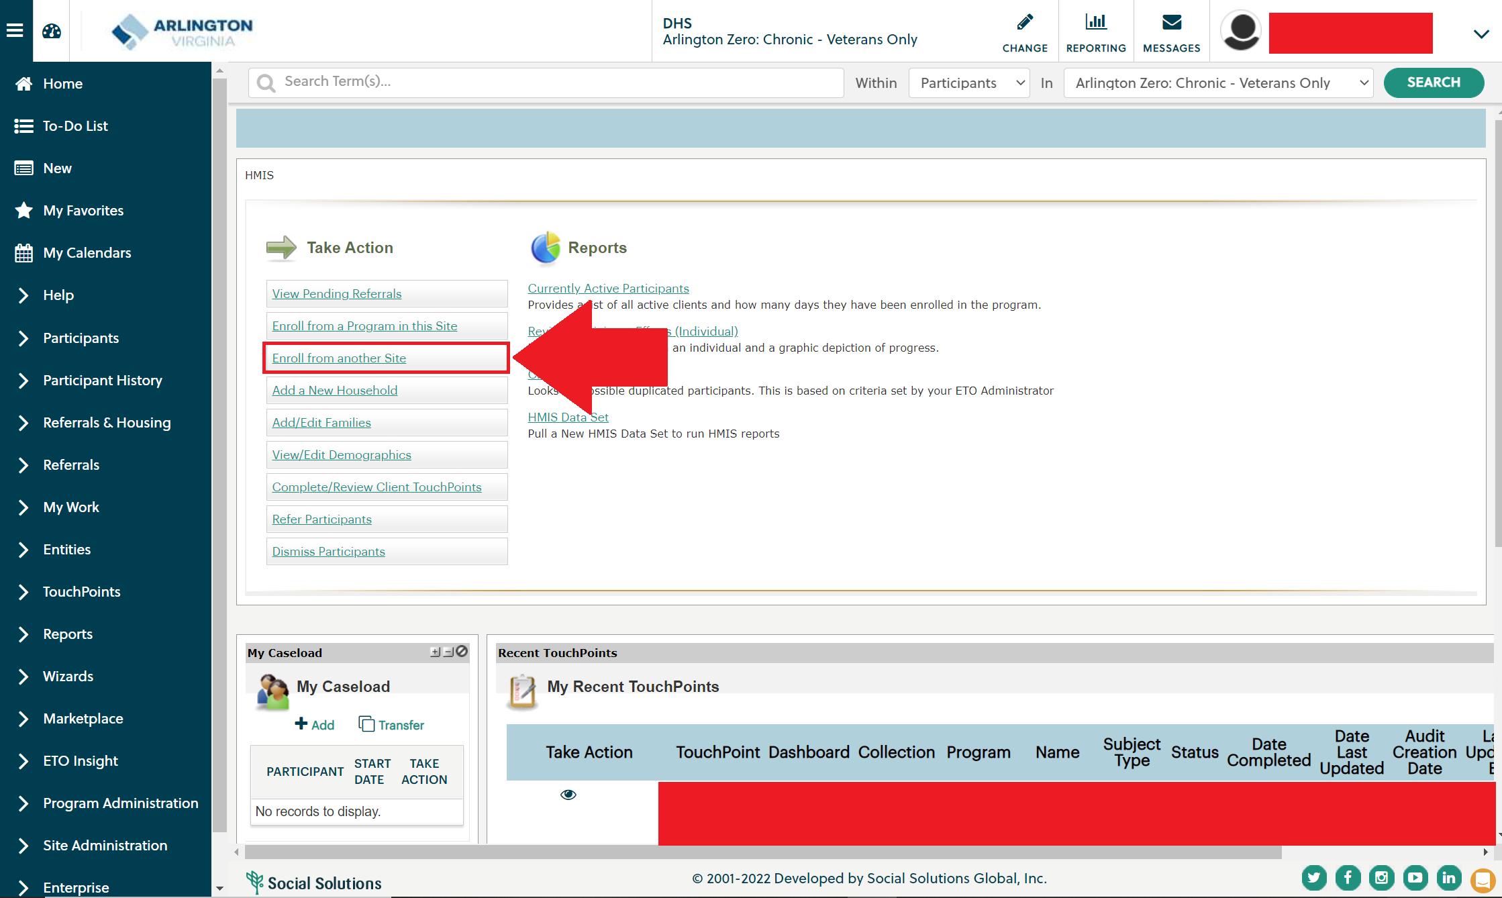
Built for Zero (BFZ): Enroll
Agency Staff

Slide 32
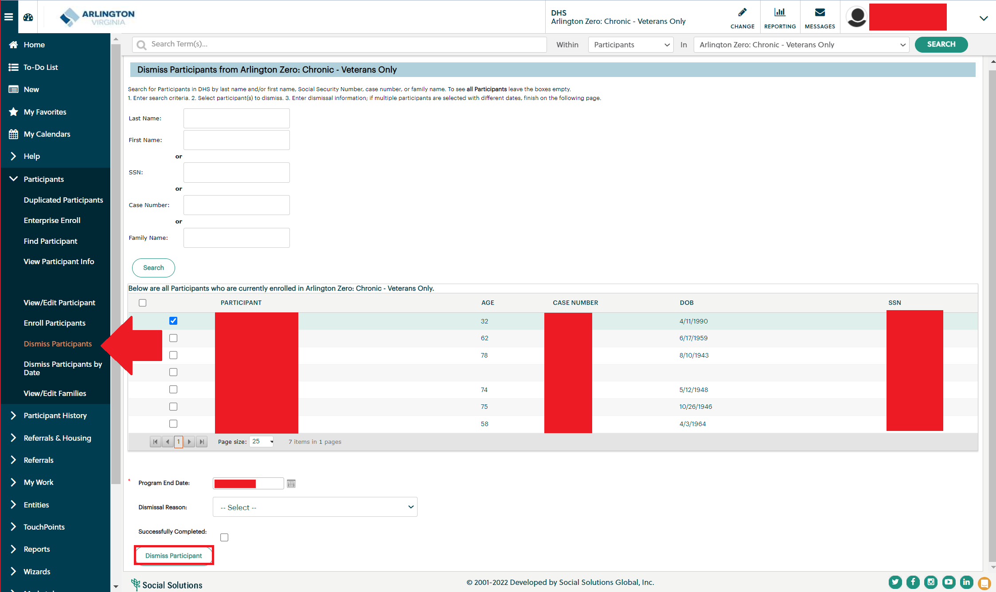
Built for Zero (BFZ): Dismiss
Agency Staff

