Slide 1
Arlington Community Criminal Justice Board
3:30pm
Thursday, July 18th, 2024
Arlington County Courthouse 10th Floor Jury Assembly Room

Slide 2
Agenda
Call to Order
Approval of May 23, 2024, Minutes
Carryover of Pretrial Services Discussion
Chair’s Update
One Year Action Plan updates
Discussion
Diversion, Serving the Unhoused, and the Criminal Justice System
Commonwealth’s Attorney Parisa Dehghani-Tafti
Arlington Circuit Court Chief Judge Judith Wheat
CCJB Member Updates (Two minute maximum per update)
Adjournment

Slide 3
Carryover of Pretrial Services Discussion
Arlington County Sheriff Jose Quiroz
Arlington County Sheriff Chief Deputy Tara Johnson

Slide 4
One Year Action Plan
Over one year:
Create a CCJB website for greater community transparency
In coordination with internal and external stakeholders adopt an updated resolution governing the CCJB
Ensure that the CCJB’s membership reflects the diversity of experiences and perspectives necessary to address present-day challenges
Re-focus on core duties and responsibilities
IN-PROGRESS
What should this group, and its work, look like?

Slide 5
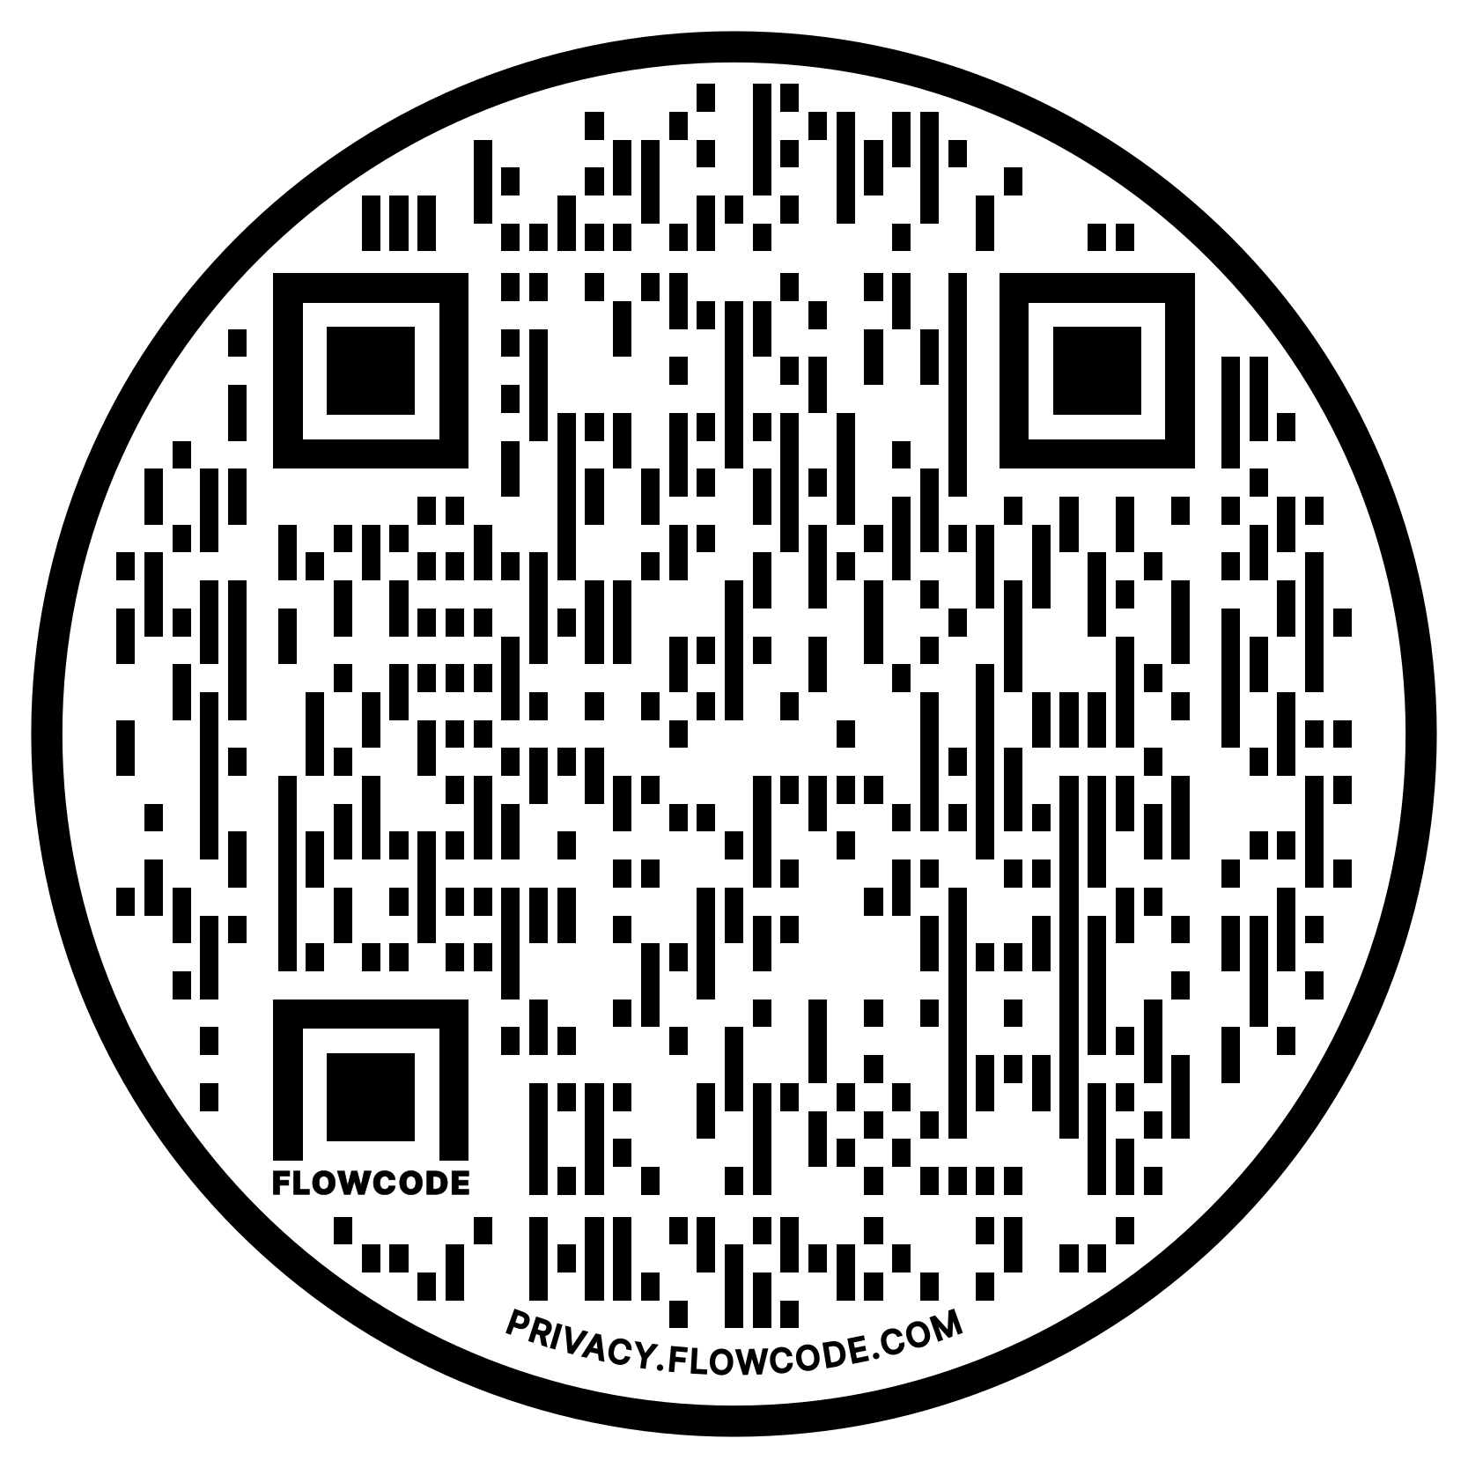
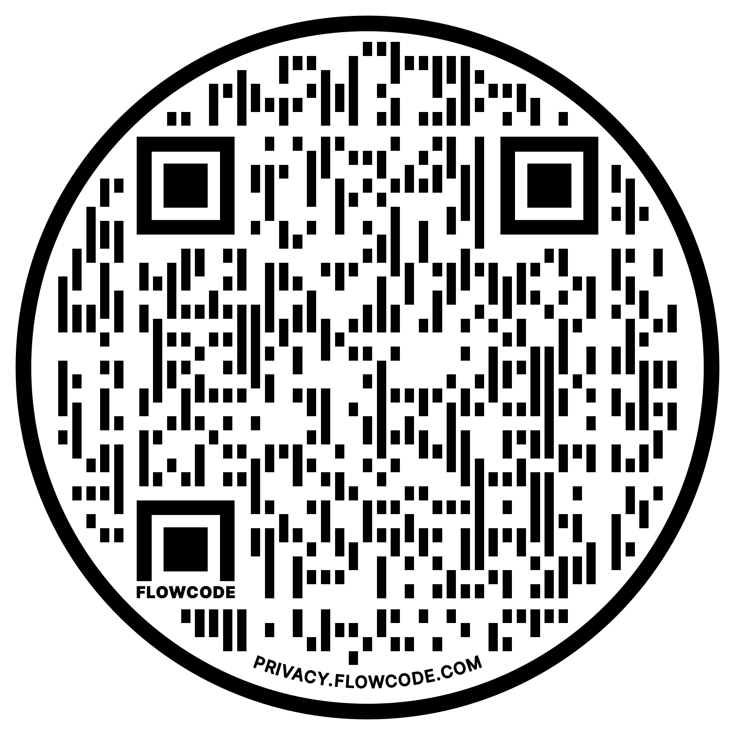
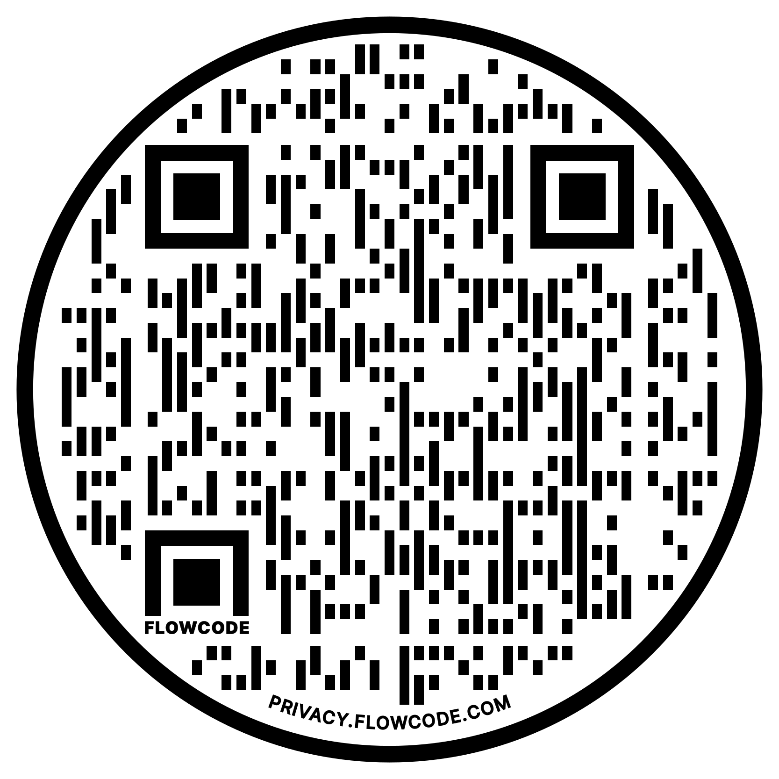
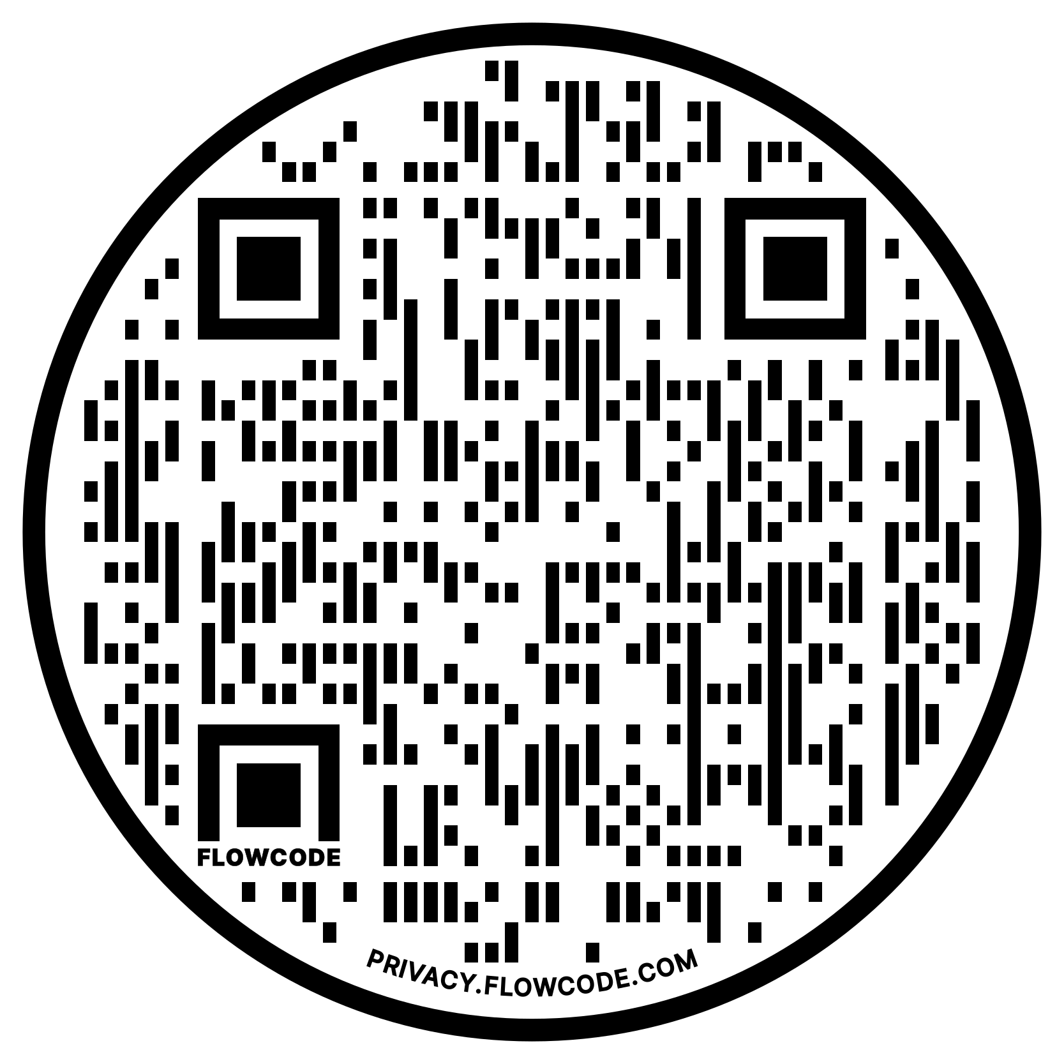
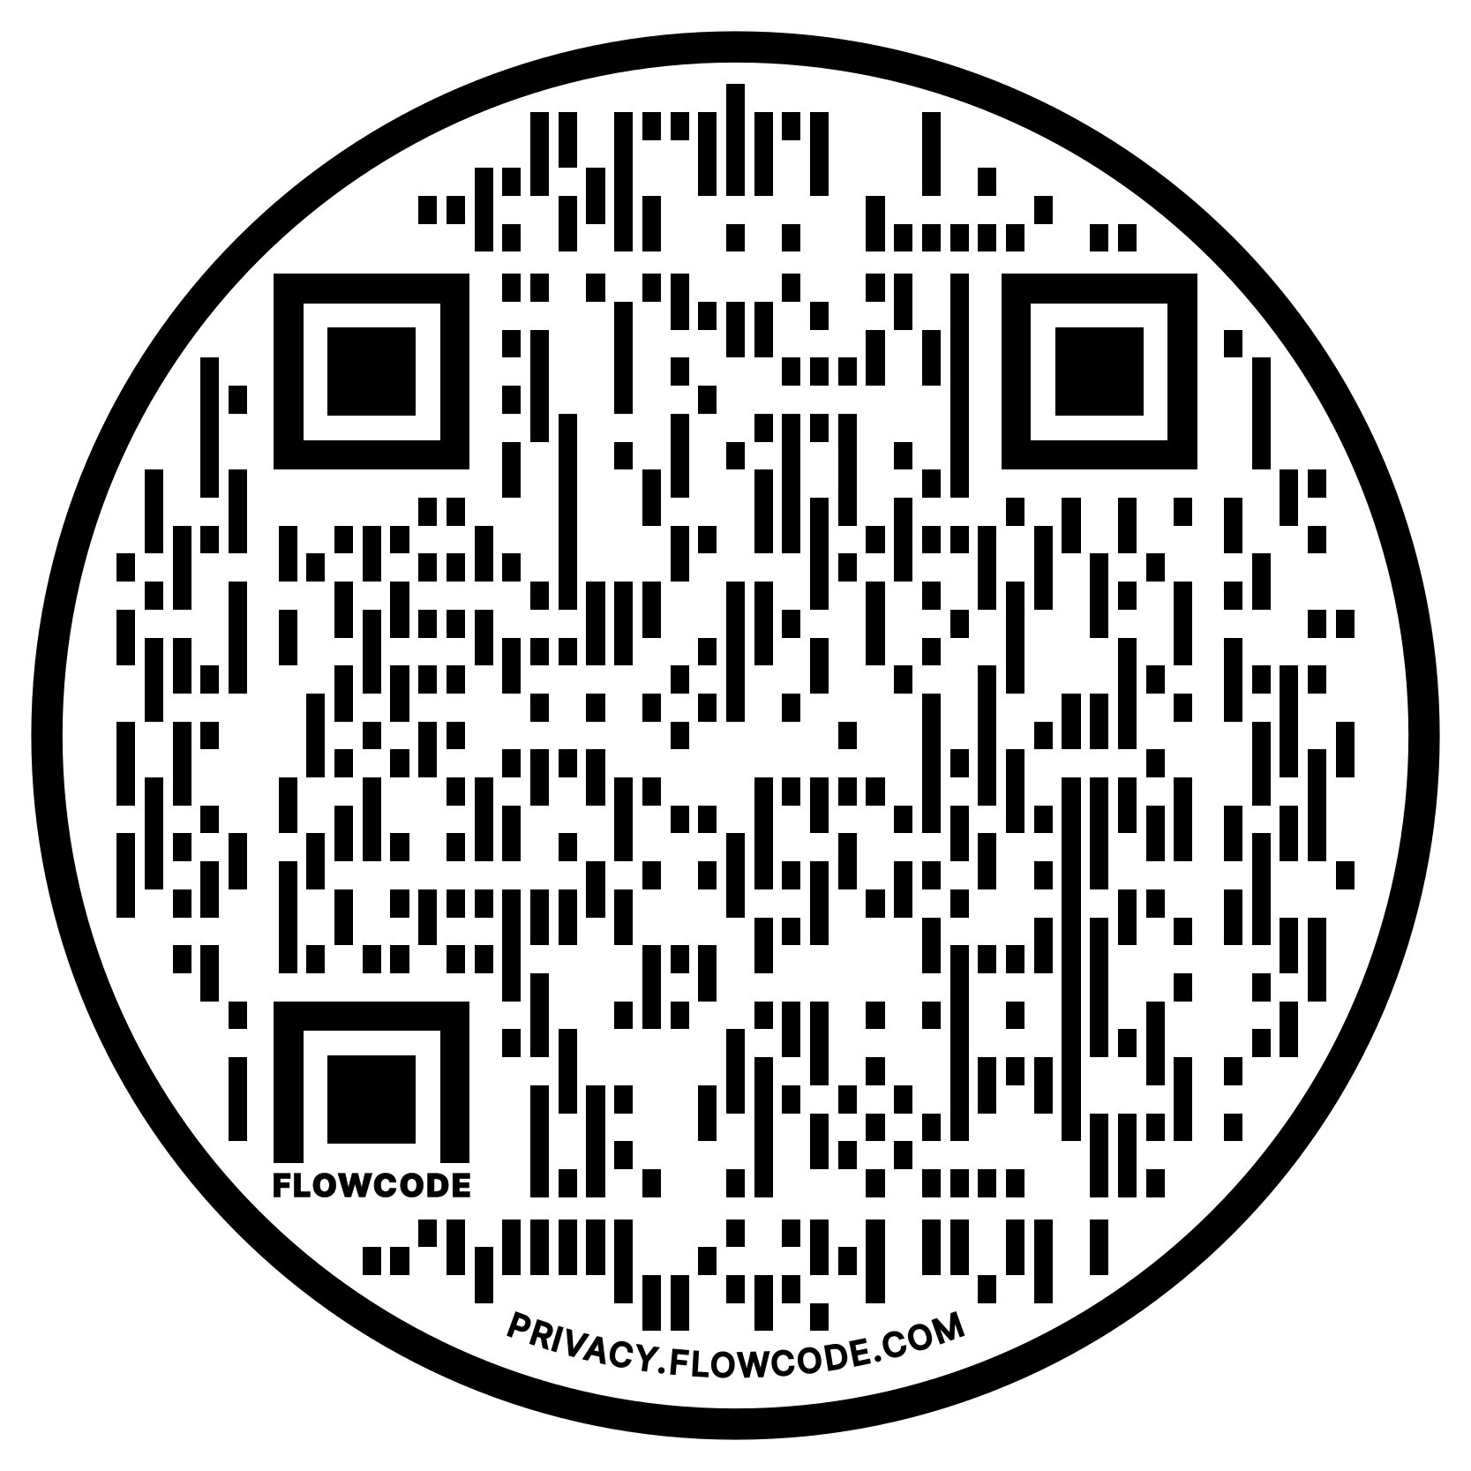
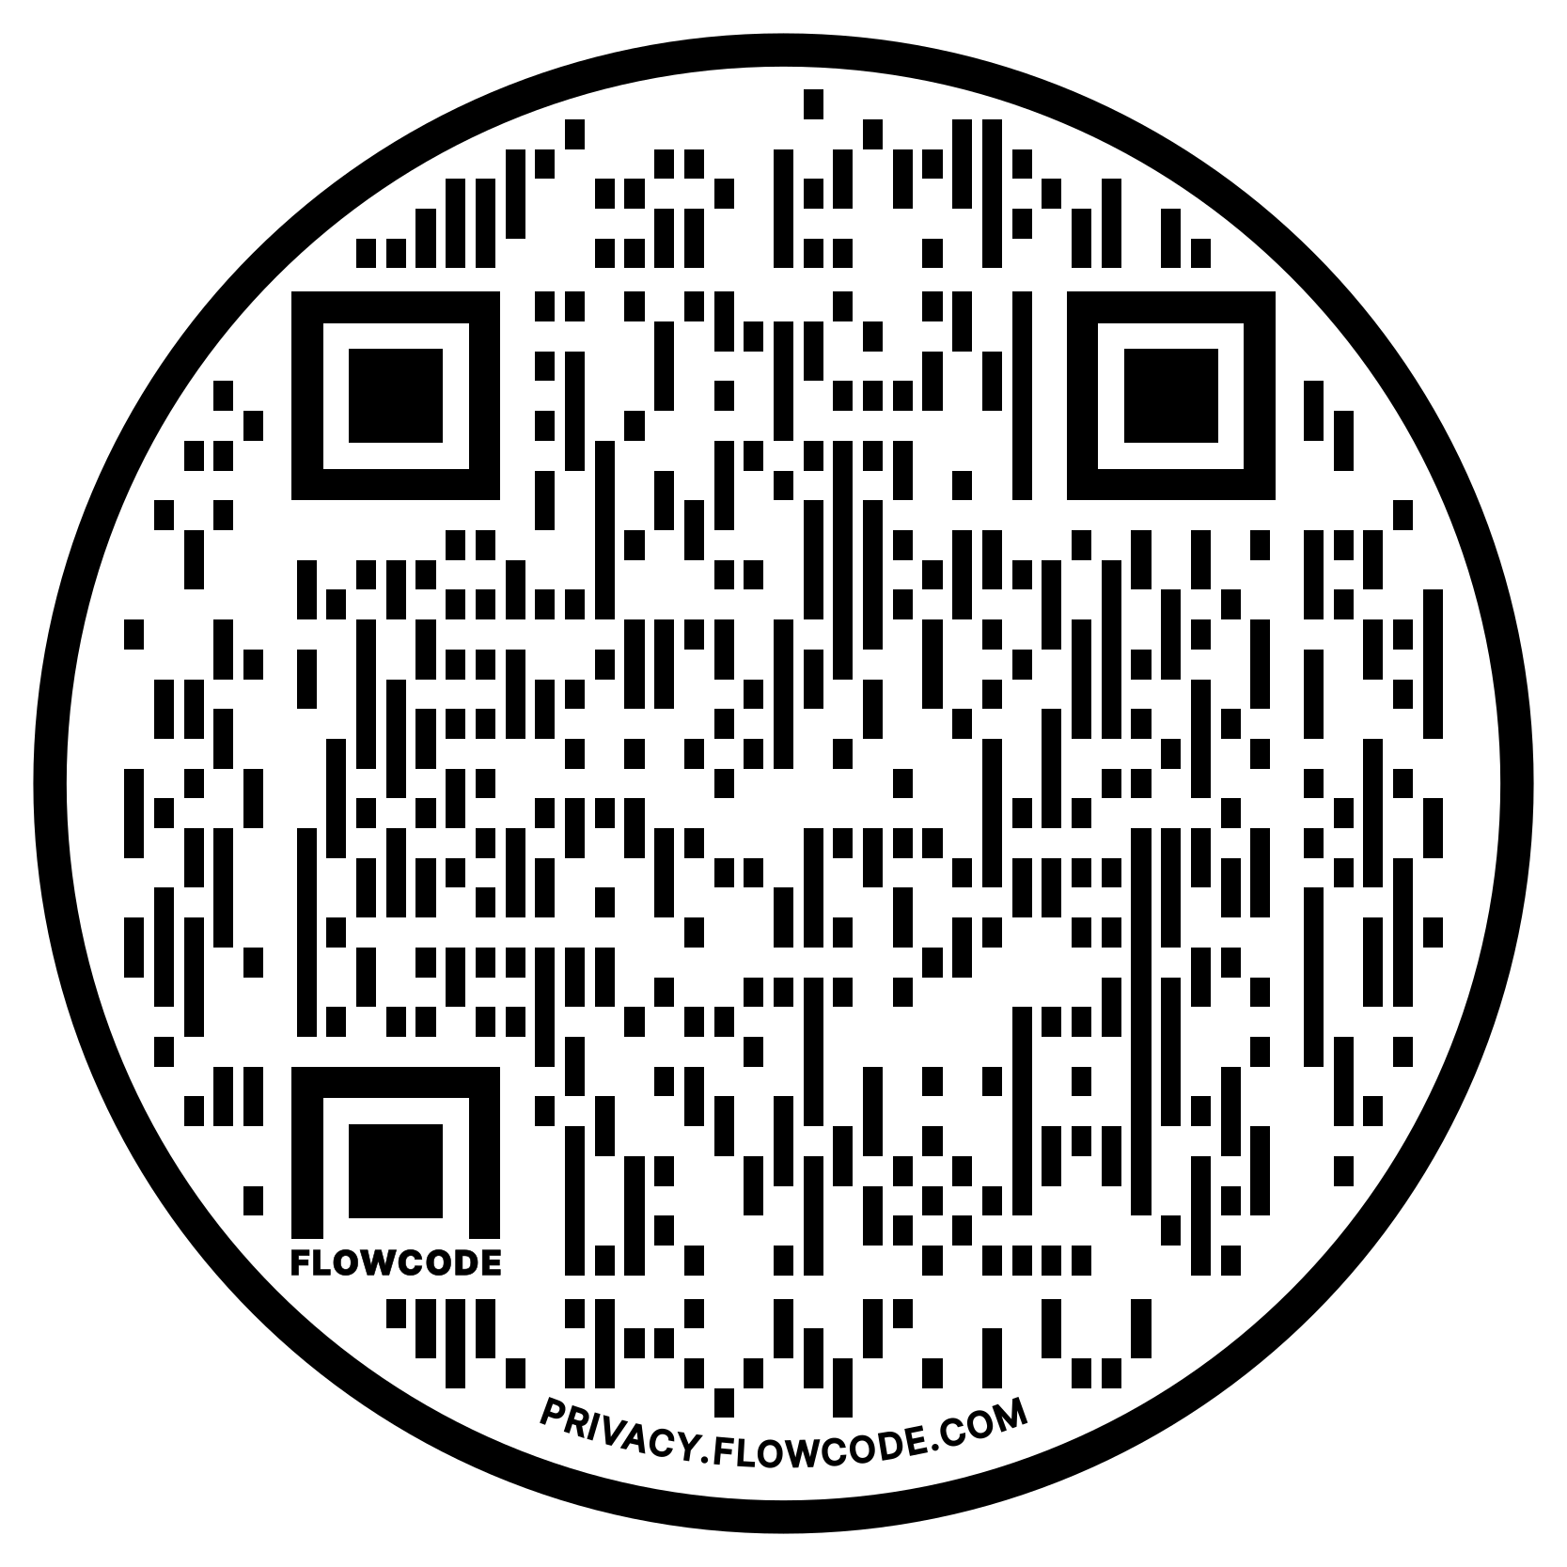
Relevant Materials
Virginia Code §§9.1-173 – 9.1-183
VA DCJS Community Corrections Act Minimum Standards for Local Community-Based Probation
VA DCJS Community Corrections Act Minimum Standards for Pretrial Services
US DOJ National Institute of Corrections National Standards for Criminal Justice Coordinating Councils
US DOJ National Institute of Corrections Essential Elements for Criminal Justice Coordinating Councils
National Association of Counties Policy Brief on Jail Population Review Teams

Slide 6
Re-Authorizing Resolution: Goals
Provide access to local expertise, research, and best practices
Identifying and advising on efficient and cost-effective strategies
Better understand and address complex interactions between criminal justice systems, health and social issues, and behavioral health challenges
Support collaborative approaches between government and non-government services
Identify new funding streams and other resources

Slide 7
Re-Authorizing Resolution: Four Primary Components
Records and Transparency
Membership
Administration & Leadership
Strategic Planning

Slide 8
Re-Authorizing Resolution: Records and Transparency
BE IT RESOLVED…
That the Clerk of the Arlington County Board, or their designee, shall be the custodian of all records related to the CCJB and shall serve as the primary staff liaison until such other person or entity is designated as such by the CCJB membership through duly approved Bylaws.
Reasoning:
Maintain clear lines of transparency during re-authorization
Ensure retention and centralization of relevant records
DCJS LCBP §5.4; NIC CJCC 7.1(b), 7.2(a), 7.3, 7.4, EE5

Slide 9
Re-Authorizing Resolution: Membership
 | Code-Required Seats | Term
1 | Arlington County Board Representative | Two 4-Year Terms
2 | Falls Church City Council Representative | Two 4-Year Terms
3 | General District Court Judge | Two 4-Year Terms
4 | Circuit Court Judge | Two 4-Year Terms
5 | Juvenile & Domestic Relations Court Judge | Two 4-Year Terms
6 | Chief Magistrate | Incumbent
7 | Arlington Chief of Police | Incumbent
8 | Commonwealth’s Attorney | Incumbent
9 | Chief Public Defender | Incumbent
10 | Arlington Sheriff | Incumbent
11 | Local Educator | Two 4-Year Terms
12 | Community Services Board Administrator | Incumbent
BE IT FURTHER RESOLVED…
That the Arlington Community Criminal Justice Board is hereby re-established and shall include the following members:
Reasoning:
Membership in 2001 Resolution:
Total Members: 31
Citizen Representatives: 1
Proposed Membership:
Total Members: 30
Citizen Representatives: 3 (+1 formerly justice-involved individual)
According to NIC, CJCC membership size varies, but most have 16-25 regardless of jurisdiction size
Ensure a more diverse and representative membership that is prepared to address the challenges we face today
 | Non-Code-Required Seats | Term
13 | Clerk of the Circuit Court | Incumbent
14 | Clerk of the General District Court | Incumbent
15 | Deputy County Manager for Public Safety | Incumbent
16 | Director of Pretrial Program | Incumbent
17 | Director of Community Corrections Unit | Incumbent
18 | Arlington DHS Clinical Services Bureau Chief | Incumbent
19 | Arlington Director of Public Health | Incumbent
20 | Independent Policing Auditor | Incumbent
21 | Director of NoVA Juvenile Detention Center | Incumbent
22 | Director of District 10 Adult Probation & Parole | Incumbent
23 | Director of Arlington Addiction Recovery Initiative | Incumbent
24 | Chair of the Community Services Board | Incumbent
25 | Community Non-Profit Representative | Two 4-Year Terms
26 | Community Non-Profit Representative | Two 4-Year Terms
27 | Citizen Representative | Two 4-Year Terms
28 | Citizen Representative | Two 4-Year Terms
29 | Citizen Representative | Two 4-Year Terms
30 | Formerly Justice-Involved Individual | Two 4-Year Terms
VA§9.1-178; DJCS LCBP §5.2; NIC CJCC 3.1, 3.3, 3.4, 3.5, 3.6, EE2

Slide 10
Re-Authorizing Resolution: Administration and Leadership
BE IT FURTHER RESOLVED…
That the CCJB shall adopt bylaws which shall include, but not be limited to, the creation of committees; the election, in odd-numbered years, of a chair and vice chair as the CCJB Officers; the creation and composition of an Executive Committee; and the frequency with which the CCJB will meet, which shall be at least quarterly. Such bylaws shall be reviewed, at a minimum, every two years.
Reasoning:
The creation of bylaws and their review at least every two years (required by DCJS Local Community-Based Probation Minimum Standards)
Will support the institutionalization of the CCJB’s efforts and allow for greater specificity than the resolution when structuring the CCJB
The creation of committees through the bylaws (examples include a Jail Population Review Team, formalizing related groups (e.g., Mental Health Criminal Justice Review Committee; Re-Entry Council), or a committee on justice-involved youth)
Creates additional opportunities for non-CCJB Members to meaningfully contribute in a formal way
Allows for greater workload distribution and increased productivity
The election, in odd-numbered years, of a Chair and Vice Chair as CCJB officers (Chair election is required by DCJS Local Community-Based Probation Minimum Standards)
Best practice is for the Chair and Vice Chair to be from different disciplines
Election in odd-numbered years is to align the CIP process with the officers’ second year
The creation of an Executive Committee to help manage, prioritize, and monitor progress
Best practice is for membership to not exceed 7 members or 25% of the CCJB membership
NIC recommends: Chair, Vice Chair, Judge, Sheriff, Commonwealth’s Attorney, Police Chief, and Chief Public Defender
Requirement to meet at least four times per year (required by DCJS Local Community-Based Probation Minimum Standards)
Best practice is for meetings at least every other month
DCJS LCBP §5.2, 5.4; NIC CJCC 2, 4.1, 4.2, 4.3(a), 4.4, 5.1, 6.1(a), 6.2, 7.1(a), EE 3, EE5, EE 6

Slide 11
Re-Authorizing Resolution: Strategic Planning
BE IT FINALLY RESOLVED…
That the CCJB shall publish a Strategic Plan every five years, beginning in 2025, which shall objectively assess the community’s needs and resources and ensure the comprehensive evaluation, development, and operation of local pretrial services, community-based probation services, and community programs.
Reasoning:
Aligns with best practices by providing a framework through which to approach and measure the work done by the CCJB
VA§9.1-180; §9.1-175; DCJS LCBP §5.3; NIC CJCC 9.1(a), 9.1(c), 9.2, 9.3, EE7

Slide 12
Tentative Timeline
Aug 2024:
Finalize language; engage Falls Church and new CCJB membership
December 2024:
CCJB adopts and Arlington County Board & Falls Church City Council approve new Bylaws
July 2024
Aug. 2024
Sept. 2024
Dec. 2024
One Year…
Dec. 2025
July 2024:
CCJB Discussion of Proposed Re-Authorization Primary Components
September 2024:
Arlington County Board & Falls Church City Council adopt CCJB Re-Authorizing Resolution
December 2025:
CCJB completes Strategic Plan
VA§9.1-180; §9.1-175; DCJS LCBP §5.3; NIC CJCC 9.1(a), 9.1(c), 9.2, 9.3, EE7

Slide 13
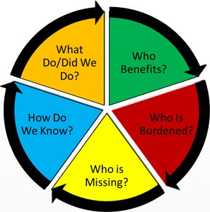
Discussion
Thoughts?
Ideas?
Questions?

Slide 14
Diversion, Serving the Unhoused, and the Criminal Justice System
Commonwealth’s Attorney Parisa Dehghani-Tafti
Chief Judge, Arlington Circuit Court Judith Wheat

Slide 15
CCJB Member Updates
Please share any updates on your work in two minutes or less!

Slide 16
Adjournment
Thank you for coming!
The next CCJB meeting is September 5th, 2024, at 3:30pm in the 10th Floor Jury Assembly Room.

