Slide 1
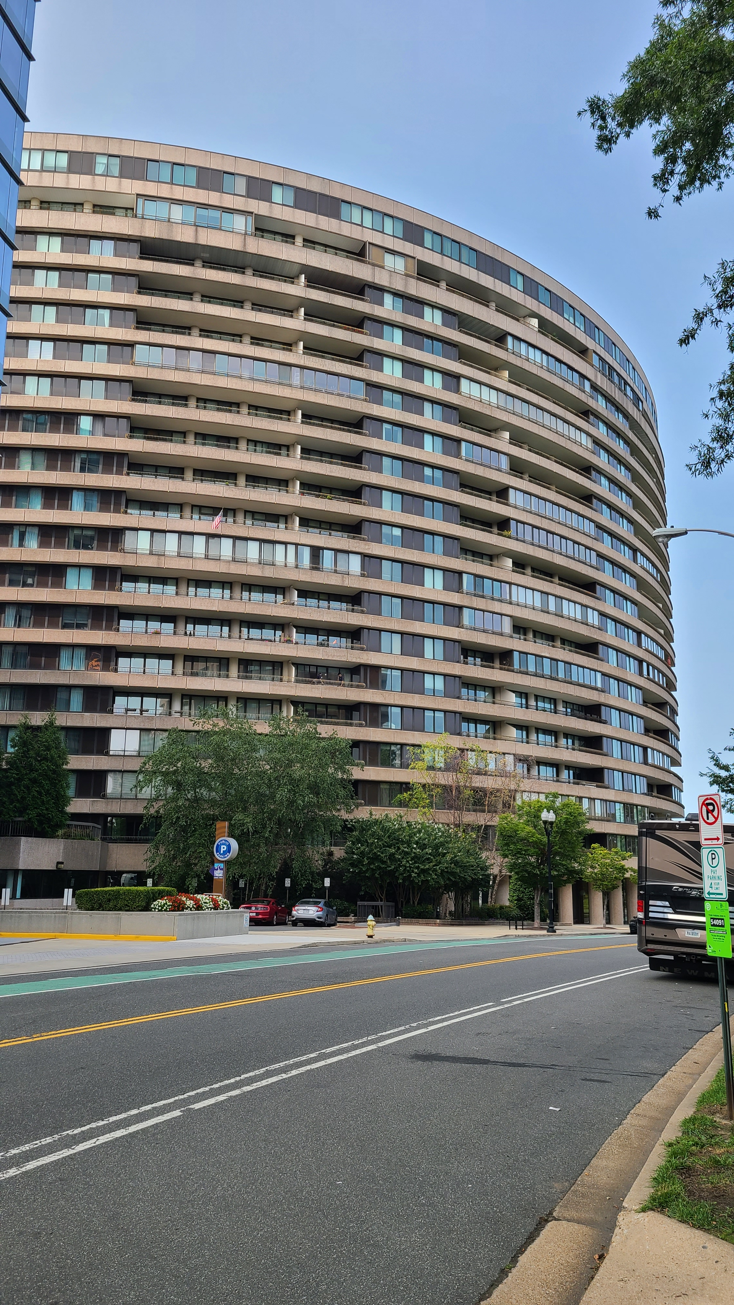
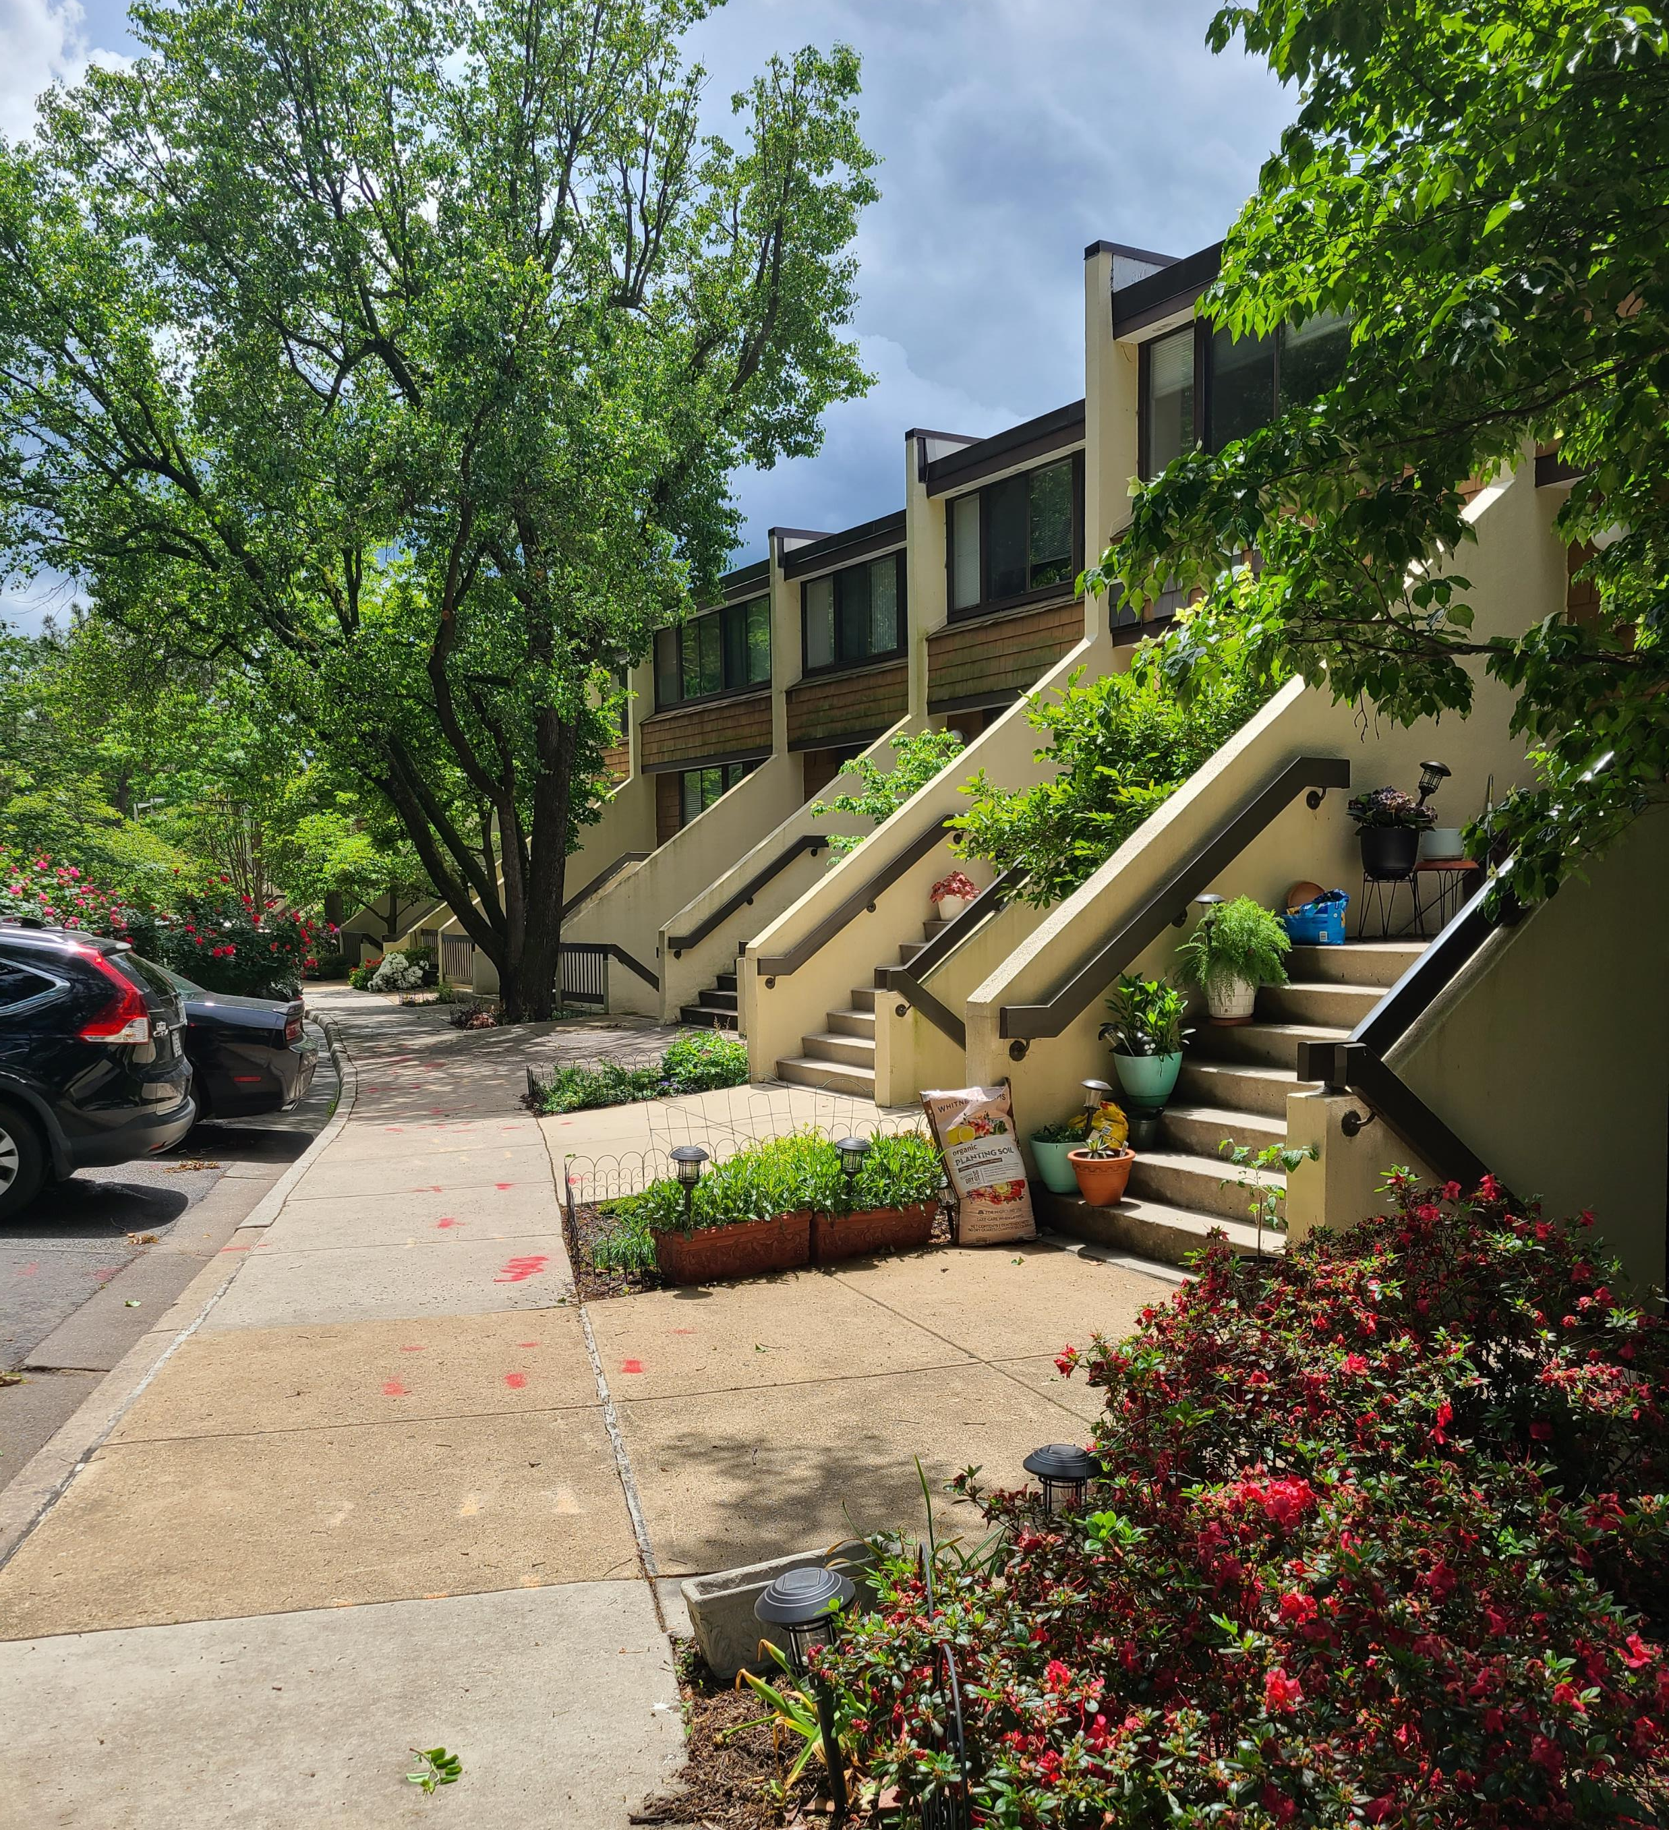
Arlington’s Comprehensive Plan: Historic and Cultural Resources Plan
HALRB Information Session
April 26, 2023

Slide 2
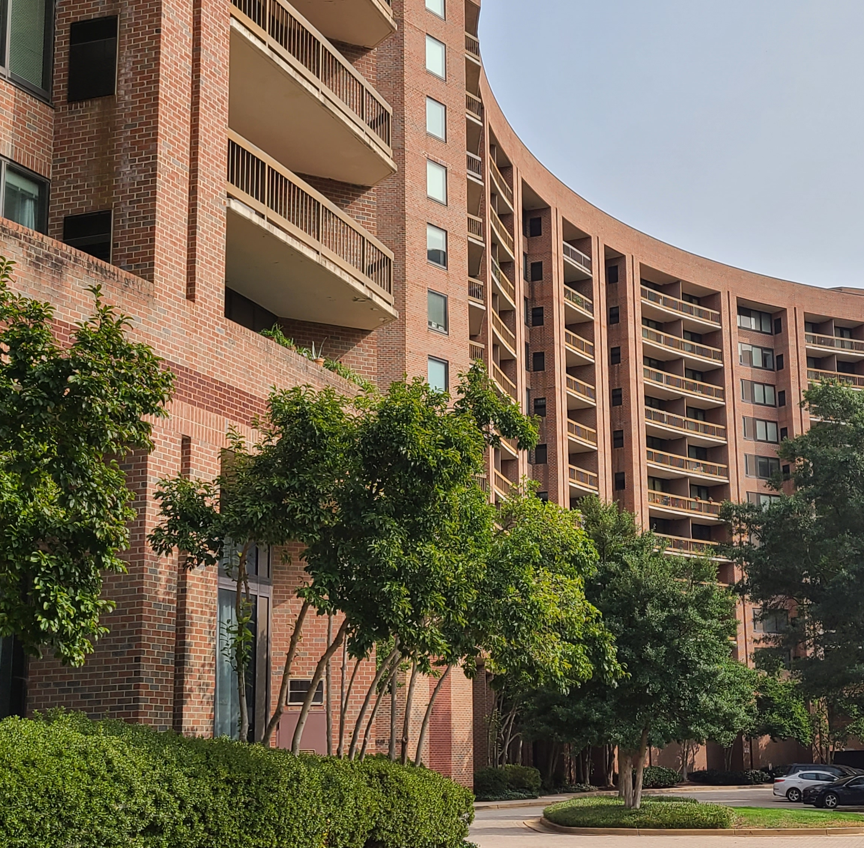
Welcome & Introductions
Birch Wood Planning
Staff
HALRB Members

Slide 3
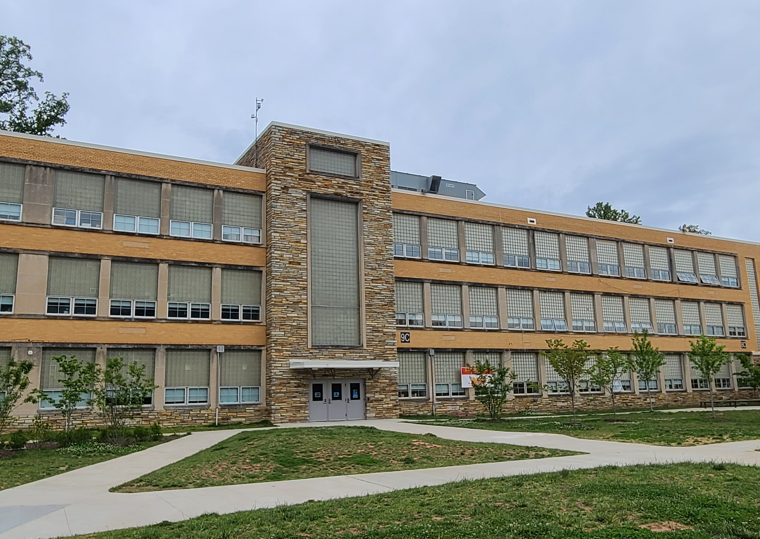
Role of the HALRB
Partner in Arlington’s historic preservation
Review and comment on the draft Historic and Cultural Resources Plan before community open house
Support the Historic and Cultural Resources Plan

Slide 4
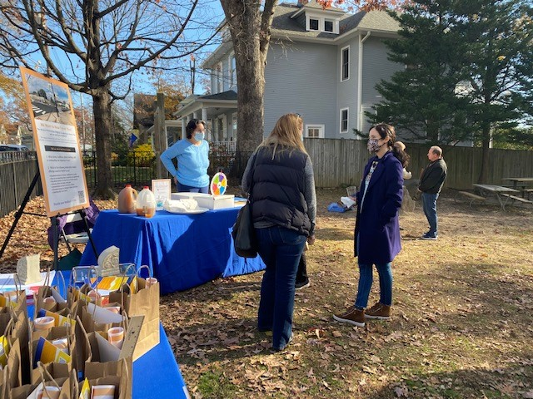
Plan Process & Timeline
Complete
Remaining
Interviews
Community Feedback Questionnaires
Virtual Kickoff Event
Social Media Outreach
Focus Groups
Outreach Week
Internal Draft Review
Release Draft Plan for Public Review/Comment
HALRB Meetings (April, August)
Plan Outreach:
Community open house
Pop-up events
Online feedback questionnaire
Cultural heritage videos
Virtual story map
Plan Presentation to County Board for Adoption (October 2023)

Slide 5
Plan Process & Timeline
Release Draft Historic and Cultural Resources Plan

Slide 6
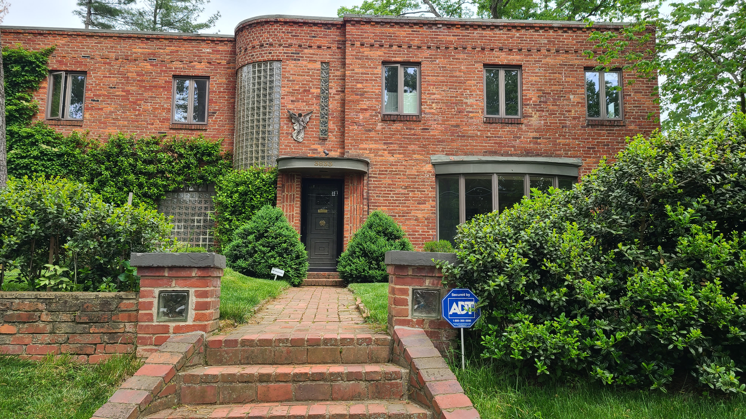
Original Plan: Accomplishments
Historic Preservation Program Staff
Cynthia Liccese-Torres

Slide 7
Original Plan: Challenges
Resources
Emergent issues requiring attention from strategic focus
Relationships and structure surrounding HP work:
Extensive public and internal input and review
Varying understanding and priorities regarding historic preservation (staff, leadership, commissions, boards, public)

Slide 8
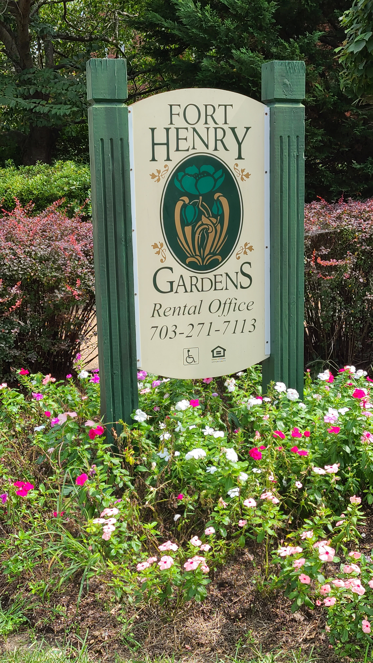
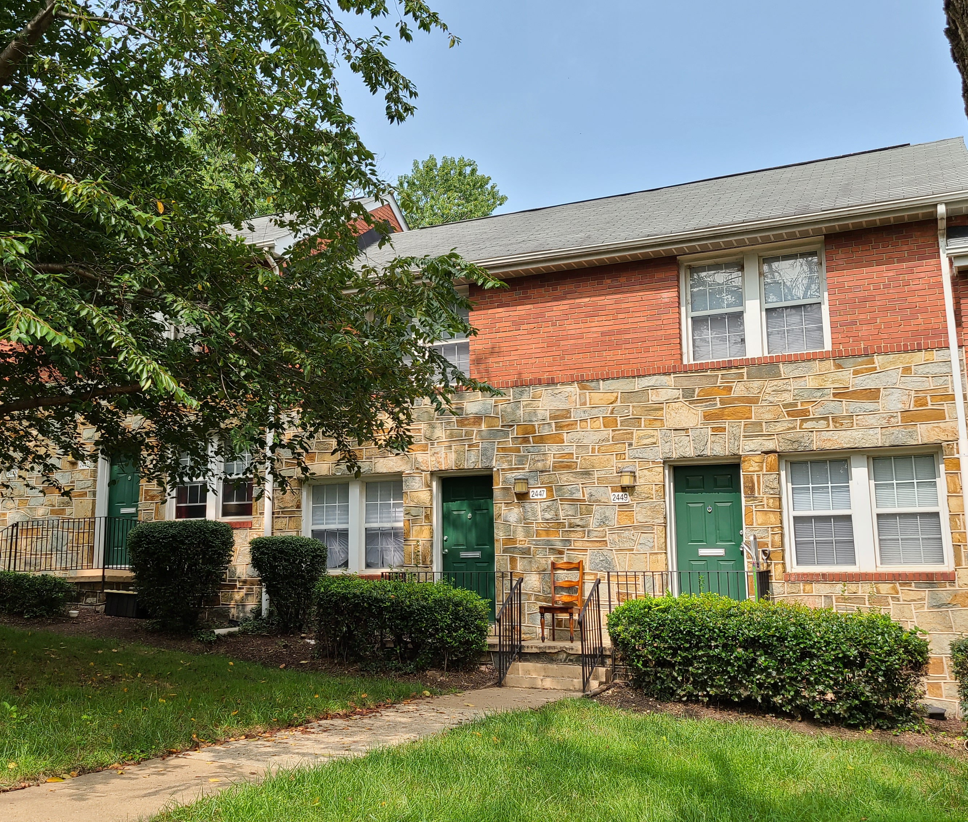
Plan Context & Focus: Equity, Accessibility
There has been a gradual and accelerating movement for change based on awareness of inequity and shifting demographics.
Language (ex: plan name), interpretation, and more impact public ability to connect to historic preservation.
The plan includes Equity Aspirations for each goal, as our intent is to ensure County historic preservation tools and services are accessible to anyone who can benefit and would want to use them.

Slide 9
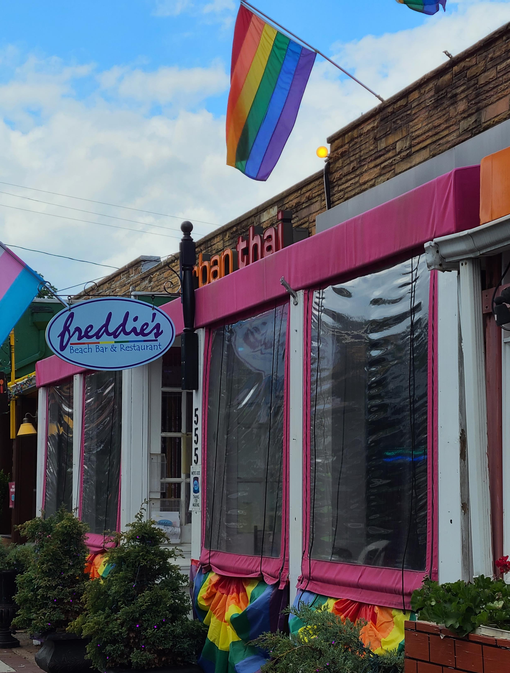
Plan Summary & Discussion

Slide 10
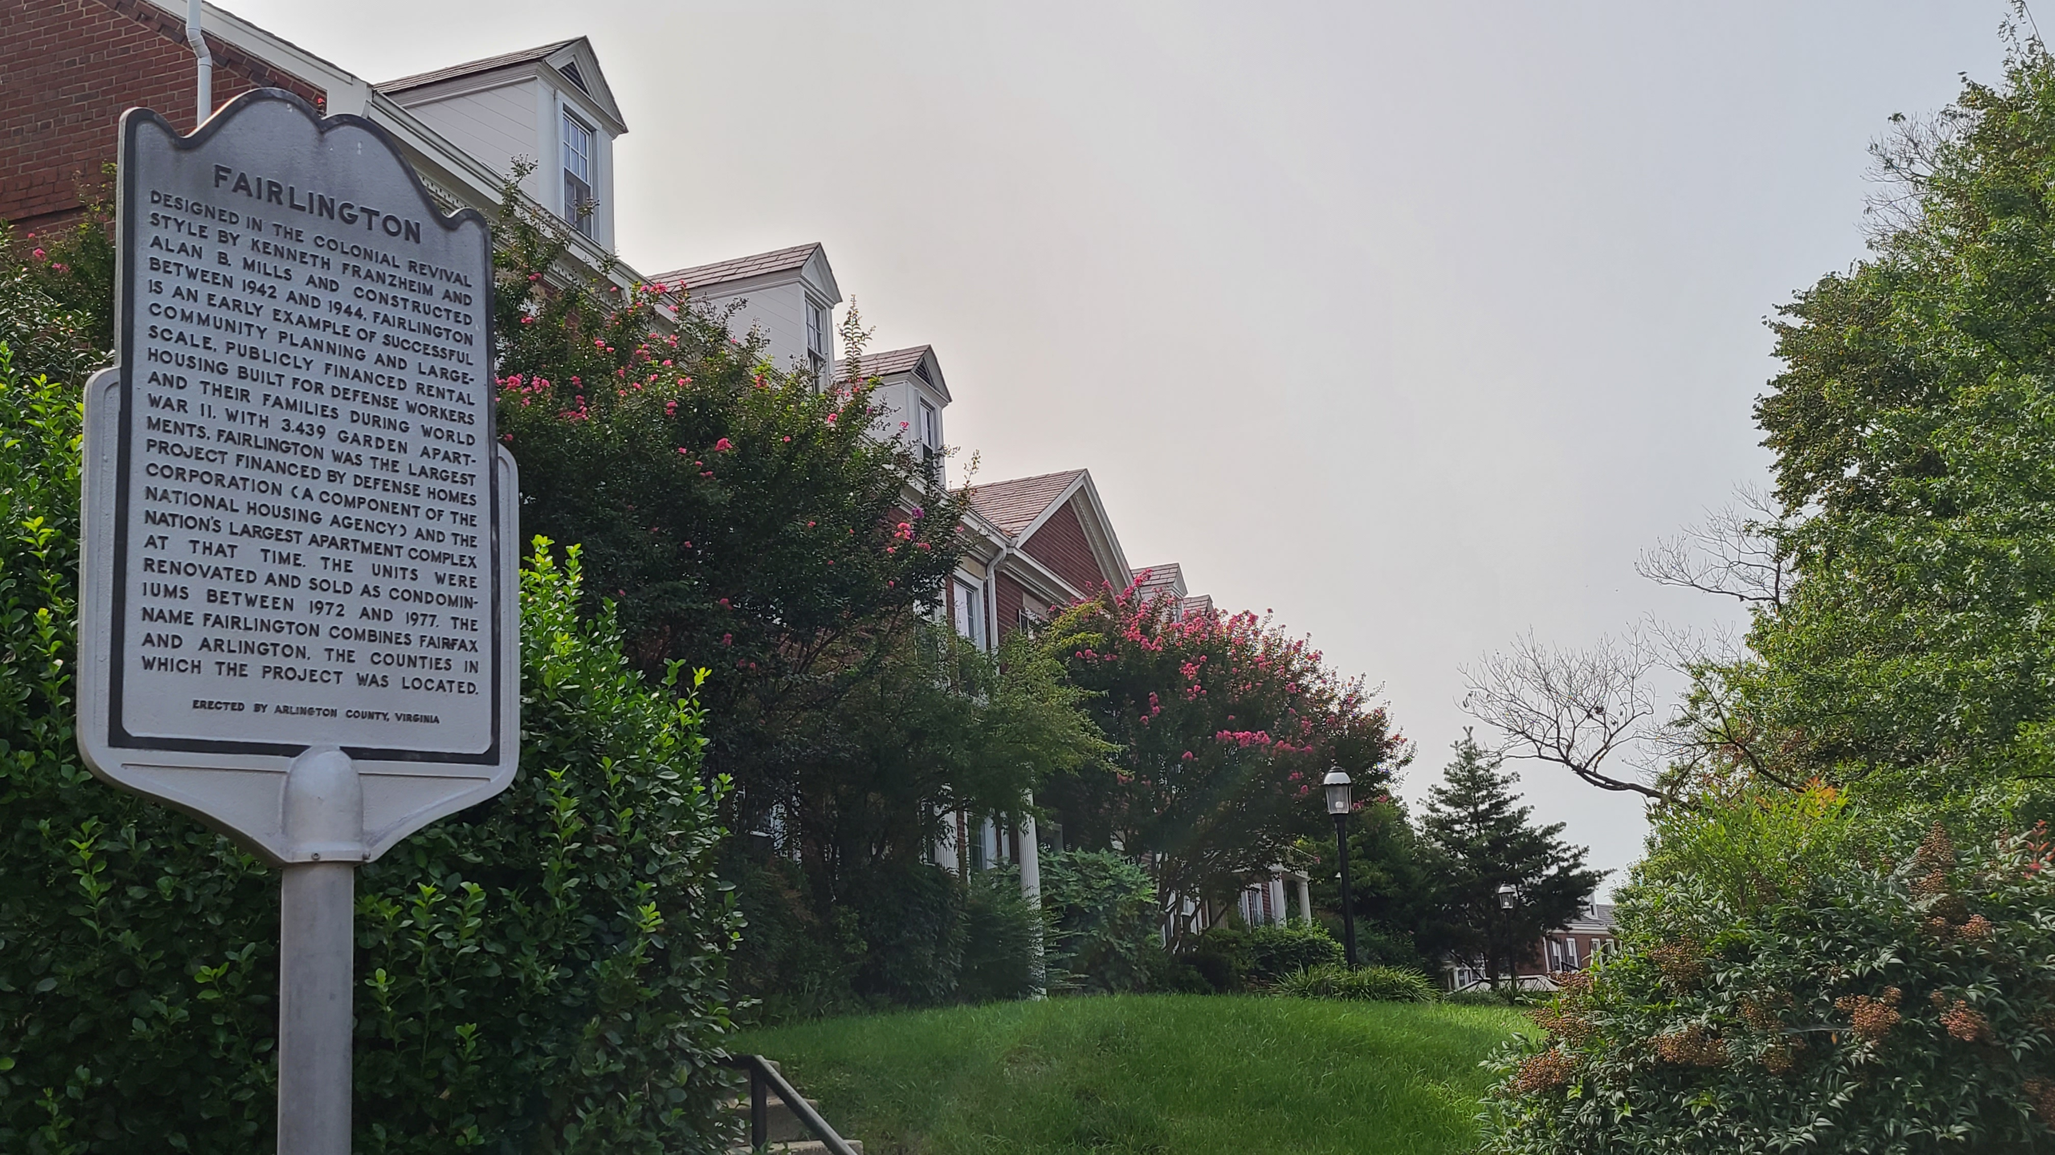
Community Engagement: Goals
Goal: Build understanding of Arlington’s history, people, and historic places.
Objective: Highlight Arlington’s diverse populations and historic places.
Objective: Conduct one outreach effort quarterly.
Goal: Build support for preservation of Arlington’s historic places.
Objective: Develop a regular “annual report”-style update on historic preservation.
Objective: Continue and expand the HPP digital newsletter.
Objective: Reach out to areas and communities that typically have not participated in historic preservation activities.

Slide 11
Incentives for Preservation: Goals
Goal: Provide incentives for preservation.
Objective: Recognize those under local historic districts (LHDs) and preservation easements.
Objective: Provide financial incentives for preservation.
Objective: Pursue flexible zoning standards (to the extent permitted by law) for historic buildings undergoing rehabilitation or adaptive reuse.
Objective: Partner and coordinate with County departments and divisions to establish a menu of County provided benefits available to owners of LHDs, recorded preservation easements, or historic properties under site plan or development review.

Slide 12
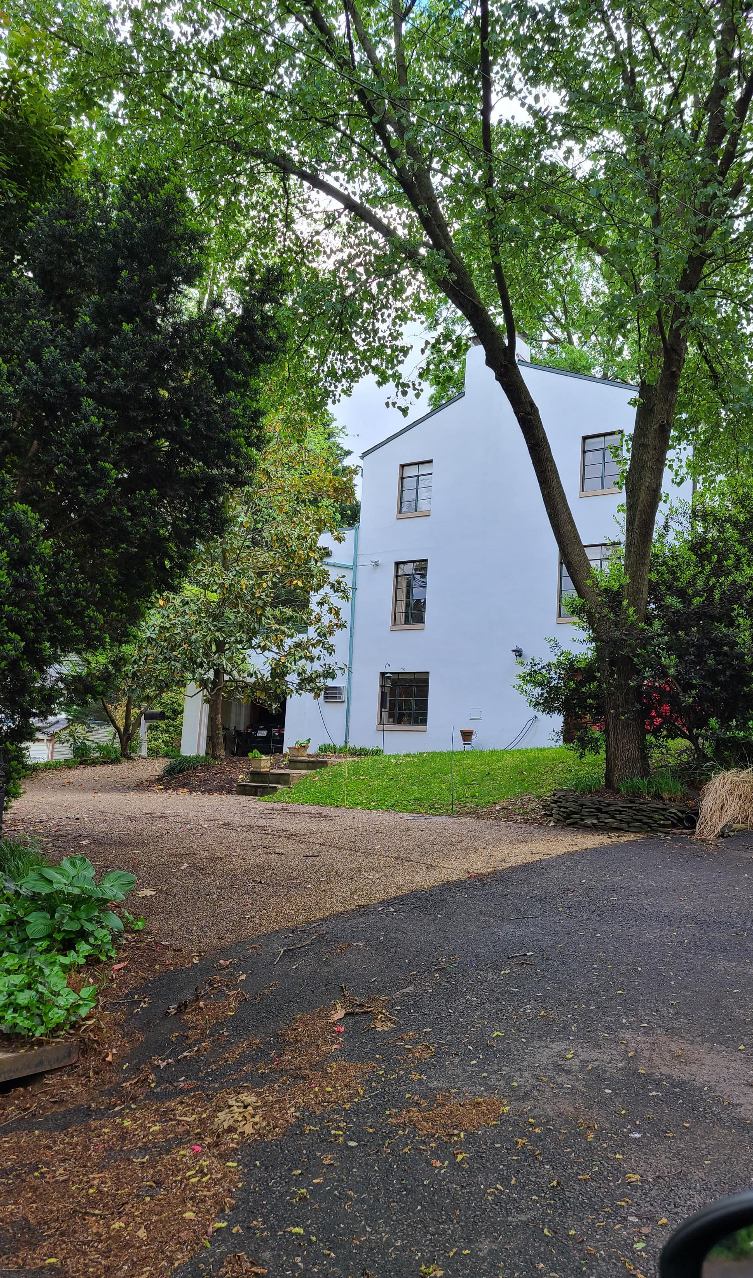
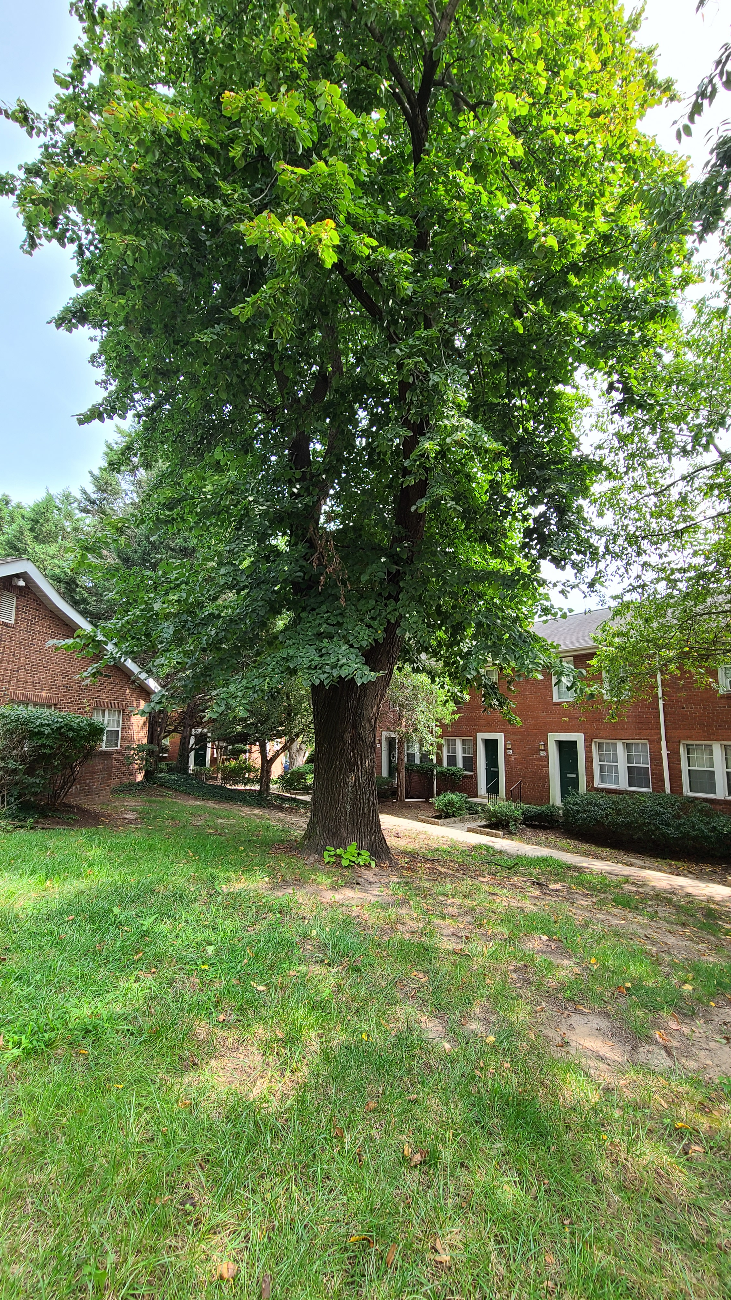
Partnerships: Goals
Goal: Formalize and define the inclusion of historic preservation into other County planning and reviews.
Objective: Develop proactive, constructive, and consistent partnerships among historic preservation and other County functions.
Objective: Require historic preservation to be included in all Sector Plans, Area Plans, Long-Range Plans, and countywide planning studies.

Slide 13
Partnerships: Goals (cont.)
Goal: Integrate historic preservation with priority initiatives.
Objective: Increase partnership between affordable housing and historic preservation.
Objective: Provide support for retrofitting historic properties for improved energy efficiency.
Objective: Support the role of trees, vegetation, and landscape design in historic neighborhoods and landscapes.

Slide 14
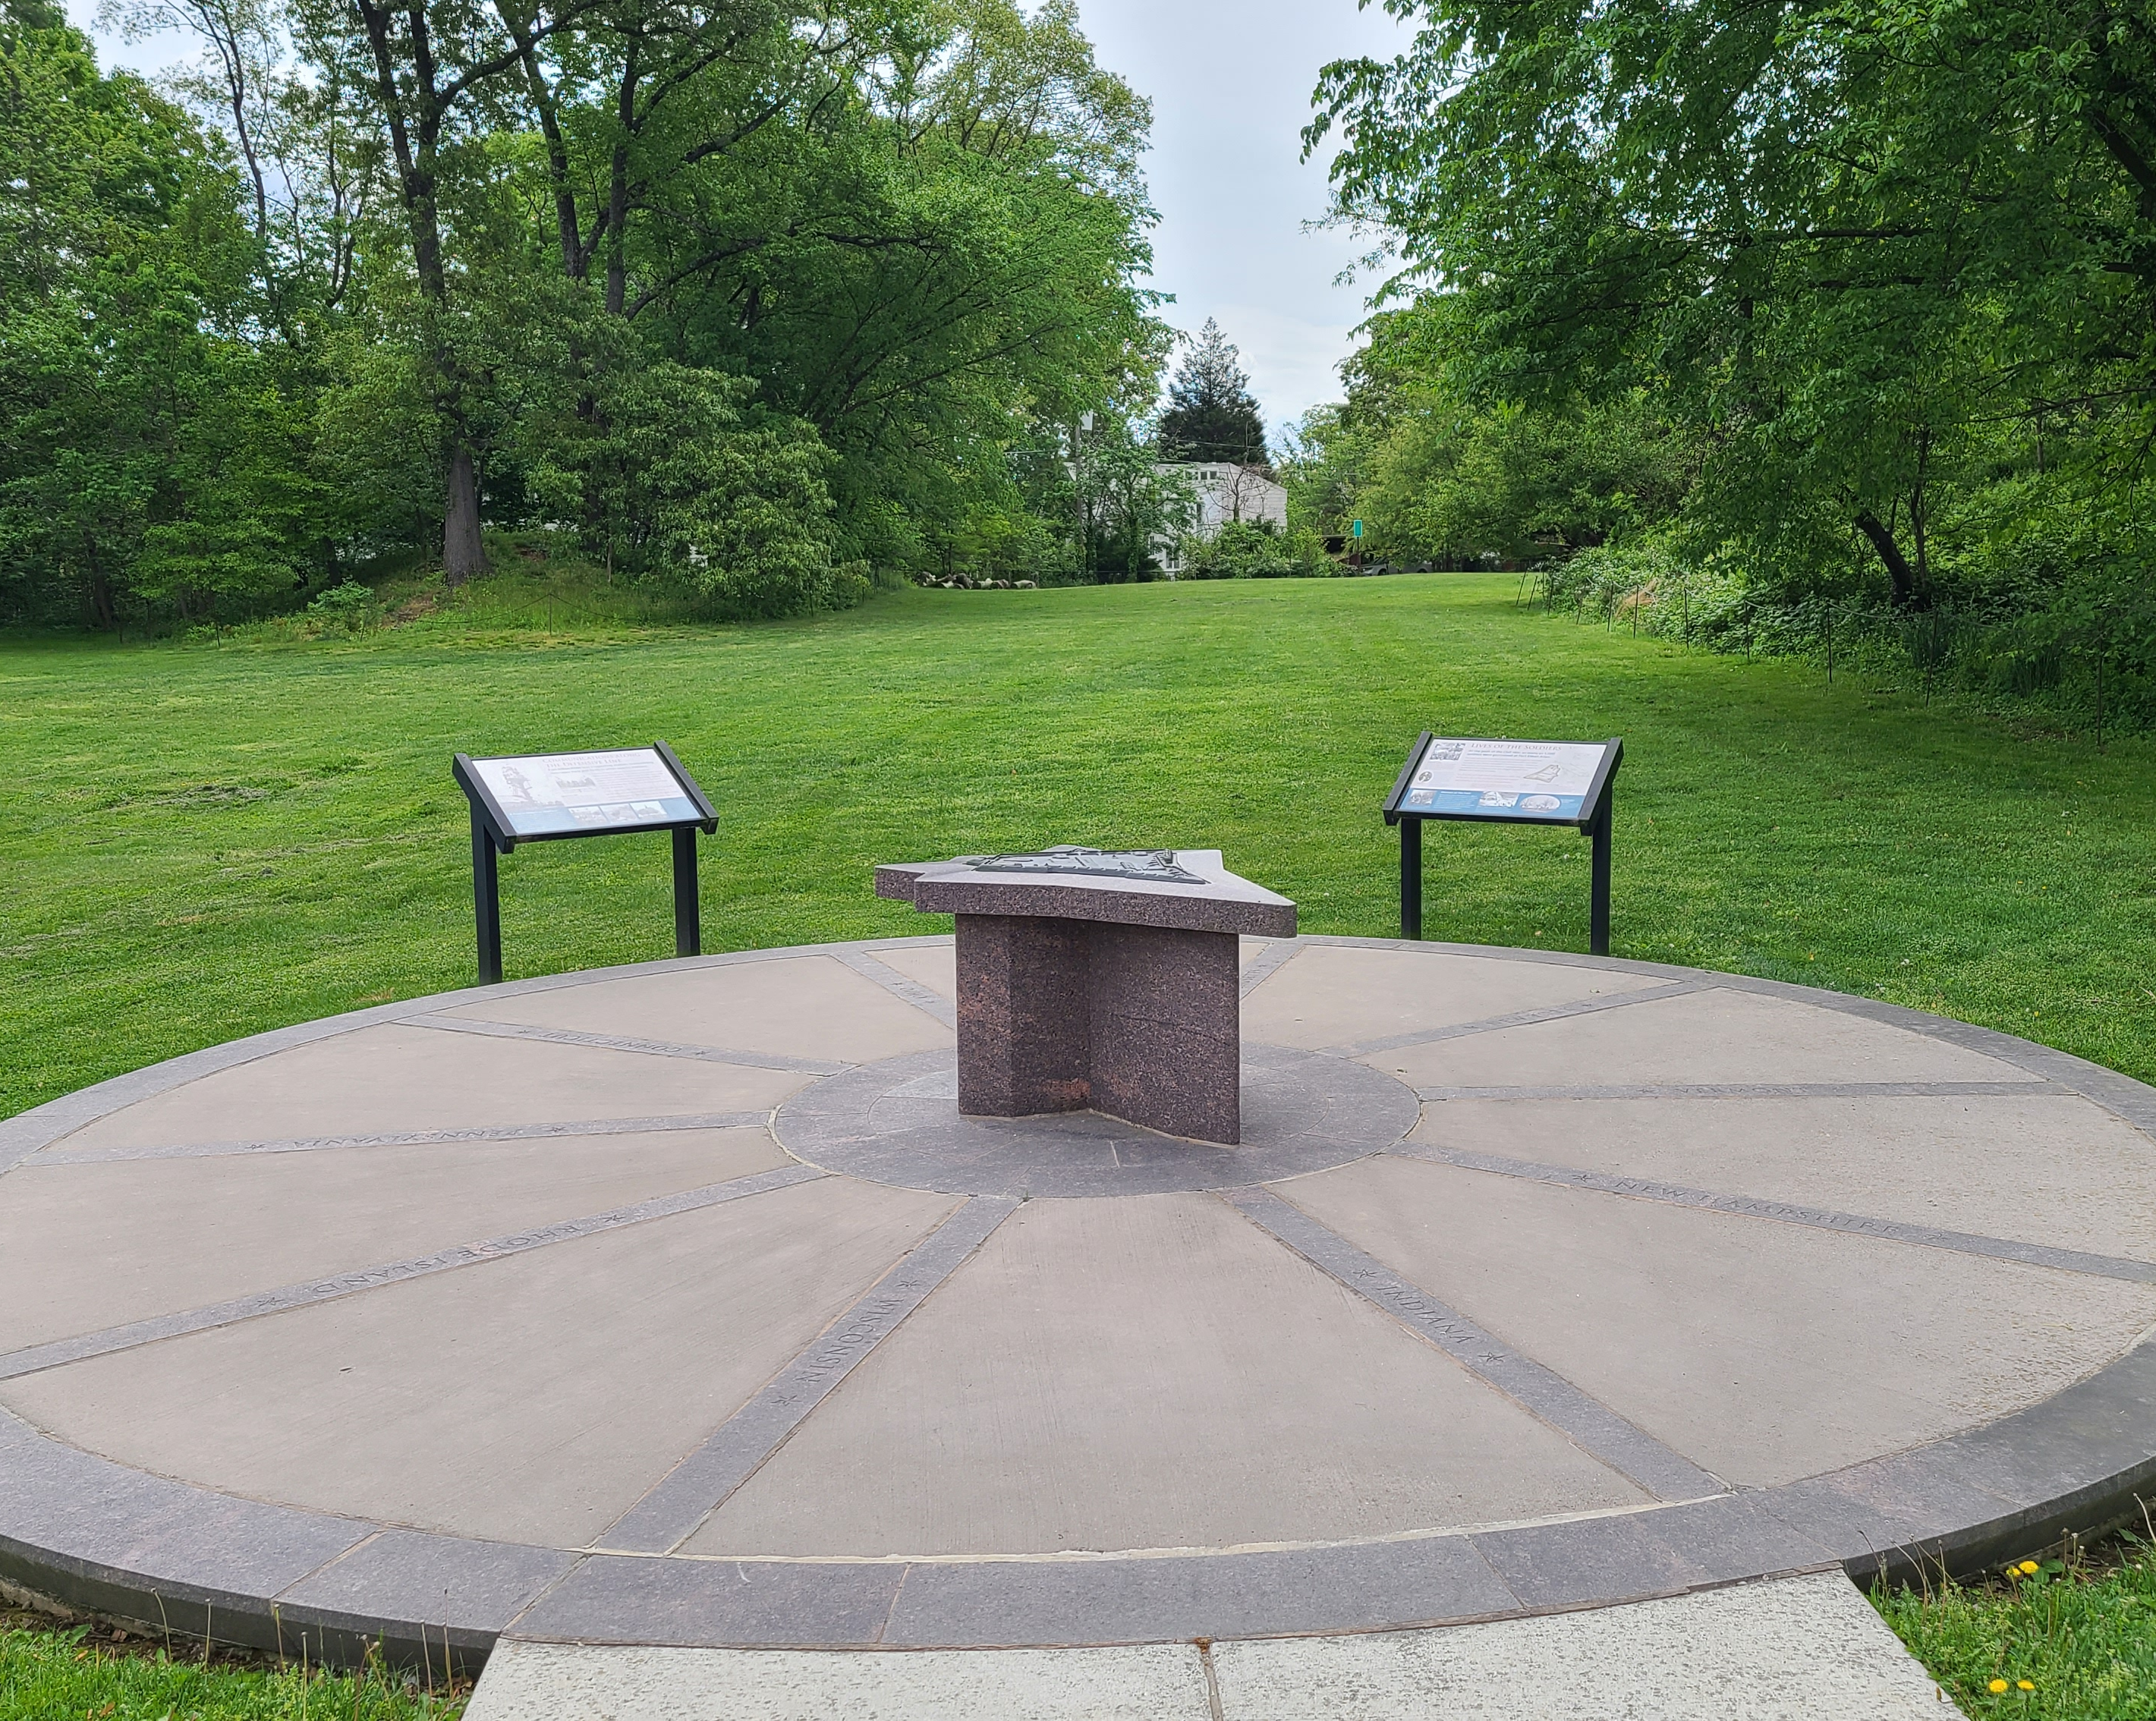
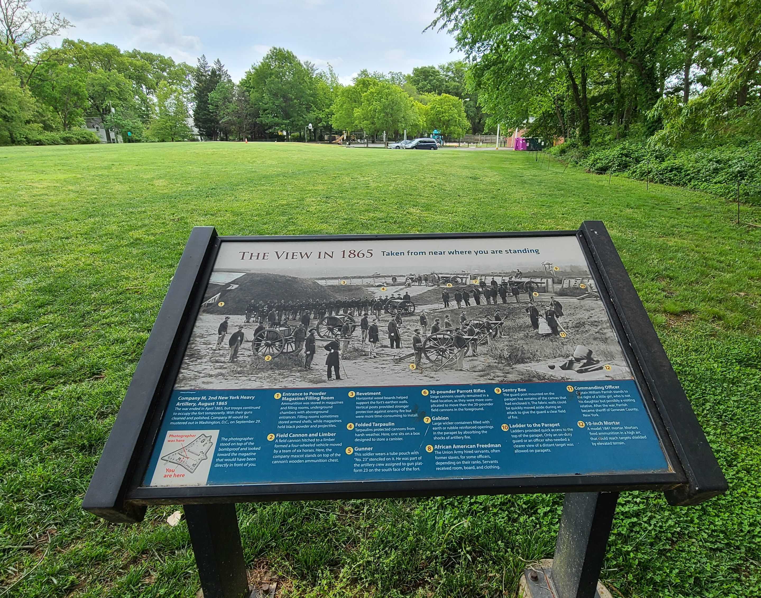
Partnerships: Goals (cont.)
Goal: Explicitly address cultural landscapes in Arlington.
Objective: Develop recommendations for maintenance and development issues at cemeteries and burial grounds.
Objective: Work with partners to understand, interpret, and preserve or enhance the physical historic resources and cultural meaning of County parks and other public spaces.

Slide 15
Regulation: Goals
Goal: Assess and improve the LHD designation process.
Objective: Evaluate the LHD designation process to strengthen alignment between HALRB recommendations and County Board decisions.
Objective: Ensure designation decisions utilize those legal requirements included in the state enabling legislation (Section 15.2-2306) or ACZO (Section 11.3.4).
Objective: Seek legislative changes at the state level to align LHD designation process with national benchmarks.

Slide 16
Regulation: Goals (cont.)
Goal: Protect structures with meaning beyond architecture and of places that are neither a single building nor a complete large neighborhood, but rather in-between in size.
Objective: Pursue the establishment of “Neighborhood Heritage Districts” focused on scale, rhythm/layout, broad materials, or other features in general.
Objective: Pursue the establishment of “micro-districts,” which are modestly sized LHDs.

Slide 17
Regulation: Goals (cont.)
Goal: Seek preservation for high-risk and underrepresented historic and cultural resources and landscapes.
Objective: Prioritize application of historic preservation tools to the highest risk and least protected resources.
Goal: Establish an Archaeology Program for Arlington County.
Objective: Develop and adopt an Archaeology Ordinance.
Objective: Develop an archaeology plan.
Objective: Develop an archaeology review process for projects on County property.

Slide 18
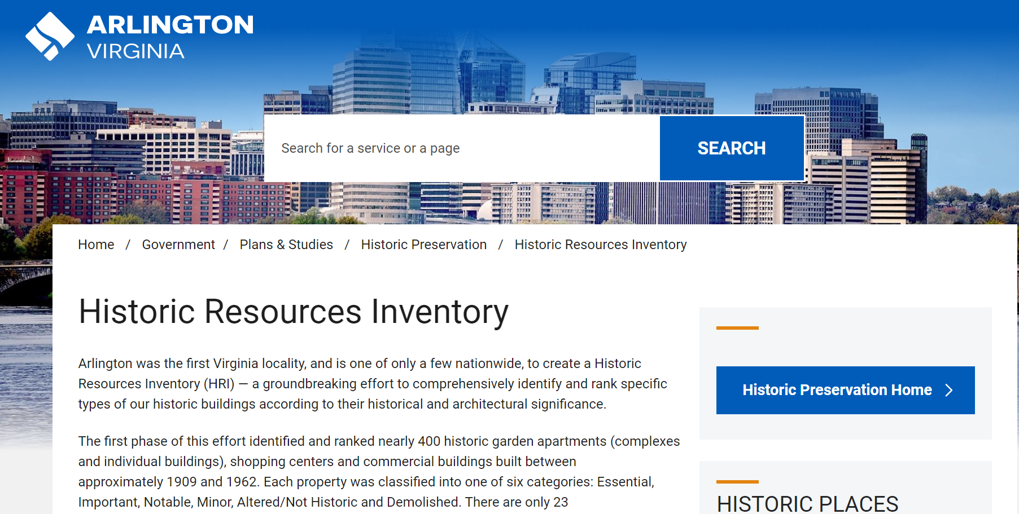
Technology, Information, and Tools: Goals
Goal: Expand and improve the usability of the Historic Resources Inventory (HRI).
Objective: Make corrections to Phase 1 of the HRI.
Objective: Provide clearer policy requirements for HRI-listed properties.
Objective: Provide accessible Geographic Information Systems (GIS) mapping connectivity to the HRI.
Objective: Develop a Phase 2 of the HRI.

Slide 19
Technology, Information, and Tools: Goals (cont.)
Goal: Improve and expand the County’s historic preservation information systems.
Objective: Conduct additional architectural and cultural surveys and studies.
Objective: Complete the African American Multiple Property Documentation heritage survey.
Objective: Share Arlington’s historic preservation data, information, and physical records.
Objective: Establish a Countywide historic archival records program and records management function.
Objective: Inventory and integrate the risks for historic properties into historic preservation information systems.

Slide 20
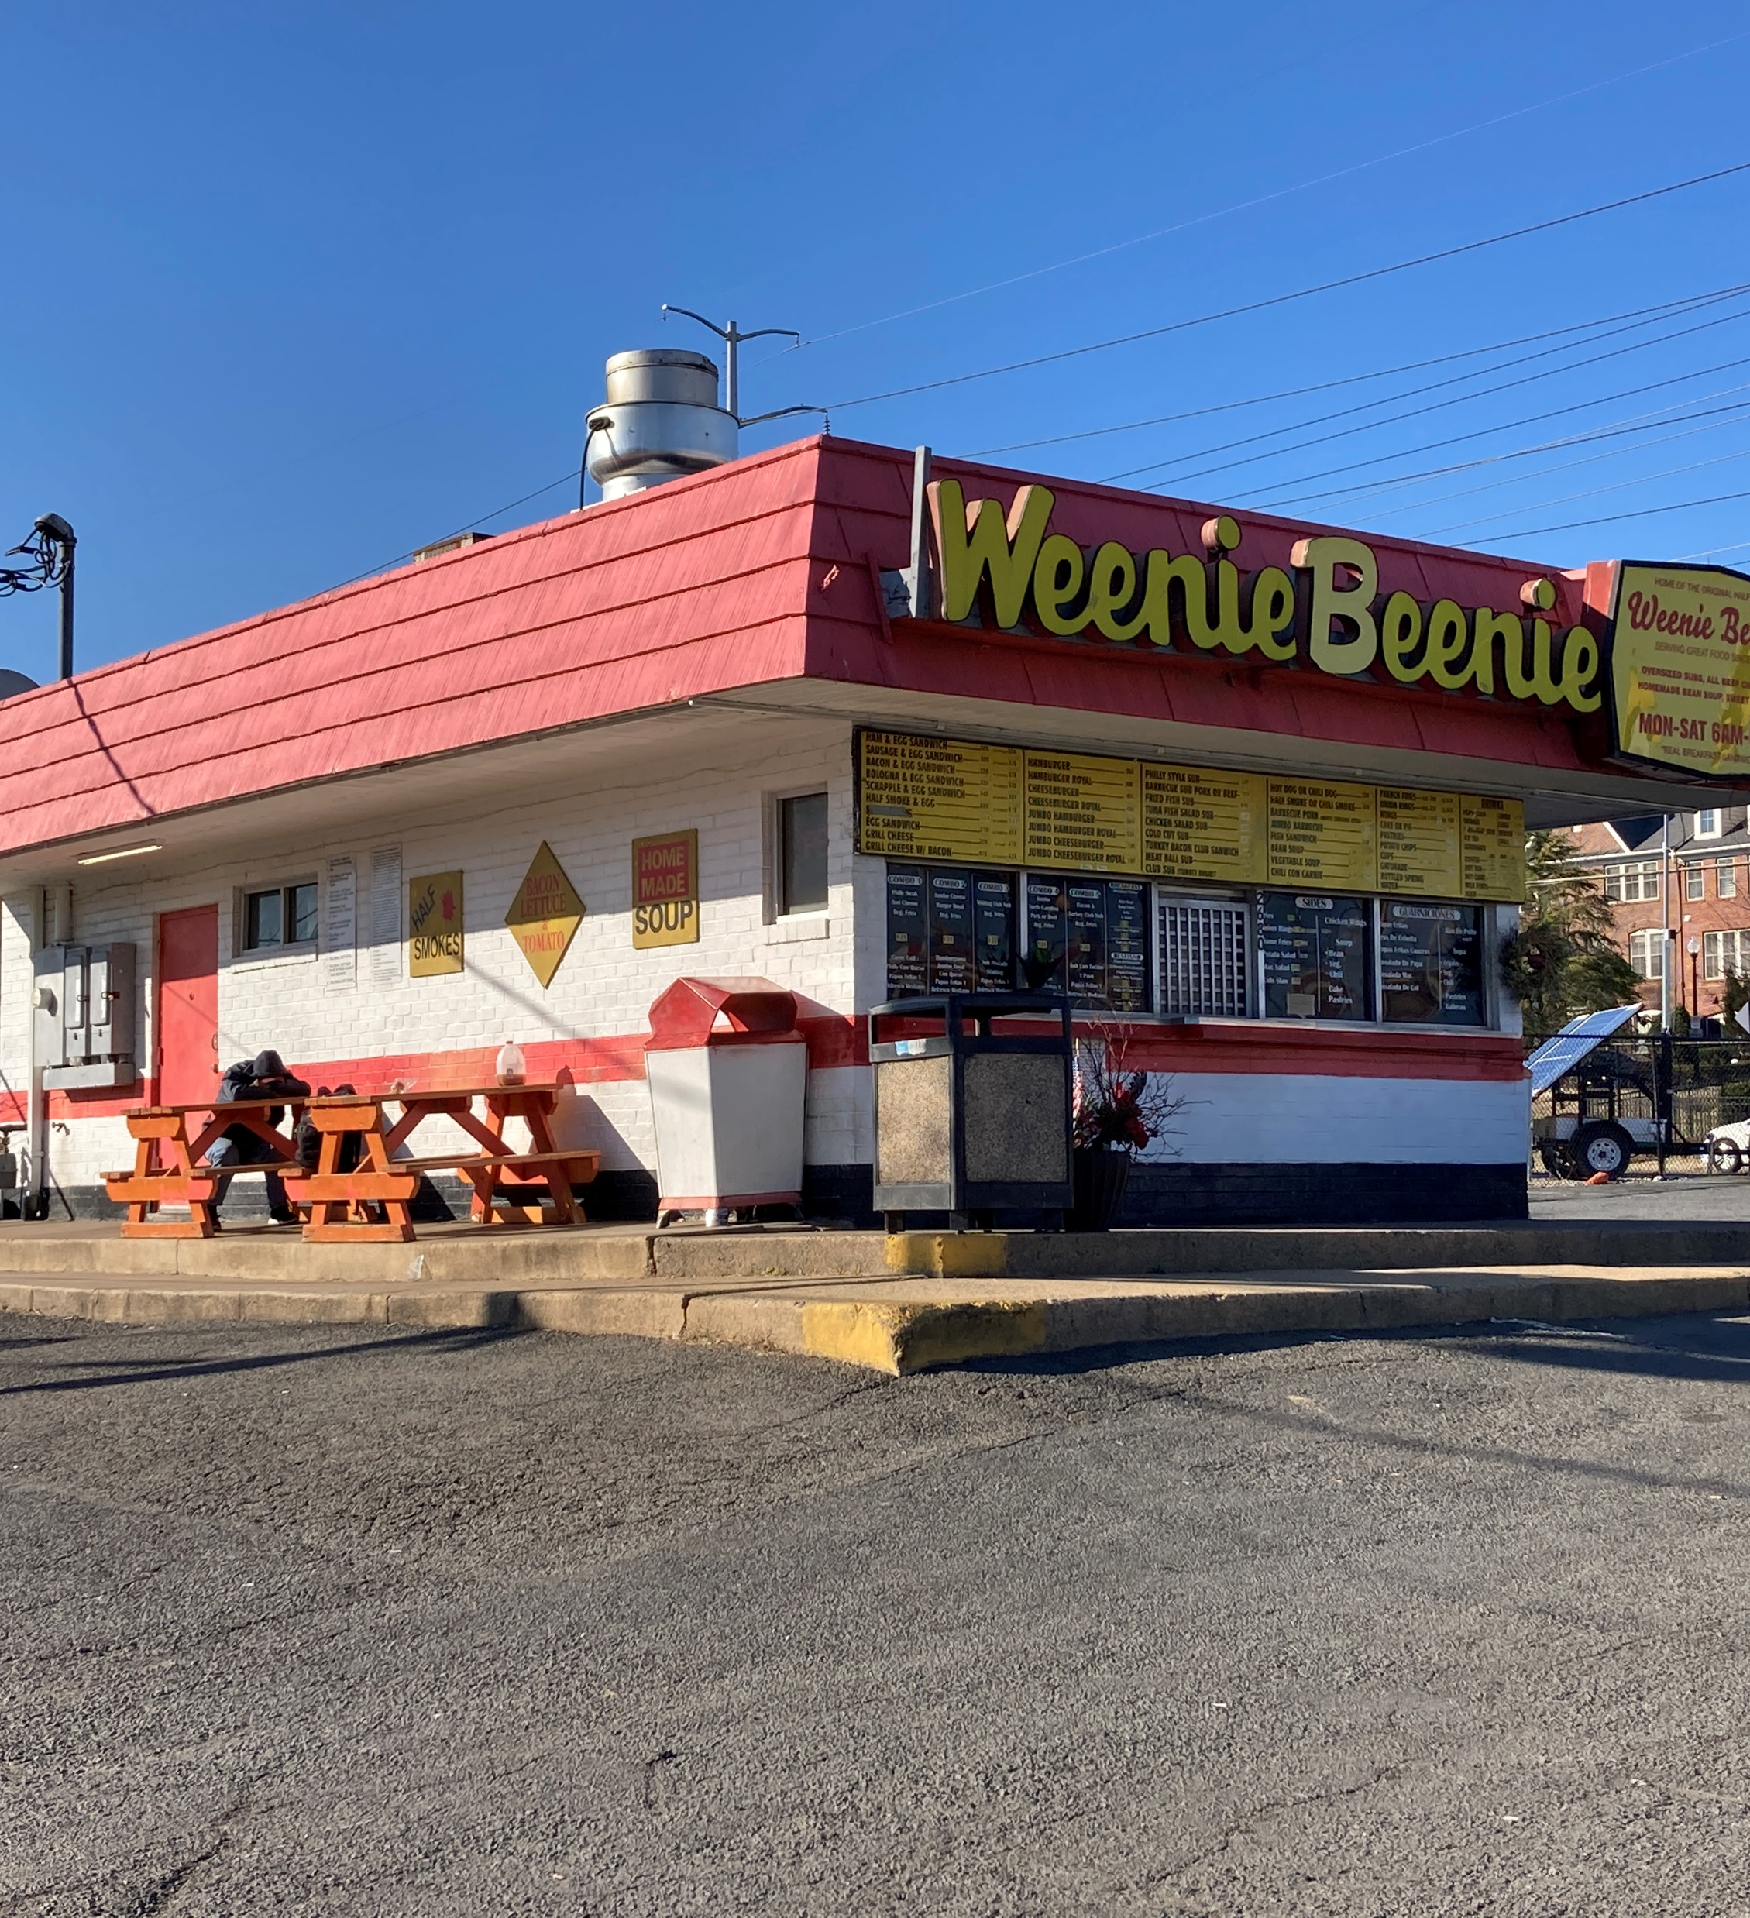
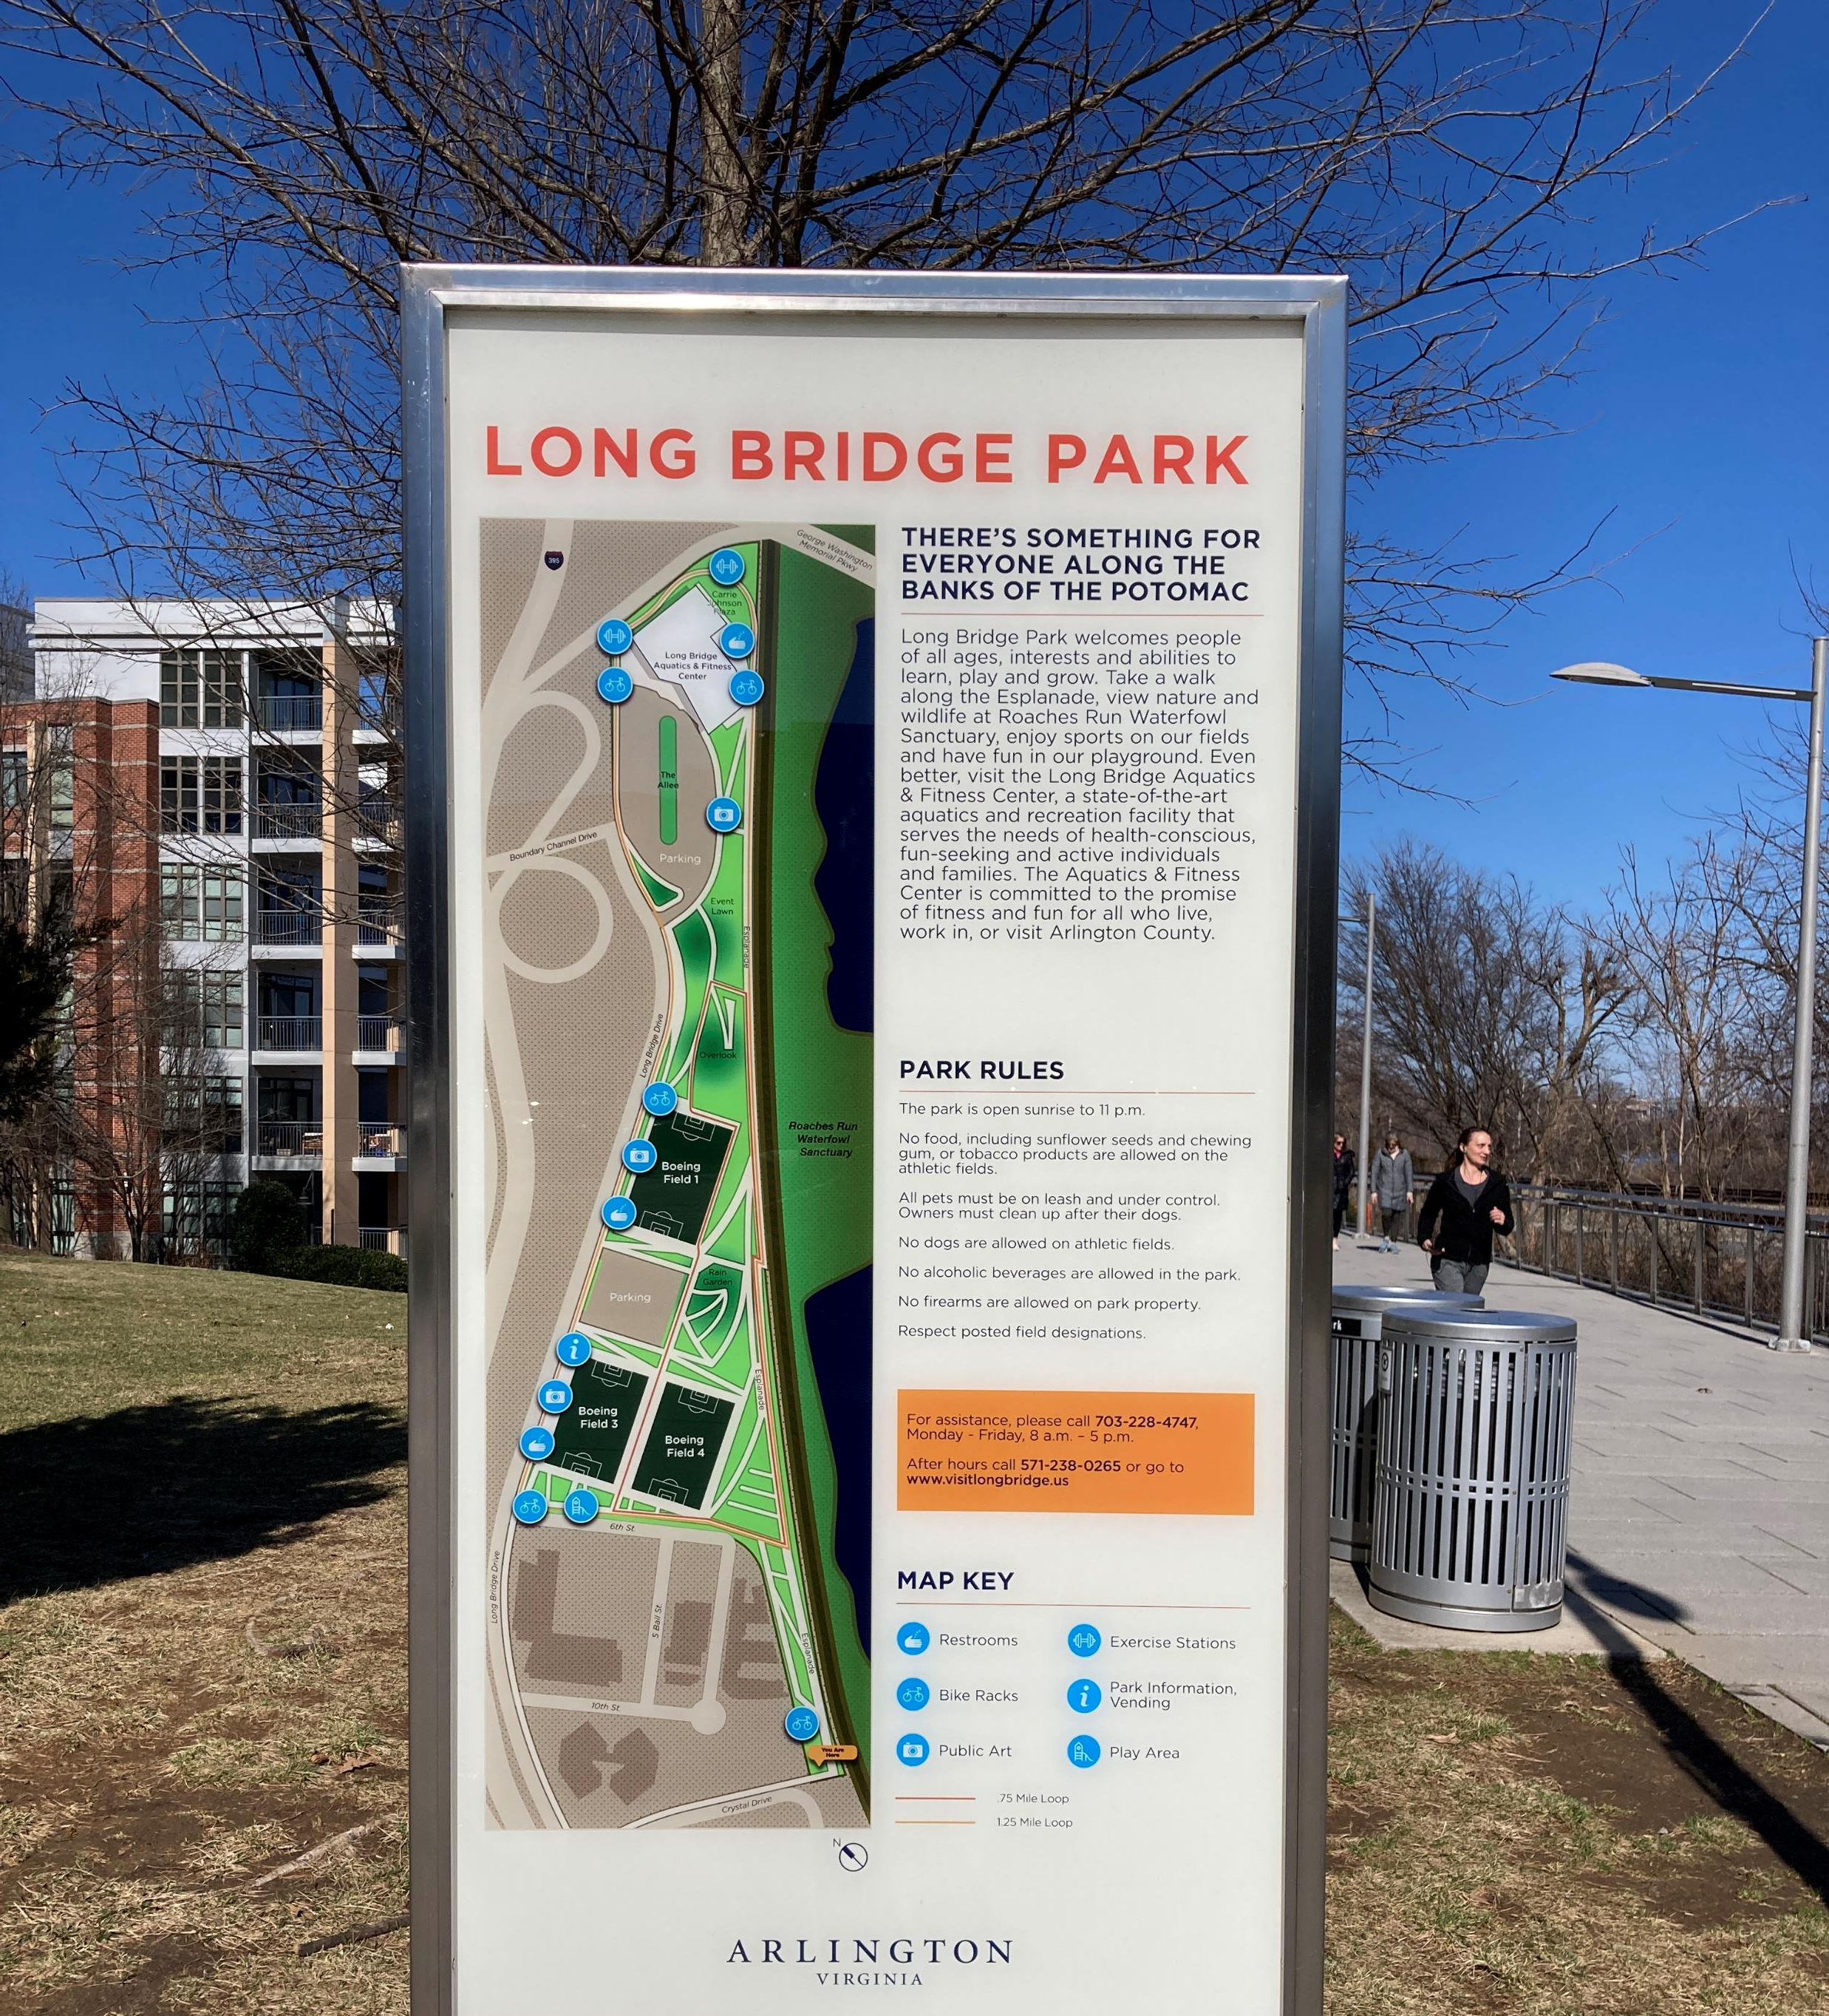
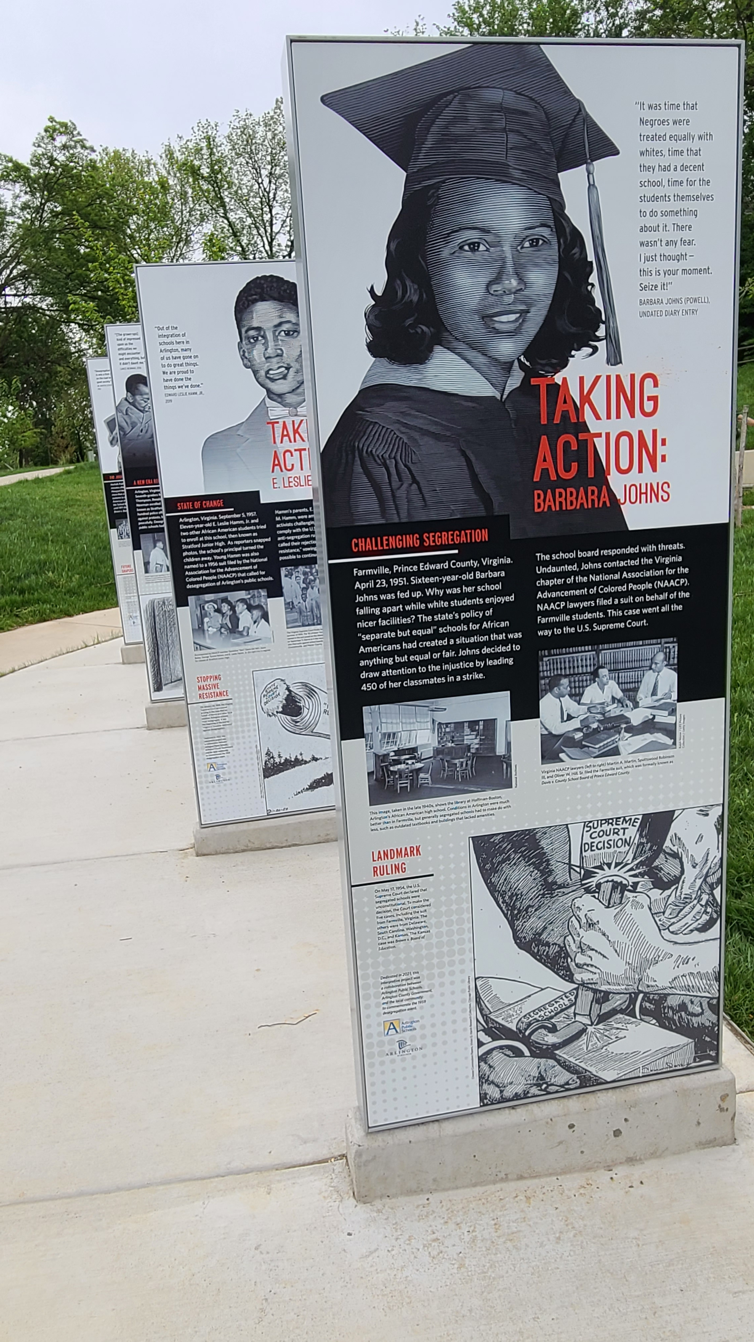
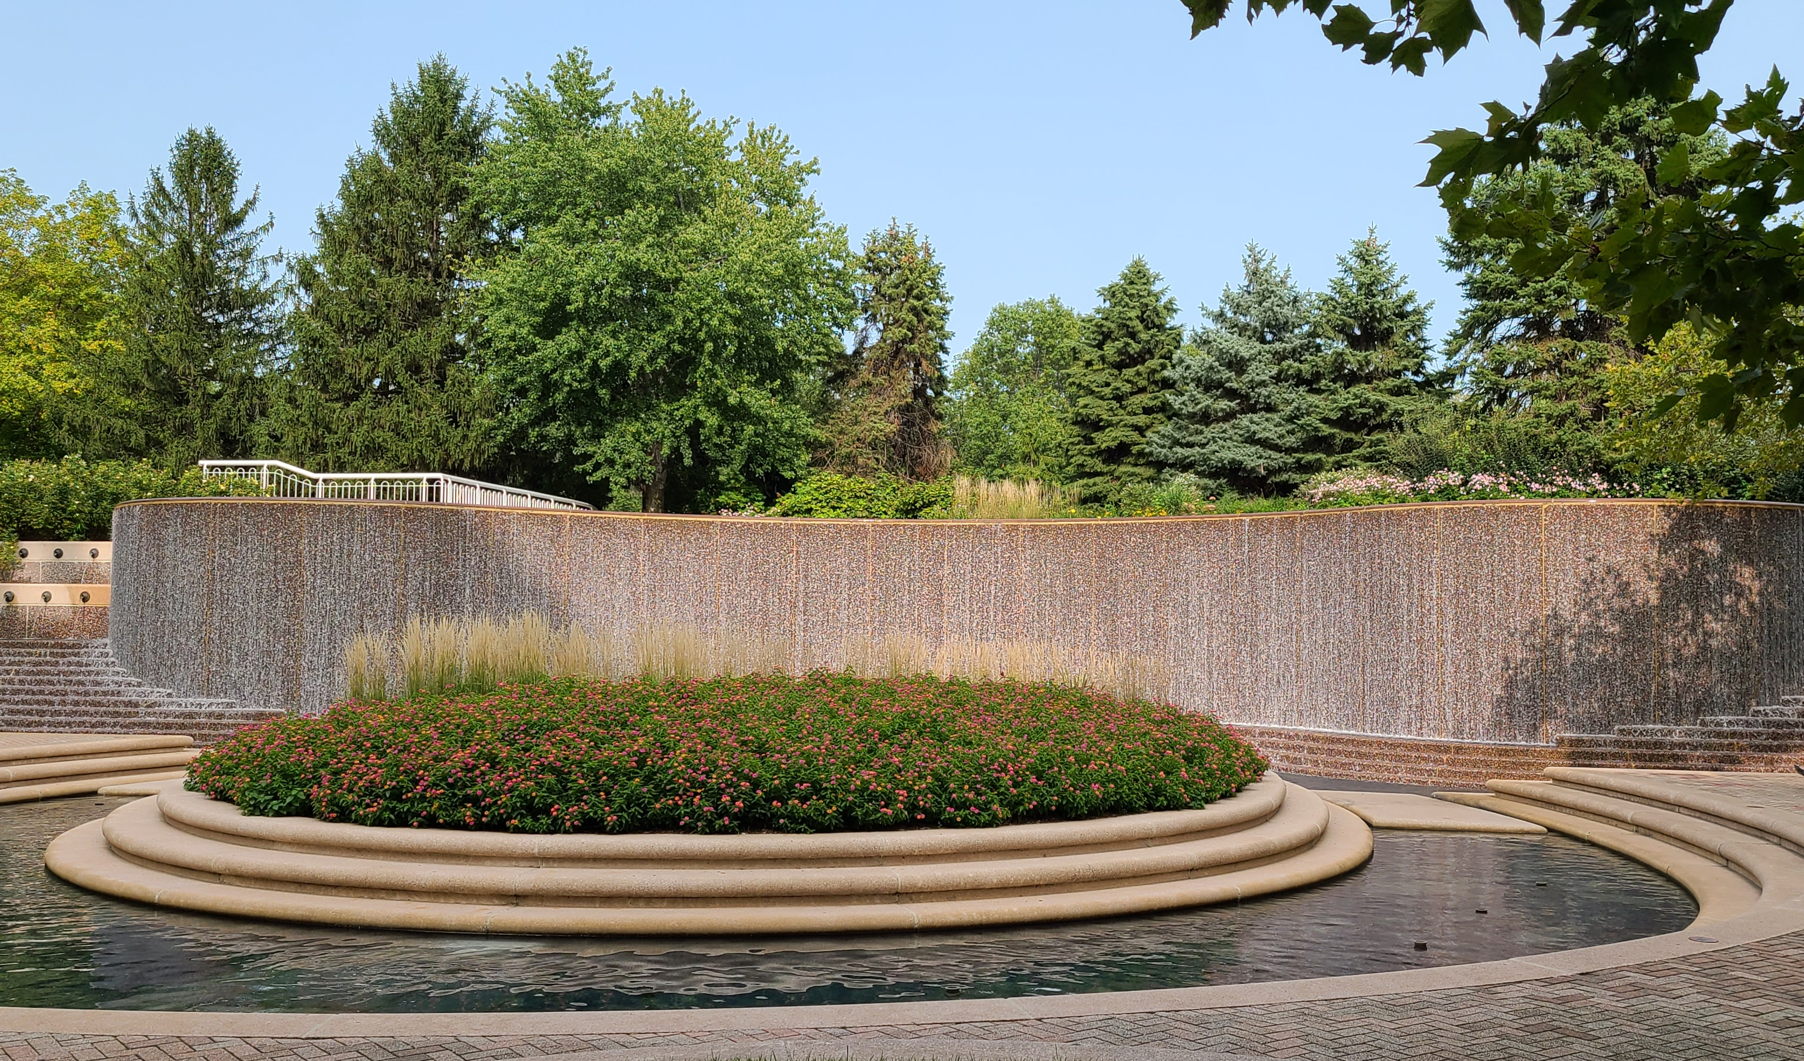
Discussion

Slide 21
Next Steps for HALRB Members
Read the Plan.
Fill out feedback form here: https://publicinput.com/d7306.
Share the Plan and the feedback form on your social media.
Sign up for a community outreach event with the HPP Staff team.
Sign up to speak on behalf of the Plan at public hearings with HPP Staff team.

