Slide 1

Bingham Center/Silver Diner Site Plan
September 14, 2023
Housing Commission

Slide 2
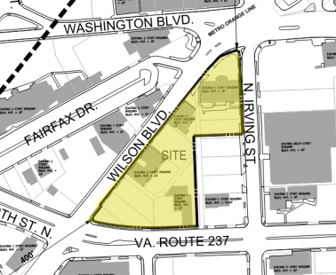
The Site
3200 Wilson Blvd
Redevelopment of the site w/hotel and 290-unit multifamily building w/ground floor retail
An auto repair facility, two office buildings, and Silver Diner restaurant to be demolished
Located within the Clarendon Sector Plan Area

Slide 3
Affordable Housing Program
Base: Choice of $1,108,118 or approximately 10 on-site units, 14 off-site nearby units or 15 off-site units
Bonus Density: 15 total on-site CAFs in 13,000 sq. ft.
  Five 1-bedroom units (652 avg SF)
  Ten 2-bedroom units (974 avg SF)

Slide 4
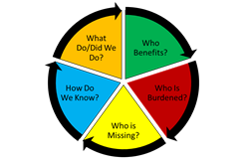
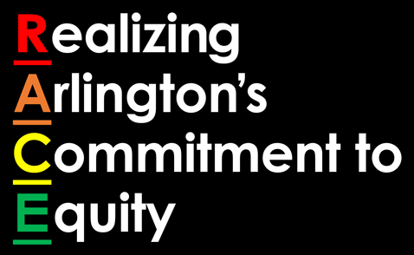
Racial Equity
Notes:
The County Board adopted an Equity Resolution in September 2019.
The resolution includes, in part, direction to apply a racial equity lens for every project.
Specifically staff asks the following questions when considering racial impacts of County projects: 1) Who benefits?, 2) Who is burdened?, 3) Who is missing?, 4) How do we know?, and 5) What do/did we do?

Slide 5
Racial Equity - Demographics
Notes:
In terms of demographics, the 2021 American Community Survey 5-year estimate data for racial composition for the census tract where the site plan is located indicates this area is not as diverse as the County as a whole.
For example, there is a smaller percentage of black (2% versus 9% Countywide) and Asian races (5% versus 10% Countywide) in the census tract where the site plan is located compared to the County as a whole. The data also shows that 6% of the population within this census tract identifies as having Hispanic or Latino origin as compared to almost 16% countywide.

Slide 6
Racial Equity
Who Benefits: Provides opportunity for low-income families to live nearby metro and other community amenities
Who is Burdened:
  12.3% of rental units affordable to HH earning less than 60% of AMI
  38% of black HH Countywide earn under $50k/year, compared to 17% of HH in County.
Who is Missing: Very-low income HH who may not be eligible for housing grants/housing choice vouchers
How we know: Information is based on Census Tract data for this geographic area
What do we do: Consider this site plan’s proposed affordable housing contribution
Notes:
In terms of the racial equity questions, the proposed 15 on-site CAFs will benefit and enable income-eligible families to live in an area of the County nearby metro and other community amenities. Those who benefit may also be those who are burdened, as the FY 22 Annual Affordable Housing Plan Indicator Report indicates only 12.3% of Arlington’s rental housing stock is affordable to households earning less than 60% of the AMI. Furthermore, the 2021 American Community Survey 5-year estimate for household incomes indicate that 38% of black households earn under $50k per year, compared to almost 17% of households in the County as a whole.
In terms of who is missing, the proposed units will be affordable up to 60% AMI and may not be affordable to households with very low incomes and who may not be eligible for housing grants or housing choice vouchers. These very-low income units are typically achieved through projects that utilize our County loan funds.
We know this information based on the census tract information for this geographic area as compared to the rest of the County as well as racial data for households earning under $50,000 annually. In terms of what do we do, the County has an opportunity to consider this site plan’s proposed Affordable Housing Program in light of these potential benefits and impacts.

Slide 7
Staff Recommendation
County staff supports the proposed affordable housing program which includes a base ordinance contribution of $1,108,118 or approximately 10 on-site units, 14 off-site nearby units or 19 off-site units, and an additional bonus density contribution of 15 on-site CAFs.

