Slide 1
Arlington County Racial Equity NOFA
A Journey in Government-Community Partnership
In partnership with United Way of the National Capital Area

Slide 2
Background: The 2021-2022 Community Leaders Group
Who
BIPOC* community leaders and representatives of community-based service providers
What
A working group to center BIPOC community voices in making recommendations for changes to Arlington County’s funding processes
Why
To reform Arlington’s human and community services funding by integrating BIPOC voices and lived experiences into the decision-making process, confronting challenges with “The Arlington Way,” and co-creating impactful solutions with the community to produce measurable outcomes and reduce disparities
The resulting funding process will be more transparent, more accessible, and more racially equitable
Arlington County Government representatives
External SMEs and facilitators, including UWNCA
Funded by E Pluribus UNUM Fellowship
Challenges with “The Arlington Way” identified by participants in the 2021 Dialogues on Race and Equity and the 2021-2022 Community Leaders Group:
Priority on relationships
Lack of transparency and access
Predetermined outcomes
Historically disadvantaged BIPOC community members & organizations in favor of the “usual” voices
(*)BIPOC: Black, Indigenous, People of Color

Slide 3
Background: Recommendations
NOFA Structure | Establish a competitive NOFA that is structured, transparent, and accessible Offer technical support throughout the process
Proposal Evaluation | Develop a holistic evaluation approach that invites the community to play a central role in defining needs and evaluating the proposals Encourage collaboration and community voice when making award recommendations
Funding Awards | Create mechanisms for greater transparency and flexibility when making award decisions Provide individual feedback to applicants
Accountability | Balance a system of structured accountability and reporting which also provides responsive and supportive oversight

Slide 4
Background: Values
Community-Centeredness | Informed by recommendations from trusted community leaders Community members have a voice in evaluating proposals Focused on maximizing positive community impact
Equity | Creating an opportunity for those who have not historically had access to government funding Providing access and support for all applicants Focused on root causes and positive impact
Accountability & Transparency | Clear and transparent processes Decisions are informed by community voice Accountability and transparency for both government and service providers
Notes:
Amber

Slide 5
NOFA Structure: Application
NOFA Application Sections include but are not limited to:
Population Description Program Description Evaluation Advancing Racial Equity Engagement & Community Outreach Appendix, including a guide to the questions, definitions of key terms, and sample responses
All applicants will submit the following documents, if available:
Most recent annual report FY 2023 Budget Most recent audit 501(c)(3) designation letter IRS Federal Form 990
Notes:
Application form will be translated into 5 languages
Accepting written and audio submissions
Submissions will be collected in a streamlined, centralized format
Technical assistance sessions will be available to support applicants in these efforts
Notes:
Elizabet

Slide 6
NOFA Structure: Technical Support
NOFA information sessions with community
Technical Assistance (TA) throughout application window – up to 4 sessions
Recorded TA sessions are posted to the NOFA website
Formative feedback will inform topics of TA sessions and need for additional sessions
Maximized transparency and access through technical assistance
Notes:
Elizabeth

Slide 7
Proposal Evaluation
Characteristics of a transparent and accountable evaluation process:
Detailed rubric made available to applicants when the NOFA is released
Diversified reviewers, including subject matter experts and community members
Intentional and low-barrier reviewer recruitment process
Training for reviewers to increase their skill and confidence in thoughtful and unbiased evaluation
Funding recommendations formed by group consensus
All work is documented for posterity and transparency
Notes:
Amber

Slide 8
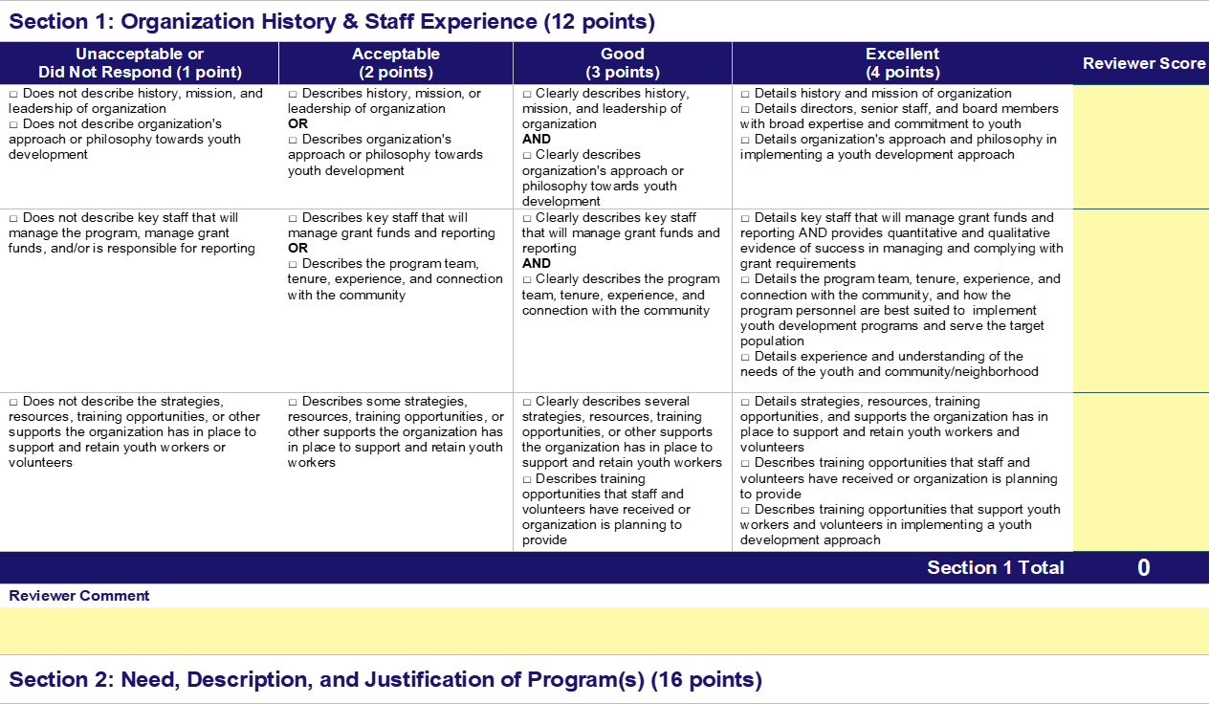
Proposal Evaluation
An informative rubric:
Is available as soon as the NOFA is released
Uses a 1-4 Likert Scale
Provides a checklist for applicants and reviewers
Ensures all criteria are addressed in the proposal
Demonstrates the level of narrative detail needed in the proposal for a higher or lower score
Some sections will be more heavily weighted
SAMPLE
Notes:
Amber

Slide 9
Proposal Evaluation
All reviewers will receive the same training focused on process- and value-oriented topics.
Values
Process
Racial equity
Objective vs. Subjective
Resist comparisons
Recognize biases
Complete a mock calibration application
Read/listen, score, and comment one section at a time
Feedback must be written
Concentrate on content rather than grammar
Helpful and community-centered feedback
Notes:
Amber

Slide 10
Funding Awards
Award recommendations are made to County Board. The Board maintains discretion to fund high-scoring projects beyond the reviewer recommendations.
Feedback
Support
Recommendation
Once awards are approved, all applicants may view their cumulative score and anonymized reviewer comments and feedback.
All applicants may meet with County staff to receive additional feedback and guidance for future NOFAs.
Decision
All County Board funding decisions are final and are not subject to review, appeal, or protest. Awards are posted online.
The post-evaluation process includes:
Notes:
Elizabeth

Slide 11
Accountability
Reporting
Written progress reports including relevant data and narrative
Including site visits
Support
Providing technical assistance
Follow-up if grantees are facing challenges
Process Review
Community engagement to understand their perception of process
Reviewing efficacy at truly meeting needs of community
Making adjustments to improve in subsequent years
Notes:
Amber

Slide 12
Next Steps: Community Engagement
Summer and Fall 2023 Engagement Plan
Board Presentation – June 2023
Providing overview and update on process
Community Meeting – Summer 2023
Providing overview and update on process
Reviewer Recruitment – Fall 2023
Community members: recruiting from public sites and service locations
Subject Matter Experts: recruiting at department and staff meetings
Other dissemination avenues:
January community meeting attendees
DHS clients
Notes:
Elizabeth

Slide 13
Next Steps: Overall Timeline
County Board Approves Principles and Funding Spring 2023
(FY ‘24 Budget)
Meeting with non-profit organizations January 2023
NOFA is released
September 2023
NOFA proposals due
December 2023
Award Recommendations Announced
Winter 2024
Distribute funds
Summer 2024
(FY ‘25, Quarter 1)
We are here
County Board Resolution establishing commitment to new process January 2023
Community information session
Summer 2023
Technical Assistance Sessions; Reviewer recruitment and training
Fall 2023
Panel review Winter 2024
Develop work plans and agreements with grantees; Provide feedback to applicants
Spring 2024
Notes:
Elizabeth

Slide 14
Questions

