Slide 1
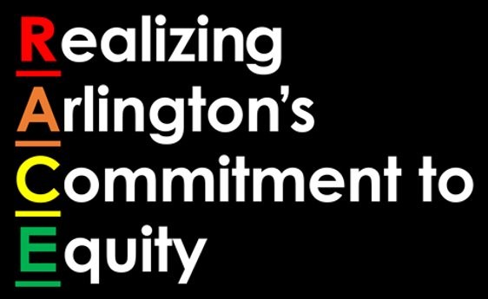
Advancing Racial Equity In Government
Arlington County Board
February 21, 2023

Slide 2
Arlington County’s Racial Equity Framework
Vision
An Equitable Arlington is one where all are valued, educated, healthy and safe regardless of race
Mission
As an employee, resident or business in Arlington, advance racial equity as a county-wide priority to eliminate, reduce, and prevent disparities in our policies, procedures, practices, engagement, and interaction with and service to the community.

Slide 3
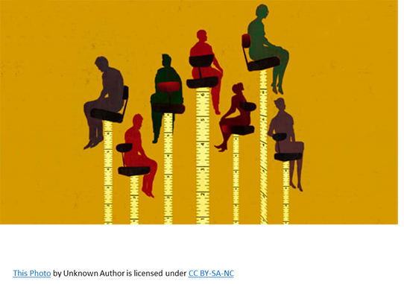
Our Primary Objectives
NORMALIZE
Ensure the commitment of every individual to meaningfully engage in raising awareness of disparities.
Commit to having conversations, engagement and education needed to share information about disparities due to race and inequities.
ORGANIZE
Build the infrastructure and establish a framework and guidelines in which racial equity work can be implemented.
Create culture for systemic and organizational change and management.
OPERATIONALIZE
Analyze planning, programs, services, policies in the context of a “response-driven government” culture to determine whether they address or exacerbate disparities.
Define strategies to address and resolve disparities.
Allocate and distribute resources to support identified strategies.
ASSESS
Track and measure outcomes and strategically manage long-term systemic impact and organizational and cultural change.

Slide 4
2022 RACE ROAD MAP
OPERATIONALIZE
To develop and consider the impact policies, plans, and decisions have on residents and employees
Race & Ethnicity Dashboard + UVA Social Impact Data Commons
Racial Equity Lens Process Guide for Staff
ORGANIZE
A sustainable and supported structure to advance racial equity
Racial Equity Core Team Interdepartmental Steering Committee
Department Equity Core Teams Established
Workforce Racial Equity Cohort Training
Restorative Mindset and Circle Process Staff Training
Dialogues on Race and Equity (DRE) Together Partners Recruitment and Training
MWCOG-GARE 2022 Cohort Participation
GARE Membership & Participation
NORMALIZE
ASSESS
A shared understanding, knowledge and terminology around racial equity
Leading With RACE Workforce Education Modules
RACE VCircles
Racial History Timeline Additions + Oral Histories
Dialogues on RACE & Equity (DRE) in Our Community Conversations
All who interact with the County see themselves in the work, the process, the system and structure
Resident Satisfaction Survey + Race and Equity

Slide 5
Making Strides In 2022...
NORMALIZE
Leading with Race Modules + Conversation Guides
Race & Ethnicity Dashboard
ORGANIZE
Racial Equity Core Team
Department Equity
OPERATIONALIZE
Race & Ethnicity Dashboard
Equity Lens Process Guide & Analysis
ASSESS
ERG Focus Groups + Summary
Equity Mindset Cohort Training
REWT Focus Groups + Interim Report
Leading with RACE Evaluations + Interim Report
Resident Satisfaction Survey
Race & Ethnicity Dashboard Briefing Report
RACE FY2022 Report
Racial History Timelines
GARE Membership
COG Chief Equity Officers Committee
DRE Together Partner Meetings
MWCOG-GARE Cohort

Slide 6
Taking Steps In 2023
NORMALIZE
ORGANIZE
OPERATIONALIZE
Leading with RACE Modules
RACE Symposium
RACE Townhalls
RACE VCircles
Equity Mindset Train the Trainer
ASSESS
Leading with RACE Interim Report
Racial Equity Audit Assessment
Program & Project Evaluations
RACE Annual Report
Equity Lens Process Guide – Analysis & Reporting
Race & Ethnicity Dashboard
Equitable Community Engagement Guide
Equity Based Nonprofit Funding Reform
Green Valley Equity Demonstration
Racial History Timeline
Race & Ethnicity Dashboard
DRE In Our Community
Restorative Mindset & Circle Process Training
Racial Equity Action Plan Template + Drafts
DRE Together Partners
COG Chief Equity Officers Committee
GARE Membership
Racial Equity Core Team
Department Equity Teams

Slide 7
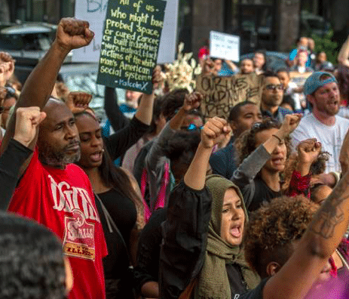
Leaders Call to Action
Lead and engage in conversations on race and equity
Confirm the strategic framework, organizational structure and commitment to their use to lead with RACE in all areas of government and the community
Use and promote the use of the Equity Lens in decision making and the Race & Ethnicity and Census Demographic Dashboards as a data source
Report on and present the outcomes of Normalizing, Organizing and Operationalizing Racial Equity

Slide 8
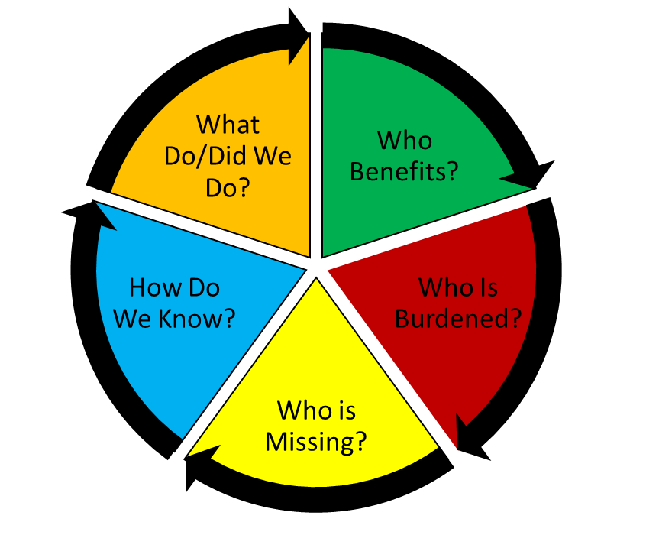
Ultimate Measure of Success
Racial Equity is who we are. It is just what we do as a matter of practice and standard operating procedure.
This Photo by Unknown Author is licensed under CC BY

